Slide 1
Unit1 How are you feeling now?
第1课时
WWW.PPT818.COM

Slide 2
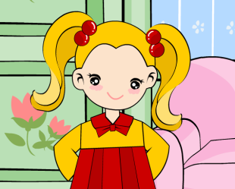
>>Lead-in
Listen and enjoy
Are you happy?
If you are happy,
please clap you hands.
If you are happy,
please stomp your feet.
If you are happy,
please shout “hurray”.
（单击电视屏幕可播放动画）

Slide 3
>>Lead-in
Look and circle
How is she feeling now? Which is happy?
What about you? How are you feeling now?

Slide 4
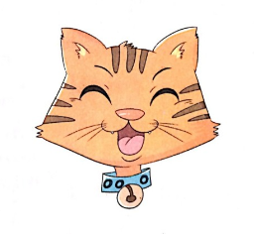
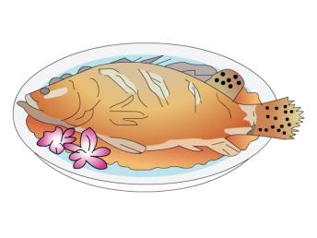
>>Presentation
Let’s learn
feel happy

Slide 5
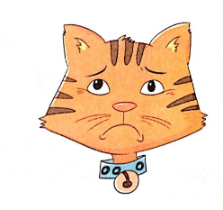
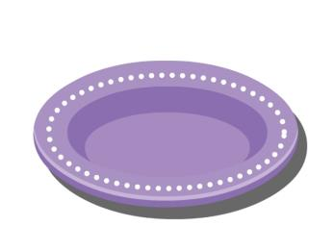
>>Presentation
Let’s learn
feel sad

Slide 6
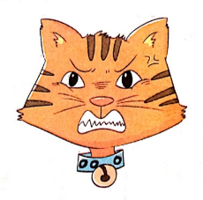
>>Presentation
Let’s learn
feel angry

Slide 7
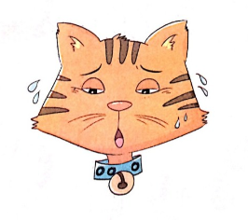
>>Presentation
Let’s learn
feel tired

Slide 8
>>Practice
Read and match
feel angry
feel sad
feel happy
feel tired

Slide 9
>>Practice
Ask and answer
How is he feeling now?
He is feeling …

Slide 10
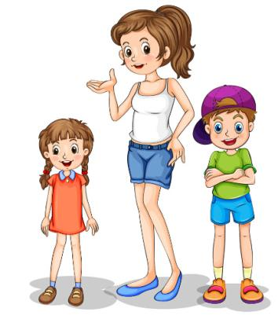
>>Practice
Let’s say
I’m tired.
What about you?
I’m feeling happy now.
How are you feeling now?

Slide 11
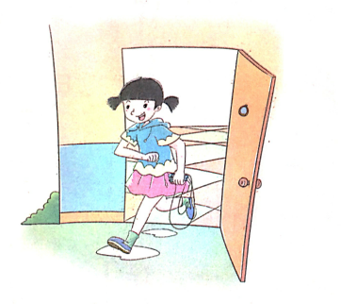
>>Presentation
Let’s learn
go out to play
happy
She is feeling _____.

Slide 12
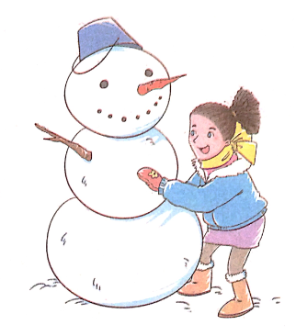
>>Presentation
Let’s learn
make a snowman
snowman
She is feeling _____.
happy

Slide 13
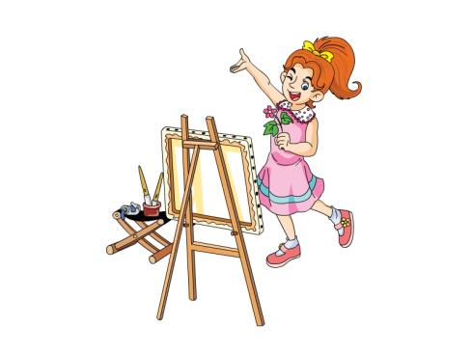
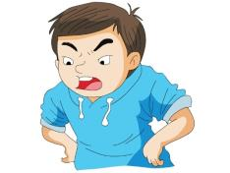
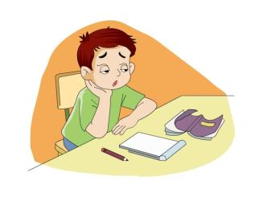
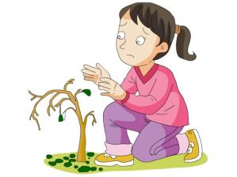
>>Presentation
Let’s and say
How does she/he feeling?

Slide 14
>>Summary
1. 词组：
feel sad
feel angry
feel happy
feel tired
go out to play/make a snowman

Slide 15
>>Homework
1.观看课文动画，按照正确的语音、语调朗读课文对话。
2.尝试画出本课所学的表情图并标注出相应的词组。
3.预习“Let’s talk”。
close

