Slide 1
Unit4 I have a ball.
人教精通版三年级上册
WWW.PPT818.COM

Slide 2
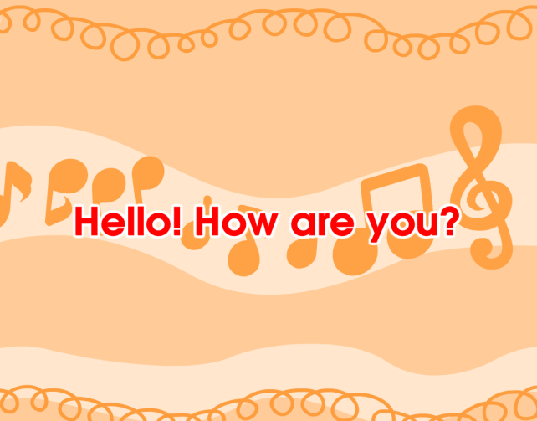
Warm-up
Let’s sing

Slide 3
Presentation
Just learn
ball

Slide 4
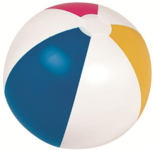
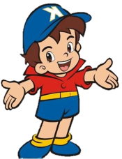
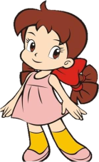
Presentation
Look! This is my ball. I have a ball.
Wow! It’s big!

Slide 5
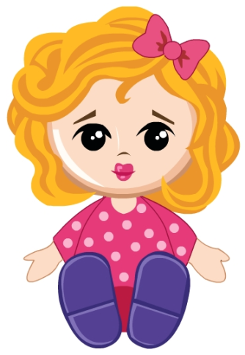
Presentation
Just learn
doll

Slide 6
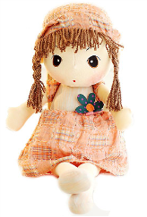
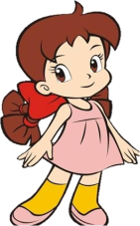
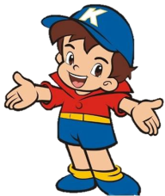
Presentation
Look! This is my doll. I have a doll.
Wow! It’s nice!

Slide 7
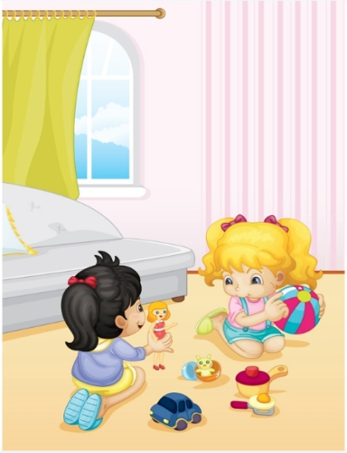
Presentation
Look, listen and say
What can you see in the picture?
(在图片上你能看到什么？）
What are they talking about?
(他们在谈论什么呢？）

Slide 8
Presentation
Listen and imitate
Wow! How nice! Look! I have a ball.
Look, Kate. I have a doll.
Oh, it’s big.

Slide 9
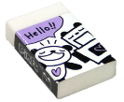
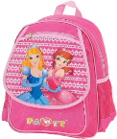
Presentation
Look and say
和别人谈论自己所拥有的东西时用：
I have …

Slide 10
Show time
两人一组，练习对话并表演，其他同学评价。
 | 模仿录音中的语音语调，有感情地朗读。
 | 可以脱离课本，适当改动其中部分，语音地道。
 | 适当添加内容，意思完整，有创新，表演生动。
Good
Great
Excellent

Slide 11
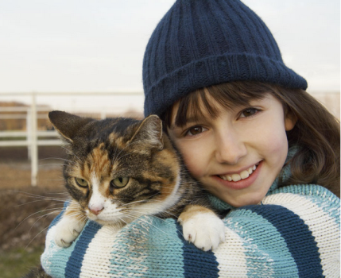
Practice
cat
I have a ____.

Slide 12
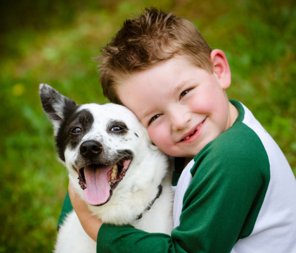
Practice
dog
I have a ____.

Slide 13
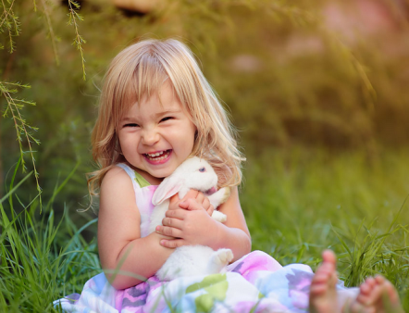
Practice
rabbit
I have a _____.

Slide 14
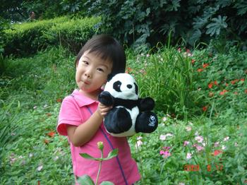
Practice
panda
I have a _____.

Slide 15
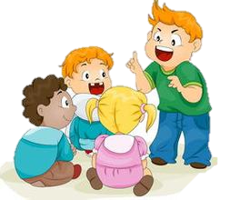
Practice
Group work
活动时间：2分钟
活动内容：四人一小组，拿出各自的学习用品或玩具，跟同学们分享。
A: Look! I have a new …
B: That’s nice!
C: I have a …
D: Wow, it’s …

Slide 16
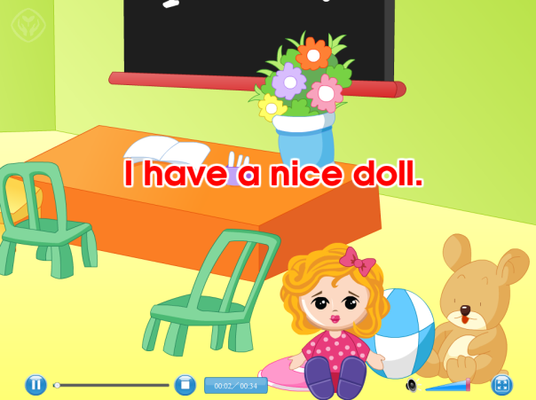
Practice
Let’s sing

Slide 17
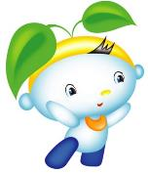
Summary
本课学习的玩具类单词有:
ball
doll

Slide 18
Summary
如何介绍自己所拥有的物品呢？
I have (a/an) …

Slide 19
Homework
1.跟读Just talk部分的课文录音，并注意语音、语调。
2.学唱“Let’s sing”部分的歌曲，并唱给你的爸爸妈妈听。
3. 预习Lesson20。
Close

