Slide 1
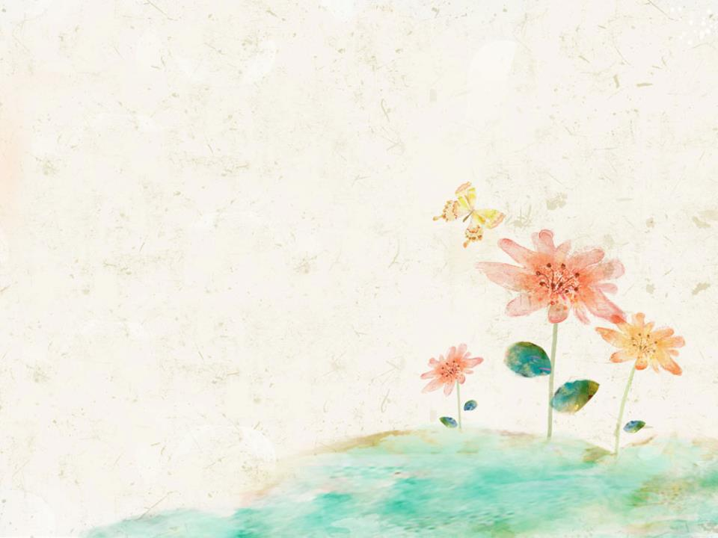
Unit 5 Animals in danger
英语 六年级 上册（三年级起点）
WWW.PPT818.COM

Slide 2



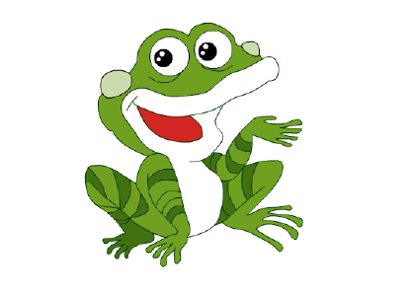
A chant: My favourite animal
Guess my animal,my favorite animal,
OK?Ready?Here we go!
Does it live in Africa?
No,no,no.
Does it live on a farm?
Has it got two legs?
Can it sing?
Can it fly?
Is it brown and red?
I'm sorry,I'm sorry,
No,no,no.
It's not a crocodile,
Not an elephant,
Not a cat,
Not a dog,
It's a crocofrog!

Slide 3
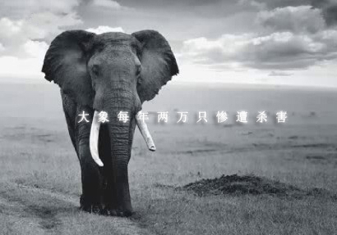
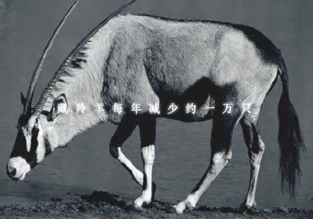
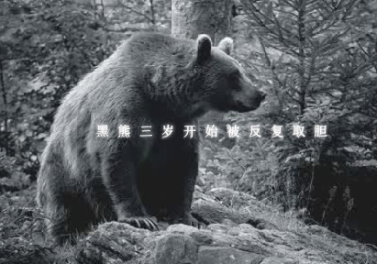
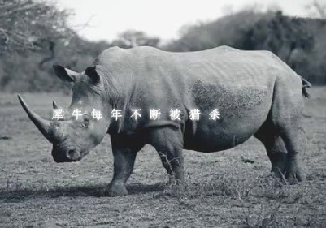
in danger 在危险中
animals in danger
濒危动物；
处于危险中的动物；

Slide 4
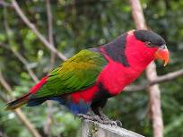
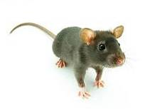
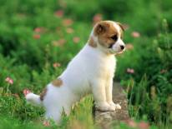
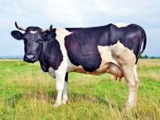
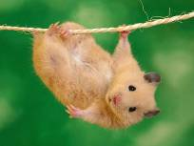
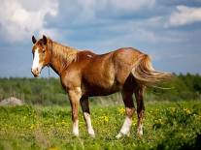
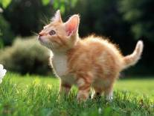
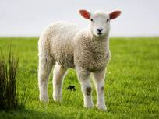
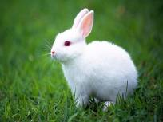
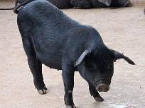
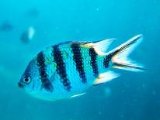
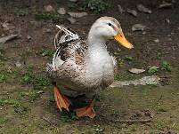
What’s your favourite animal?

Slide 5
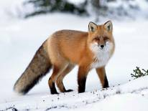
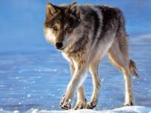
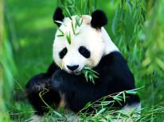
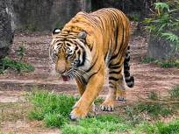
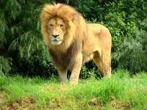
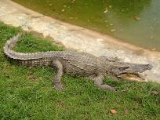
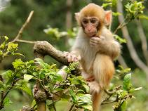
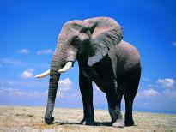
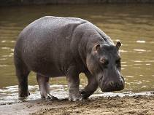
What’s your favourite animal?

Slide 6

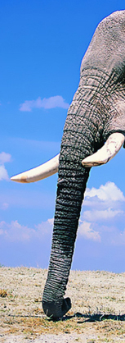


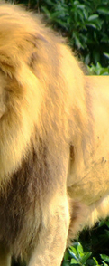
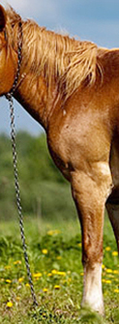

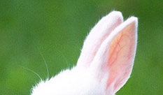


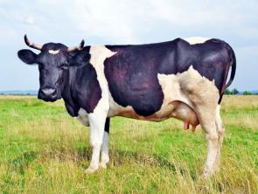
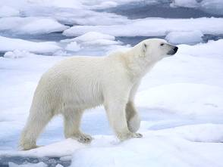
elephant
horse
lion
rabbit
cow
polar bear

Slide 7

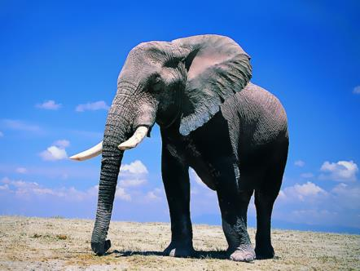
Listen,read and guess:
four legs.
a long nose.
a very big animal.
in Africa and Asia.
It has got
It has got
It's
It lives
elephant

Slide 8

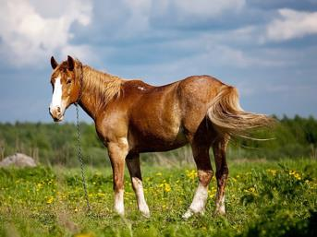


Listen,read and guess:
It has got
It eats
It lives
four legs.
grass.
on a farm.
It gives us milk.
People ride it.
cow
horse

Slide 9
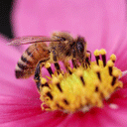
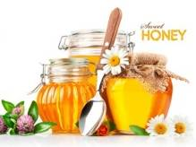
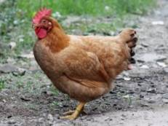
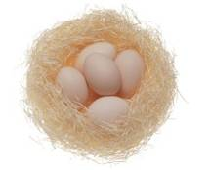
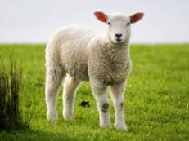

Look and say:
bee honey
... gives us...
hen eggs
sheep wool

Slide 10
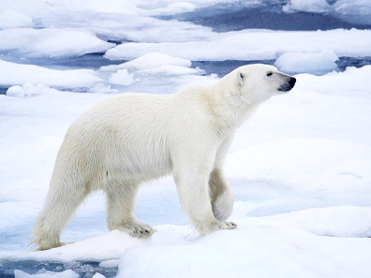
Listen,read and guess:
four
other animals
white
in the Arctic
It has got ............... legs .
It eats ................................... .
Its fur is ................ .
It lives ............................... .
polar bear

Slide 11


It has got white fur.
Its fur is white.

Slide 12
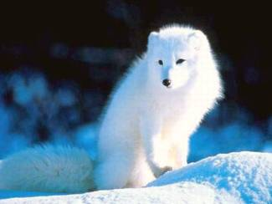
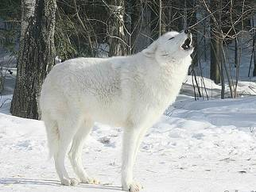
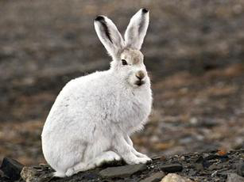
Animals in the Arctic
Arctic fox
Arctic wolf
Arctic hare

Slide 13
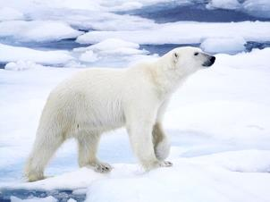
A or B:
A
B
A
B
1.It has got ............... legs .
2.It eats ................................... .
3.Its fur is ................ .
4.It lives ............................... .
A.four B.two
A.grass B.other animals
A.white B.brown
A.in Africa and Asia B.in the Arctic
polar bear

Slide 14

Listen,read and guess:
four legs.
other animals .
in Africa and Asia.
It has got
It eats
It lives
It is smaller than a tiger.
lion

Slide 15
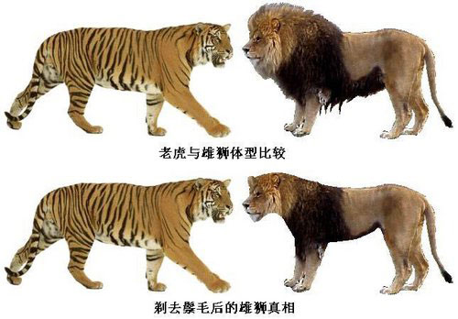
small 小的——smaller较小的
The lion is smaller than a tiger.

Slide 16
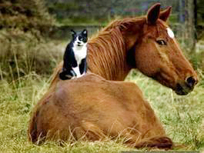
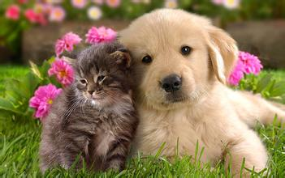
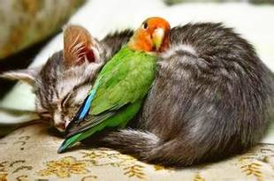
smaller than... 小于...
The cat is small
er than the dog.

Slide 17

Listen,read and guess:
four legs.
grass.
a sheep.
It has got
It eats
It's smaller than
Foxes like to eat it.
rabbit

Slide 18
T or F：
F
T
T
( )1.The tiger is smaller than a lion.
( )2.The rabbit is smaller than a cow.
( )3.The panda is smaller than a polar bear.

Slide 19
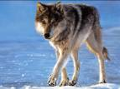


Yes or No：
Yes
No
No
1.Is it smaller than a lion? ( )
2.Is it smaller than a cow? ( )
3.Is it smaller than a panda? ( )

Slide 20








Slide 21



Slide 22






Has it got ............?
Does it eat ...........?
Does it live ...........?
Is it smaller than a....?
Is it a .........?
four legs
grass other animals
on the farm in Africa and Asia in the Arctic
rabbit cow lion

Slide 23
Fill in the blanks:
milk
horse
Arctic
Africa and Asia
smaller than
1.The cow gives us ............. .
2.People can ride the................ .
3.The polar bear lives in the ............ .
4.The elephant and the lion live in ................................ .
5.The rabbit is ....................... a sheep .

Slide 24





Homework:
1.Pairwork（二人活动）:
2.Writing(作文):
It has got...
It lives ...
It eats...
It...
3.收集相关资料，与伙伴们分享。

Slide 25




animals on a farm
It has got ... It eats... It lives ...
cow
horse
rabbit
It gives us milk.
People ride it.
It's smaller than a sheep. Foxes like to eat it.
Notes:
25

Slide 26



wild animals
It has got ... It eats ... It lives in ...
elephant
polar bear
lion
It is a very big animal.
It lives in Africa and Asia.
Its fur is white.
It lives in Arctic.
It is smaller than a tiger.
It lives in Africa and Asia.
Notes:
26

Slide 27

smaller than
bigger than
smaller than
bigger than

