Slide 1
Unit 8 Topic 3
He said the fashion show
was wonderful.
Section D
WWW.PPT818.COM

Slide 2
Read through Sections A-C carefully and fill in the blanks with the correct words.
Grammar
Object clauses(Ⅳ)
Kangkang said he____________(watch) it.
And he said the fashion show _______(is) wonderful.
She asked Kangkang what he ______(be) doing.
She said she________(wear) a Yao costume.
watched
was
was
wore

Slide 3
Functions
People _______ it cheongsam.
_______ come another three models.
That's really________ !
Today people can design the Tang costume as_______ formal _____ casual clothes.
call
Here
cool
either
or

Slide 4
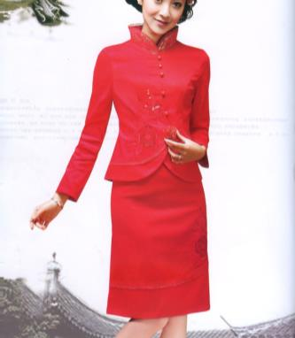
How much do you know about the Tang costume and cheongsam?
Example:
S1:The Tang costume stands for Chinese history and fashion culture.
S2:People designed the cheongsam in the Qing dynasty.

Slide 5
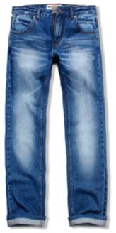
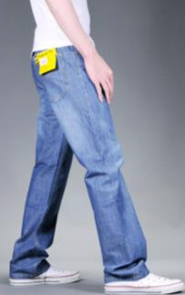
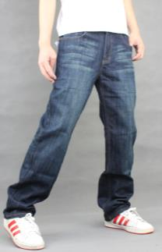
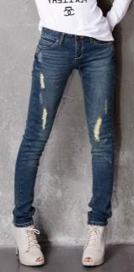
blue jeans
The well-known item of American clothing is blue jeans.
They are the most popular choice of clothing for young people.
well-known adj.众所周知的，著名的
item n. 一件商品（物品）；项目
choice n.选择；挑选

Slide 6
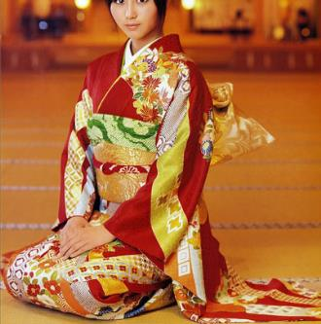
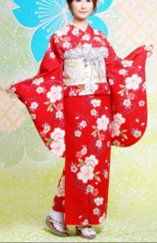
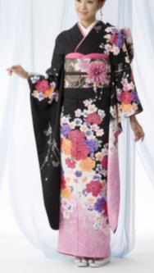
kimono
Kimonos are beautiful,but today people wear them only on special occasions like marriages and national celebrations.
marriage n.结婚，婚姻
celebration n. 庆祝；庆祝会

Slide 7
1
Read the following information and complete the table on Page 104.
Country | Traditional clothing | Material | Occasion to wear
 |  |  | In the past | Today
 |  |  | working
 | kimono
casual and working
America
blue jeans
cotton
Japan
silk
casual and formal
formal

Slide 8
Key points of 1
1. At one time, Japanese people wore kimonos for casual and formal occasions.
曾经，日本人在非正式和正式场合都穿和服。
at one time 曾经，一度，相当于once。如：
At one time, he was a teacher.他曾经是一位老师。
2. Today, few people wear kimonos except on special occasions like marriages and national celebrations.
如今，几乎没有人穿和服，除非在像婚礼或国家庆典这样的特殊场合。
except 除······之外(指从整体中除去一个或一部分，除去的人或物不在整体内。) 如：
Everyone was tired except John. 除约翰之外，大家都累了。

Slide 9
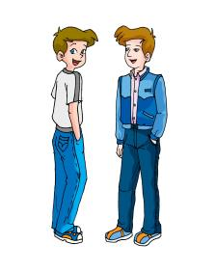
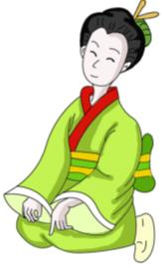
Listen and follow.
America
● The well-known item of American clothing is blue jeans.
● In the past, many workers wore heavy cotton jeans.
● Today, clothing factories make many different styles and colors of jeans.
● They are the most popular choice of clothing for young people around the world.
Japan
● The kimono is the Japanese traditional clothing.
● The Traditional kimono was made of silk.
● At one time, Japanese people wore kimonos for casual and formal occasions.
● Today, few people wear kimonos except on special occasions like marriages and national celebrations.

Slide 10
Retell the passage with the help of key words.
America
● ________________of________________ is blue jeans.
● In the past,_____________________________jeans.
● Today, ______________make ______________ and _____________.
● They are _____________ choice of clothing for ______________________________.
Japan
● __________________________ traditional clothing.
● ______________________________ silk.
● At one time, ___________wore kimonos ________and ________________.
● Today, few people _________except ______________ like _________and ________________.

Slide 11
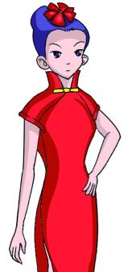
2
Discuss the following information with your partner. Then write a passage about the cheongsam.
What people usually call it: qipao in most parts of China
Who it is designed for: Chinese women
When people designed it: the Qing dynasty
What material it is made of: silk with beautiful knots on it
Who wore it first: Man minority women
When it became popular:in the 1920s
How popular it is now:very popular across the world
Wh-questions are helpful for you to plan your writing.

Slide 12
Example:
The cheongsam is both a woman’s dress and a part of China's culture. It is called “qipao” in most parts of China and it’s a traditional dress for Chinese women.
People designed the cheongsam in the Qing dynasty. It’s made of silk with beautiful knots on it. The Man minority women wore the cheongsam first. It started to become popular in the 1920s. Then more and more women liked wearing the cheongsam. Many foreigners like it, too. So it’s very popular across the world now.

Slide 13
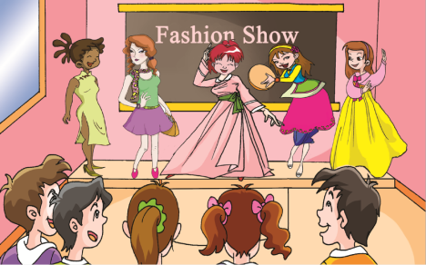
Project
Classroom Fashion Show
1. Bring your favorite clothes to your classroom.
2. Introduce some clothes to your classmates. You can tell them about the color,material, style and so on.
3. Hold a fashion show in the classroom.
4. Write a short passage about the fashion show.

Slide 14
Exercises in class
根据首字母及句意完成句子。
1. Do you know if they like this new i_____?
2. You should make your own c_______ instead of following others.
3. They all went to sleep e________ me.
4. Tony's cousin got married last week. He took part in his m__________.
5. I set up a new company,would you like to come to my c___________?
tem
hoice
xcept
arriage
elebration

Slide 15
Exercises in class
根据短文内容填空，每空一词。
Fashion is _______ of history and culture. At one ________，middle school students wore the same school uniforms for all the occasions. But now in some schools students begin to design the school uniforms______ either formal ______ casual clothes. By the way, there _______ a fashion show of our middle school students yesterday evening. We saw many models come there to _________ the clothes. All the clothes stand ________ the fashion culture of middle school students. Betty was wearing brown pants with two pockets and a pair of running shoes. Two girls were different_________Betty. They were wearing traditional minority costumes with many beautiful silk knots and some other decorations. Susan was __________ a suit of her personal style with a belt. As for（至于）the others, I don’t want to describe them. In a word, all the models looked so beautiful _______ we didn't believe that all the models were all students of our school.
full
time
as
or
was
model
for
from
wearing
that

Slide 16
Summary
We learn:
1. Some new words and a phrase:
well-known,item,choice,marriage,celebration,at one time
2. To summarize the object clauses:
Kangkang said he watched it.
He said it was wonderful.
She asked Kangkang what he was doing.
She said she wore a Yao costume.
We can:
◆Talk about the world traditional fashion culture:
The well-known item of American clothing is blue jeans.
They are the most popular choice of clothing for young people around the world.
The kimono is the Japanese traditional clothing.
Today, few people wear kimonos except on special occasions like marriages and national celebrations.

Slide 17
Homework
1.Read 1 aloud and try to repeat.
2.Finish Section D in your workbook.
3.Review the Topic 3 of Unit 8.

Slide 18
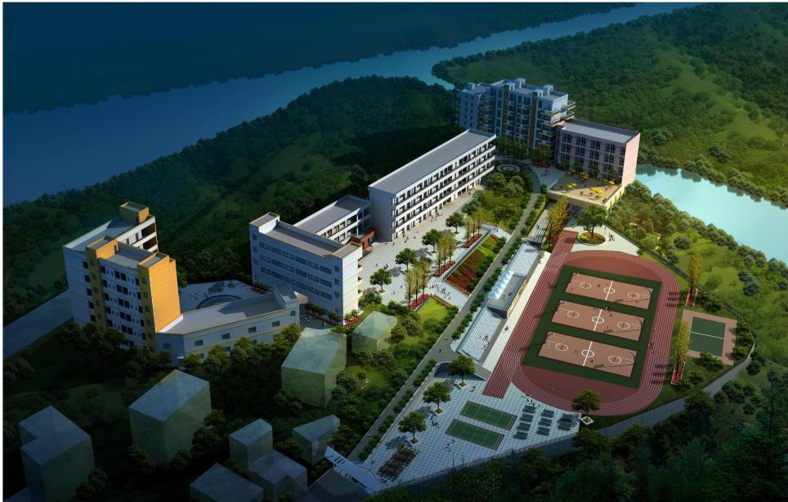
Thank you

