Slide 1
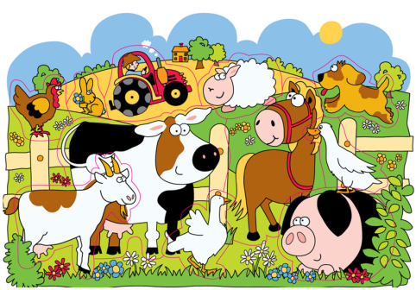
A day on the farm
第一课时
WWW.PPT818.COM

Slide 2
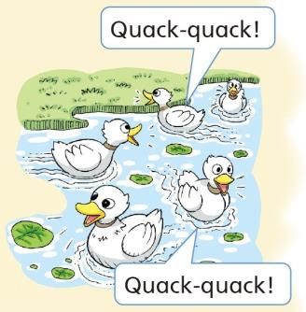
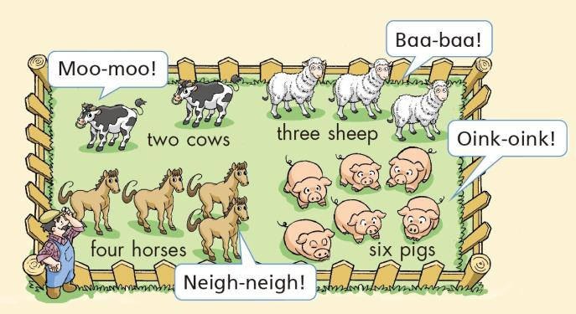
Old MacDonald has a farm
Notes:
2

Slide 3
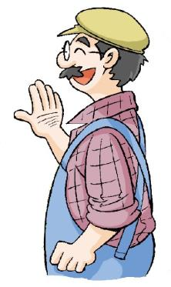
Look and say
Old MacDonald
Notes:
3

Slide 4
Look and say
Old MacDonld
Notes:
4

Slide 5
Sing and answer
What can you hear on his farm?
Notes:
5

Slide 6
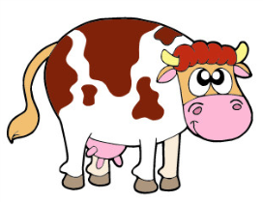
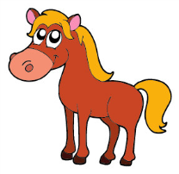
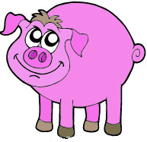
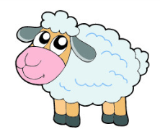
Look and say
Animals
on the farm
cow
horse
pig
sheep
Notes:
6

Slide 7
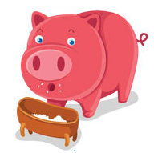
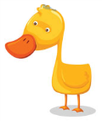
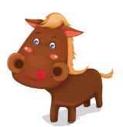
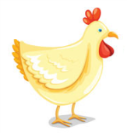
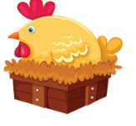
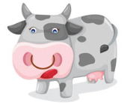
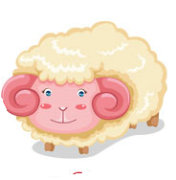
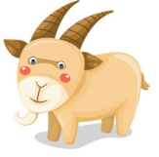
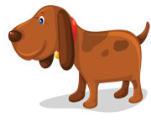
Look and say
Animals
on the farm
Notes:
7

Slide 8
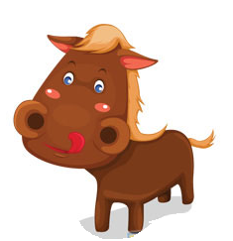
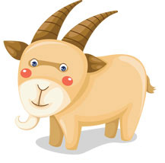
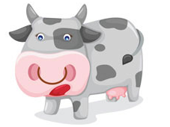
Clap and say
Notes:
8

Slide 9
Ask and answer
What can you see on his farm?
I can see two cows.
Notes:
9

Slide 10
Ask and answer
What can you see on Mr MacDonald’s farm?
I can see ...
Notes:
10

Slide 11
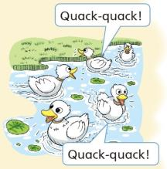
Look and read
I can see two cows.
I can see six pigs.
I can see five ducks.
I can see four horses.
I can see three sheep.
Notes:
11

Slide 12
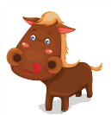
Look and think
cow cows
pig pigs
duck ducks
horse horses
sheep sheep
Notes:
12

Slide 13
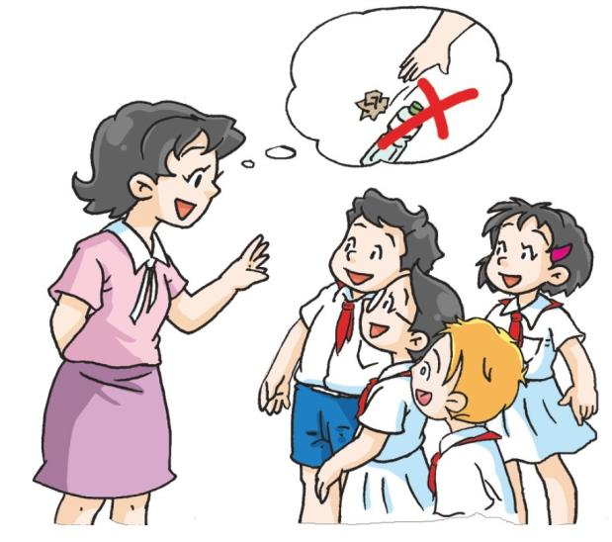
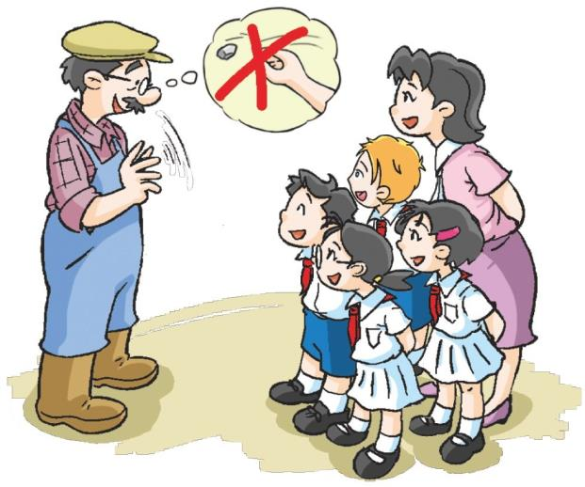
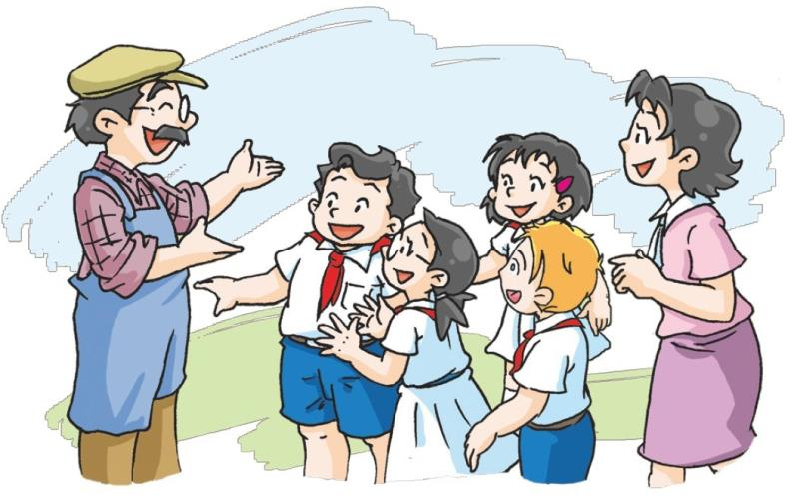
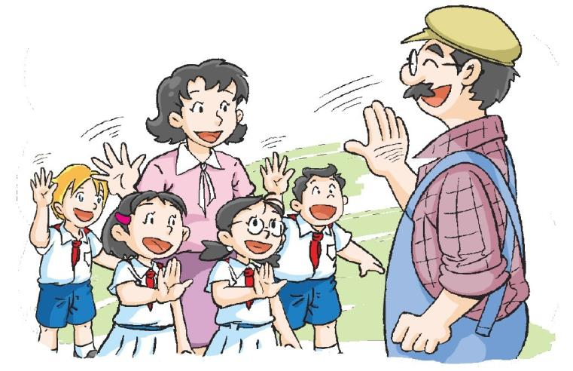
Notes:
13

Slide 14
Read and answer
1 Miss Fang and the children are on _______________’s farm.
Mr MacDonald
2 They can hear some ________.
cows
Notes:
14

Slide 15
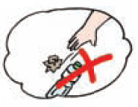
Think and say
Rules on the farm
Don’t litter.
Don’t throw stones.
Notes:
15

Slide 16
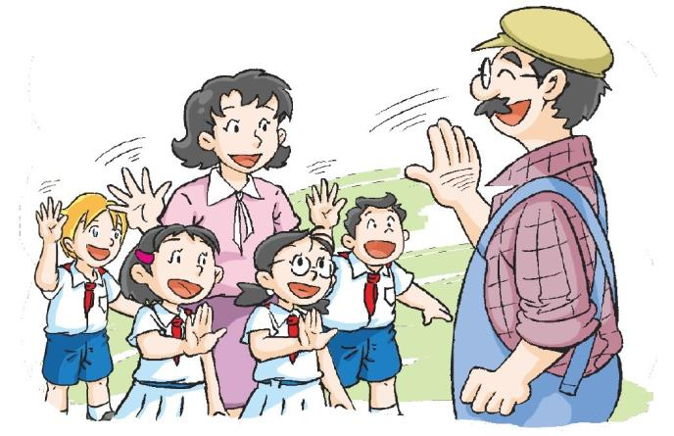
Good morning, children.
Good morning, Mr MacDonald.
Notes:
16

Slide 17
Don’t litter.
Yes, Miss Fang.
Notes:
17

Slide 18
Don’t throw stones.
Yes, Mr MacDonald.
Notes:
18

Slide 19
Listen! What can you hear?
I can hear some cows.
Let’s go and see the animals.
Great!
Notes:
19

Slide 20
Act it out
Notes:
20

Slide 21
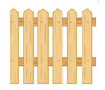
Think and say
What does it mean?
Don’t litter.
Don’t throw stones.
Don’t walk on the grass.
Don’t open the gate.
Notes:
21

Slide 22
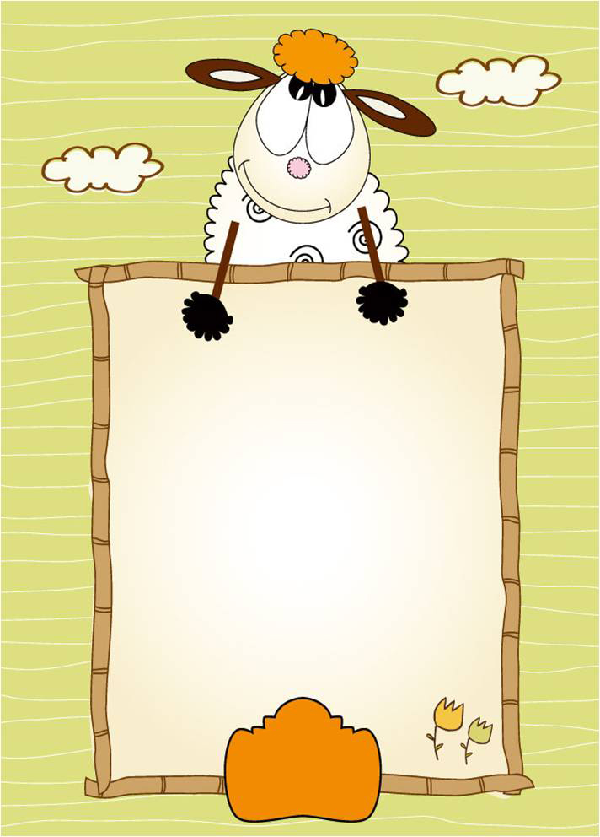
Homework
1 Spell and copy these words.
horse sheep cow pig
2 Write about one animal on the farm.
Notes:
22

