Slide 1
Unit5 I like those shoes.
人教精通版四年级上册
WWW.PPT818.COM

Slide 2
Let’s sing
Warm-up

Slide 3
Free talk
Lead-in
How’s the weather today?
What shall we do?
What clothes(衣服) shall we wear?

Slide 4
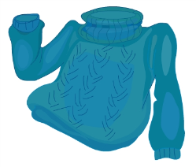
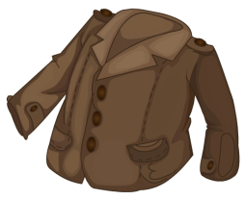
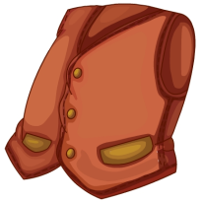
Presentation
Look and say
sweater
coat
vest
skirt

Slide 5
Presentation
Let’s learn
T-shirt

Slide 6
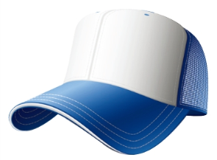
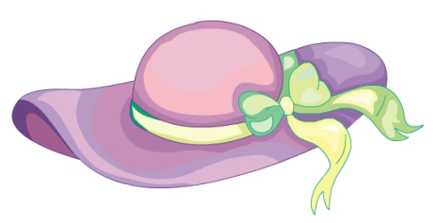
Presentation
Let’s learn
cap
hat

Slide 7
Presentation
hat cap词义辨析
两者皆为帽子的意思。
hat 通常是有边和帽顶的。
cap 是没有边的，像游泳用的游泳帽。或是前面有帽舌的棒球帽。

Slide 8
Practice
Game 1
大小声
T-shirt cap hat

Slide 9
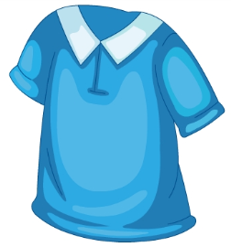
Practice
Game 2
What’s missing?

Slide 10
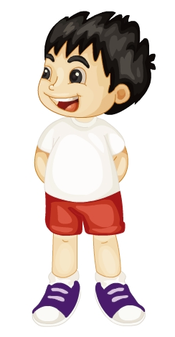
Presentation
Let’s learn
It’s sunny today. I’ll put on my cap.
put on my cap

Slide 11
Presentation
Let’s learn
It’s hot today. Put on your hat, please.
Put on your hat

Slide 12
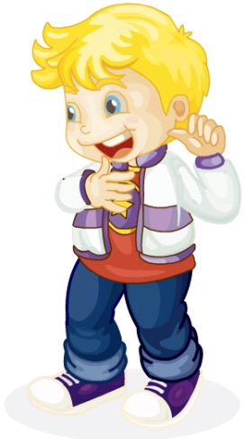
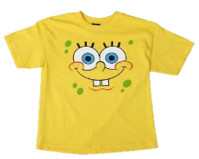
Presentation
Let’s learn
It’s hot today. Put on your T-shirt, please.
Put on your T-shirt

Slide 13
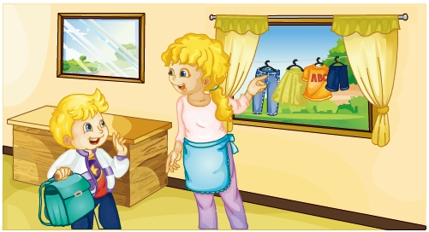
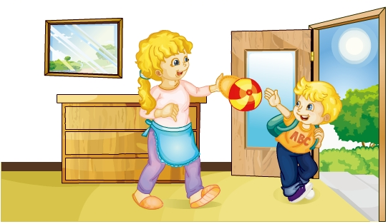
Look and guess
Presentation
Guess! What are they talking about?

Slide 14
Presentation
Listen and imitate
1
It’s hot today, Mum. Where’s my new T-shirt?
It’s over there.
2
3
4
Peter! Put on your cap, please.
Thanks, Mum.

Slide 15
Practice
Let’s read
1
2
3
Read together.
(齐读)
Read in roles.
（分角色读）
Read in groups.
(分组读）

Slide 16
Show time
两人一组试着来表演，其他同学来评价。
 | 模仿录音中的语音语调，有感情地朗读。
 | 可以脱离课本，适当改动其中部分，语音地道。
 | 适当添加内容，意思完整，有创新，表演生动。
Good
Great
Excellent

Slide 17
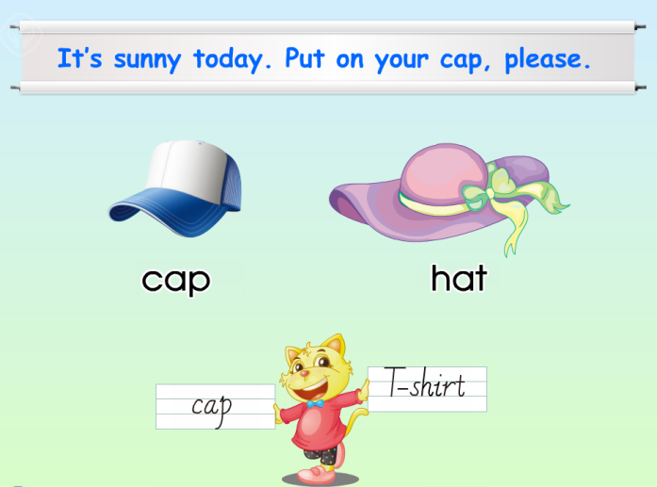
Just read and write
Practice

Slide 18
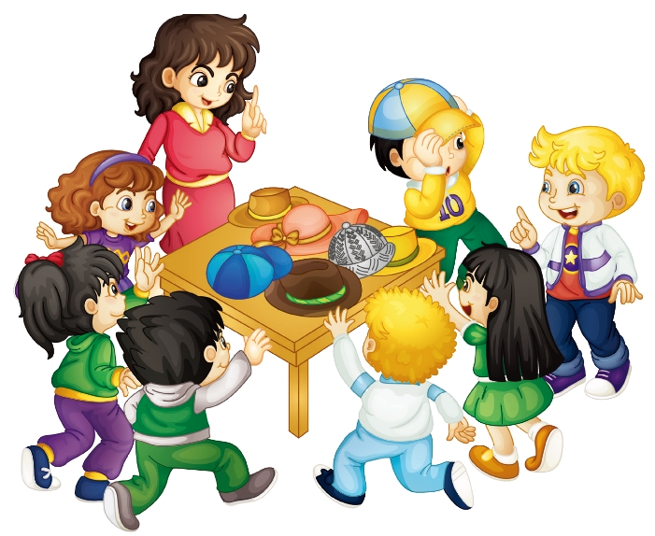
Practice
Let’s play
It’s sunny. Put on a hat, please.
Out!

Slide 19
Summary
本课学习的着装类的单词有：
T-shirt
cap
hat

Slide 20
Summary
如何表达天气状况及穿衣建议呢？
It’s … today.
Put on your …, please.

Slide 21
Homework
1. 跟读Just talk部分的课文录音，并注意语音、语调。
2.观看今明两天的天气预报，并运用本课所学句型给自己的父母提一些穿衣的建议。
3. 预习Lesson26。
Close

