Slide 1
Lesson 3
Guo Yang is running
WWW.PPT818.COM

Slide 2
Let’s chant:
Doing,doing,What are you doing?
Writing,writing,I am writing.
Running,running,I am running.
Singing,singing,I am singsing.
Dancing,dancing,I am dancing.

Slide 3
Free talk.
What are you doing?
I'm ...
running skipping reading a book
singing dancing playing football

Slide 4
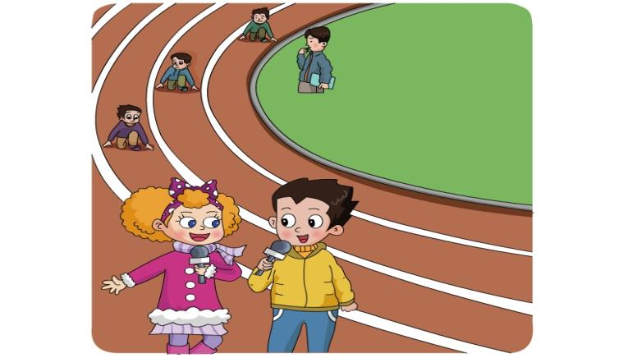

Slide 5
Listen and answer:
What's GuoYang doing ?
What's WangHong doing ?
What's Danny doing ?

Slide 8
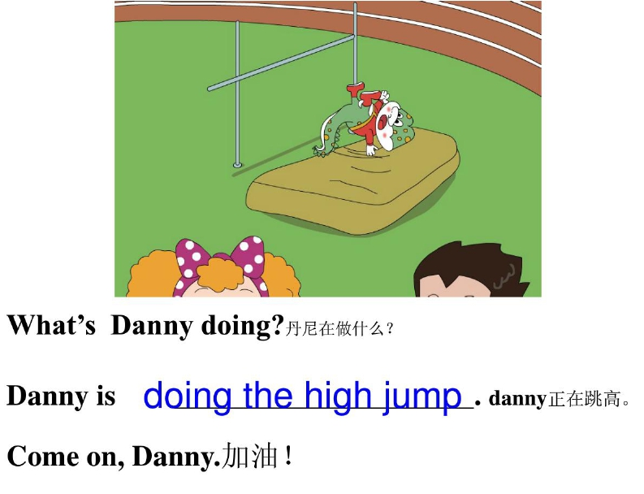

Slide 9
Listen and try to imitate.
Jenny:Good morning,everyone.
GuoYang:Today is our Sports Day.
Jenny:Look!GuoYang is running!
GuoYang:Oh!GuoYang is the winner.
Jenny:What's WangHong doing?
GuoYang:She's doing the long jump.
Jenny:Now,Danny is doing the high jump.
GuoYang:Come on,Danny!

Slide 10
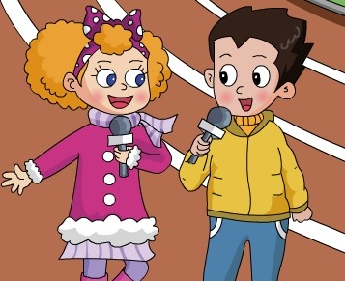

Slide 12
Let’s talk.

Slide 14
Movement is life.
生命在于运动！
享受生活每一天！

