Slide 1
Let’s go to school.
第1课时
WWW.PPT818.COM

Slide 2
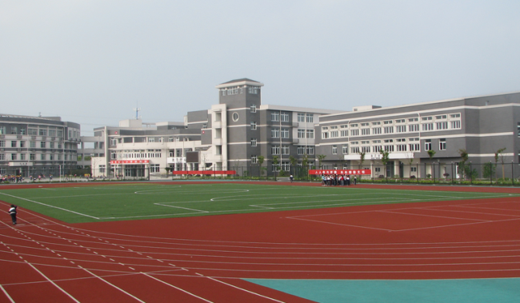
Let’s learn
school
学校

Slide 3
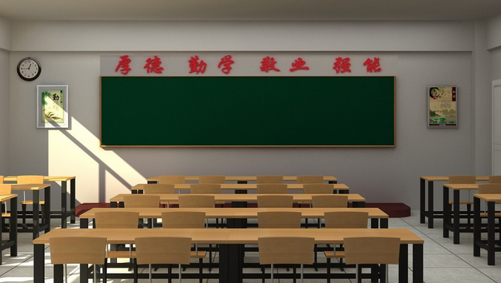
classroom
教室

Slide 4
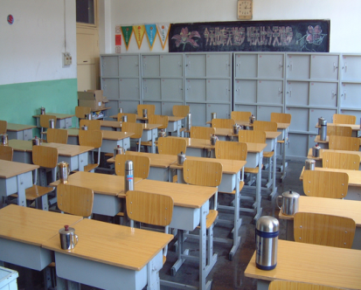
Look and say
classroom
This is _________.

Slide 5
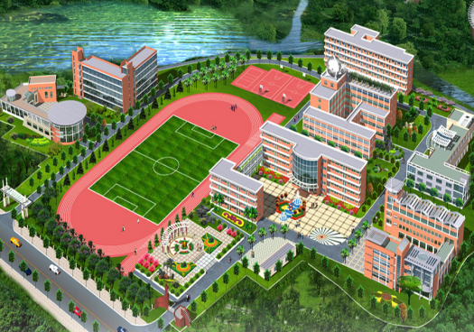
school
This is _________.

Slide 6
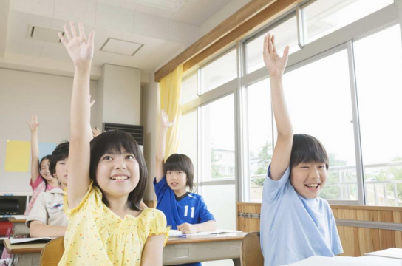
classroom
小朋友们在哪里上课呢？

Slide 7
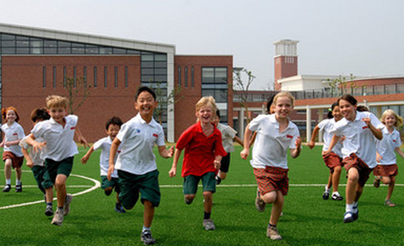
school
小朋友们在哪里玩耍呢？

Slide 8
Let’s learn
初次见面，打招呼时不仅仅可用简单的hello, hi, 还可说Nice/Glad to see you!

Slide 9
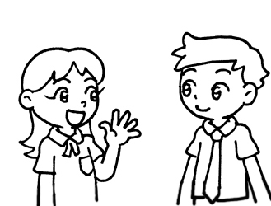
Gao Wei: Hello, Kate! Nice to see you!
你好，Kate，很高兴见到你。
Kate: Hello, Gao Wei! Nice to see you!
你好，高伟, 很高兴见到你。

Slide 10
Gao Wei: Hello, Kate! Nice to see you again.
你好，Kate，很高兴再次见到你。
Kate: Hi, Gao Wei! Glad to see you again!
你好，高伟，很高兴再次见到你。

Slide 11
Let’s + 动词原形表示 “让我们做……”

Slide 12
Gao Wei: Let’s go to school.
让我们去学校吧。
Kate: OK. Let’s go!
好的，我们走吧。

Slide 13
Let’s read
Gao Wei: Nice to see you, Kate.
Kate: Glad to see you, Gao Wei.
Gao Wei: Let’s go to school.
Kate: OK. Let’s go.

Slide 14
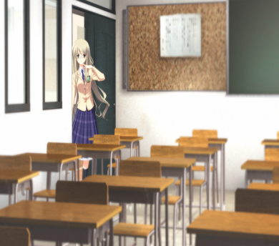
Let’s do
A: _____ to see you.
B: _____ to see you.
A: Let’s go to the ______.
B: OK. _____ go.
Nice/Glad, Nice/Glad, classroom, Let’s

Slide 15
Let’s play
同桌间相互练习所学句型

Slide 16
Let’s sing
A: Hello, Gao Wei! Hello, Kate! Nice to see you again.
B: Hello, Gao Wei! Hello, Kate! Let’s go to school.
A: Go to school. Go to the classroom. Go to school. Go to the classroom.
B: Hello, Gao Wei! Hello, Kate! Let’s go to school.

Slide 17
Thank You.

