Slide 1
陕旅版小学英语三年级下册
Unit5 Do You Like Candies?
第2课时
WWW.PPT818.COM

Slide 2
教学目标
学习句型Do you like …?询问对方的喜好，以及肯定回答和否定回答：Yes, I do.\No, I don’t.

Slide 3
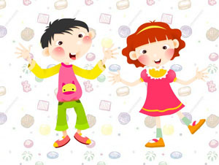
歌曲Do you like

Slide 4
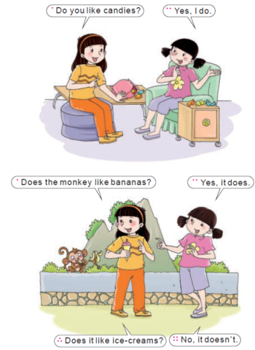
自主读part A的Let’s talk的句子

Slide 5
跟读Let’s talk
Unit5PartALetstalk课文录音.mp3

Slide 6
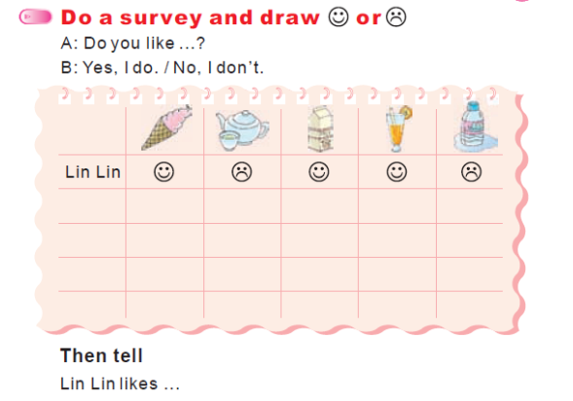
Part B---Do a survey

Slide 7
随堂练
完形填空
(1)A:___ you like candies?
B: No, I _____.
(2)A: ____ she like bananas?
B: Yes, she _____.
(3)A: ___ you like bread?
B：____,I do.
(4)A：____ he like bananas?
B: _____, he doesn’t.

