Slide 1
Unit 3
How do you get to school?
Section B
WWW.PPT818.COM

Slide 2
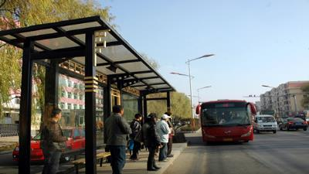
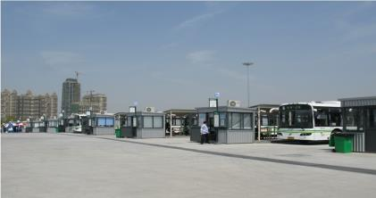
创设情境
Guessing
bus stop
bus station

Slide 3
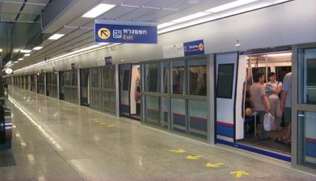
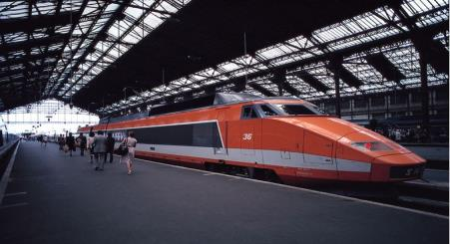
subway station
train station

Slide 4
启发思考
1a. Match the words with the pictures.
b
1. ___bus stop 3. ___ bus station
2. ___ train station 4. ___ subway station
c
a
d

Slide 5
1b. Tell your partner how you get to school. Imagine you
use two types of transportation.

Slide 6
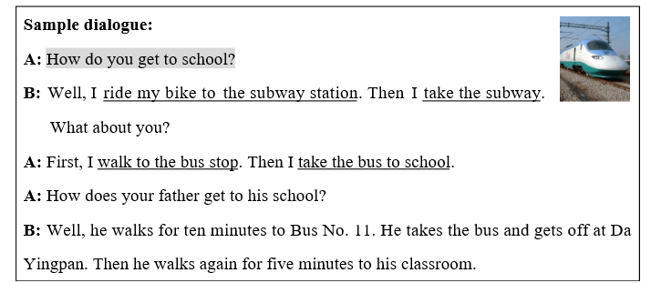

Slide 7
Bob invites Mary to visit his house.
They are having a dialogue.
Mary asks something about Bob.

Slide 8
1c. Listen and check the things that Mary wants to know.
Mary wants to know…
___ where Bob lives.
___ how far he lives from his
grandparents’ home.
___ how he gets to his grandparents’ home.
___ how long it takes to get to his
grandparents’ home.
___ what he thinks of the trip.
√
√
√

Slide 9
1d. Listen again. How does Bob get to his grandparents’ home? Check 1 or 2.
√

Slide 10
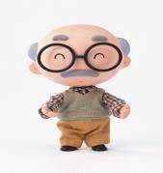
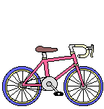
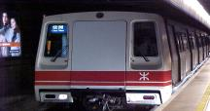
A: How does grandpa get to the park? B: First, he … to 某地 Next, he … to 某地 Finally, he … to 某地

Slide 11
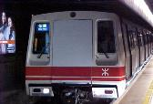
A: How does Nina go to the library? B: First, she…to 某地 Next, she…to 某地 Then, she…to 某地

Slide 12
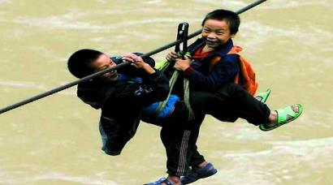
自主或小组探究
2a. Look at the picture and title below.
Guess what the passage is about.
Crossing the River to School

Slide 13
Crossing the River to School
How do you get to school? Do you walk or ride a bike? Do you go by bus or by train? For many students ,it is easy to get to school. But for the students in one small village in China, it is difficult. There is a very big river between their school and the village. There is no bridge and the river runs too quickly for boats. So these students go on a ropeway to cross the river to school.

Slide 14
One 11-year-old boy, Liangliang, crosses the river every school day. But he is not afraid. “ I love to play with my classmates. And I love my teacher. He’s like a father to me.”
Many of the students and villagers never leave the village. It is their dream to have a bridge. Can their dream come true?

Slide 15
2b. Read the passage and answer the question.
1. How do the students in the village go to school?
2. Why do they go to school like this?
3. Does the boy like his school? Why?
4. What is the villagers’ dream?
Do you think their dream can come true?
Why or why not?

Slide 16
1. They go on a ropeway to cross the river to school.
2. Because there is a big river between their school and the village. There’s no bridge and the river runs too quickly for boats.
3. Yes, he does. He loves to play with his
classmates. He loves his teacher.
4. Their dream is to have a bridge.
Yes. I think so. Many kind people will help them.

Slide 17
2c Read the passage again.
Complete the sentences with words from the passage.
For the students in the village, it is___________to get to school.
2. They have to cross a very ____ river between their school and the village.
difficult
big

Slide 18
3. They cannot go by boat because the river runs too_______.
4. It is not easy to cross the river on a ropeway,
but the boy is not_______.
5. The students and the villagers want to have a bridge.
Can their dream come______?
quickly
afraid
true

Slide 19
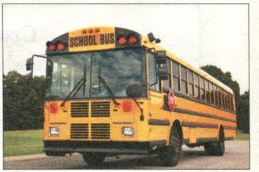
协作交流
3a. Read the e-mail from your pen pal Tom in the US .
Fill in the blanks with the words in the box.

Slide 20
Hi there,
How are you? Thanks for your
last e-mail. you want to know
how I _____ school, right? Well,
I usually______ my home at
about 8:00 and ______to the bus stop. The school bus is about 20 __________ from my home. It_____ about 40 minutes to get there by bus. The bus ride is never_______ because I always talk to my classmates.
What about you ? How do you get to school?
Tom
kilometers
takes
boring
get to
walk
leave
get to
leave
walk
kilometers
takes
boring

Slide 21
3b. Write an e-mail to Tom and tell him how you get to school. These questions may help you.
1.When do you leave home?
2. How do you get to school?
3.How far is it from your home to school?
4.How long does it take you to get to school?
5. Do you like your trip to school?

Slide 22
1. 先根据自己的实际情况回答五个提示问题。
2. 将五个答语连成一段连贯的文字。
3. 适当发挥自己的想象, 写出其他可能的句子。
按e-mail的写作格式, 先向对方进行问候, 或客套。然后, 将以上文字整理成一篇小信件。
5. 最后, 再通读一遍自己的作品, 看有没有错误或不通顺的地方。就大功告成了！

Slide 23
Dear Tom,
_______________________________________________________________________________________________________________________________________________________________________________________________________________________________________________
How are you? Thank you for your last e-mail. I know how you get to school. Now let me tell you how I get to school. I usually leave home at half past seven. First, I walk to the subway station. Then I take the subway to school. My school is about ten kilometers from my home.

Slide 24
It usually takes me about half an hour to get to school. I usually meets many friends. So my trip is interesting , too.
____________________________________________________________________________________________________________
Peter

Slide 25
总结提高

