Slide 1
Unit 3 Writing Home
Lesson 15 Sending the Postcards
WWW.PPT818.COM

Slide 2
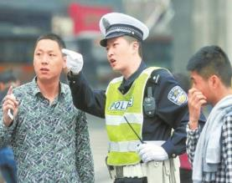
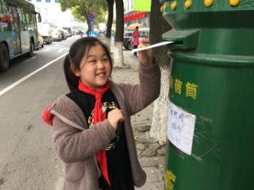
Warming up
Introduce them
1
2
3

Slide 3
01
What are the two men doing in Picture 1?
They are asking the way.

Slide 4
02
What can you see in Picture 2?
We can see a girl sending a letter.

Slide 5
03
What is the woman doing in Picture 3?
She is writing a postcard.

Slide 6
Leading
Leading in
Answer the questions.
点击输入文本内容点击输入文本内容点击输入
What do Danny and Jenny want to do?
Do they know the way to the post office?
What do they do?

Slide 7
Presentation
带着问题读课文。
How much are the stamps?
How many stamps will Jenny buy?
One stamp for 10 yuan.
Two.

Slide 8
听录音，回答问题。
Does Danny need stamps?
Yes, but not now.
What is Danny doing?
He is writing nine postcards to his mother.
How many postcards is Danny writing to his mother?
Nine postcards.

Slide 9
小组活动
向同伴口头叙述丹尼和珍妮在邮局的情况，然后找出对方的错误。

Slide 10
Consolidation and extension
Consolidation and extension
单词识记：看谁先找出它们，并最先记住。
1
send the postcards
turn left
2
go down
3
4
write to

Slide 11
读课文比赛
看哪一组读得最顺畅准确。
仿照课文，介绍自己的购物情况。

Slide 12
Summing up
Jenny and Danny want to…
Excuse me.
Go straight.
Turn left at the traffic lights.
I’m writing nine postcards to my mother.
重点句型
02

Slide 13
want to
表示“想做……”后接动词原形
例如：I want to read a book.
重点句型
02
现在进行时表示正在进行的动作，表现为“be + doing”的形式。

Slide 14
Evaluation
内容 | 学生A | 学生B | 学生C | 学生D
积极发言
乐于合作
完成情况

Slide 15
Homework
用英语讲述今天所见的事情（使用课本句式）。
完成Let’s do it!中的练习。

Slide 16
参考答案：
How much is that cap?
It’s fifteen yuan.
How much are those shoes?
They are thirty yuan.
How much are those stamps?
They are eight yuan.

Slide 17
Thank you!

