Slide 1
UNIT 1
How can we become good learners?
WWW.PPT818.COM

Slide 2
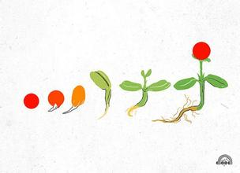
Free talk
Do you have good ways to learn English?
How do you study your English?

Slide 3
Language points
by在初中英语中的用法有以下几种：
(1) 意为靠“在……旁”、“近”。
如：们在湖边画画。 They are drawing by the lake.
(2) 意为“不迟于”、“到……时为止”。
如：他在晚饭前会好的。
He will be all right by supper time.

Slide 4
(3) 意为“依靠”、“用” 、“凭借”、“通过”、“乘坐” 等。表示方法、手段。如：我乘公交车去上学。
I go to school by bus.
(4) 意为“被”、“由”等。用于被动句中，表示行为主体。如：
许多人讲英语。
English is spoken by many people.

Slide 5
(5) 组成其它短语:
1) by the way : 意为“顺便说”、“顺便问一
下”，常做插入语。如：
顺便问一下，李丽在哪儿？
By the way, where’s Lily?
2) by oneself : 意为“单独”、“自己”。如：
我不能把她单独留下。
I can’t leave her by herself.

Slide 6
How do you study your English?
I study English by working with friends.

Slide 7
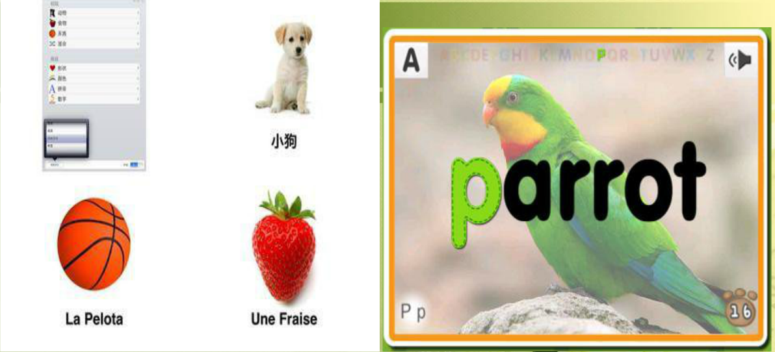
How do you study your English?
I study English by making word cards

Slide 8
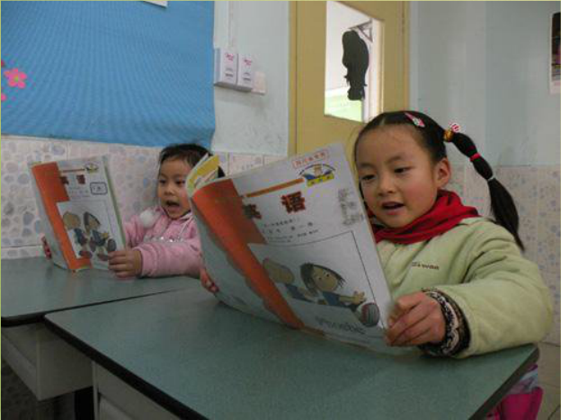
How do you study your English?
I study English by reading textbooks

Slide 9
How do you study your English?
I study English by listening to tapes

Slide 10
How do you study your English?
By asking the teacher for help

Slide 11
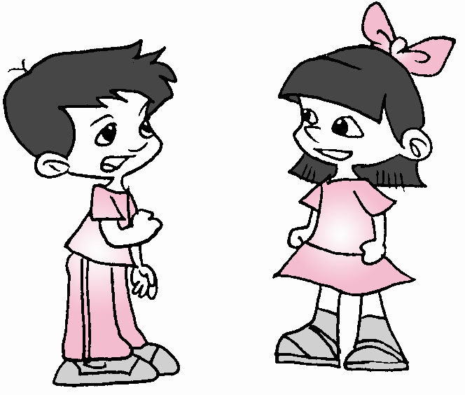
Do you know other ways ?
By watching English movies
By reading English stories
By speaking with foreigners
By reading English newspaper

Slide 12
It’s too hard to understand the voices.
too + 形容词/副词 + to + 动词原形
“太……而不能……”，
该句型用于肯定句，但表示否定的意义。
1.他太小了而不能去上学。
He is ______ ________ ______ _____to school.
2. Tom runs too slowly _______ (catch ) the early bus.
too young to go
to catch

Slide 13
1.Why is Jack a little nervous ?
2. What advice does Annie give to Jack about how to read quickly ?

Slide 14
The more you read, the faster you’ll be.
你读得越多，你就会越快。
the +比较级， the +比较级
越……, 就越……
1.越多越好。
The _________, the____________.
2.你学习越努力，就会取得越好的成绩。
The _________ you study, the _______ grades you will get.
more
better
harder
better

Slide 15
Exercises
根据汉语提示用正确形式填空。
1. Do you have any _________ (单词卡)?
2. Please read _____ (大声地), I can’t
hear you.
3. Your ____________ (发音) sounds
good.
4. English ________ (语法) is very important.
word cards
aloud
pronunciation
grammar

Slide 16
阅读3a短文，回答下列问题
Why did Wei Fen find it difficult to learn
English?
2. What did she do in English class?
3. What is the secret to language learning?
Because the teacher spoke so quickly that
she didn’t understand her.
She just hid behind her textbook and never
said anything.
Listening to something interesting is the secret
to language learning.

Slide 17
Language points
1. Why did Wei Fan find it difficult to learn
English?
为什么魏芬发现学英语很难？
“find + it +adj. +to do sth.””发现做某事…”
(2012.山东滨州) My pen pal Andrew found it
difficult _______ Chinese well.
Learning B. learn
C. to learn D. learned
C

Slide 18
2. What is the secret to language learning?
语言学习的秘诀是什么？
the secret to … “…的秘诀” 其中to 为介词, 表示所属，意为“…的….同类短语：
the key to the door 门的钥匙
the answer to the question 问题的答案

Slide 19
3. I was afraid to ask questions because my pronunciation was very bad.
但是因为我糟糕的发音，我害怕问问题。
be afraid to do sth. 意为“害怕做某事”。
be afraid of sb/ sth. “害怕某人/某物”。
be afraid that 从句. “担心…”。

Slide 20
汉译英。
1. -- 你是怎样准备考试的？ -- 哦，我和同学们一起学习。
--How do you study for a test?
--Well, I study by working with my
classmates.
2.-- 你曾经参加过学习小组吗？
-- 是的，参加过。通过这种方式我学会
许多。
-- Have you ever studied with a group? -- Yes, I have. I’ve learned a lot that way.

