Slide 1
Unit 2 School life
第5课时
WWW.PPT818.COM

Slide 2
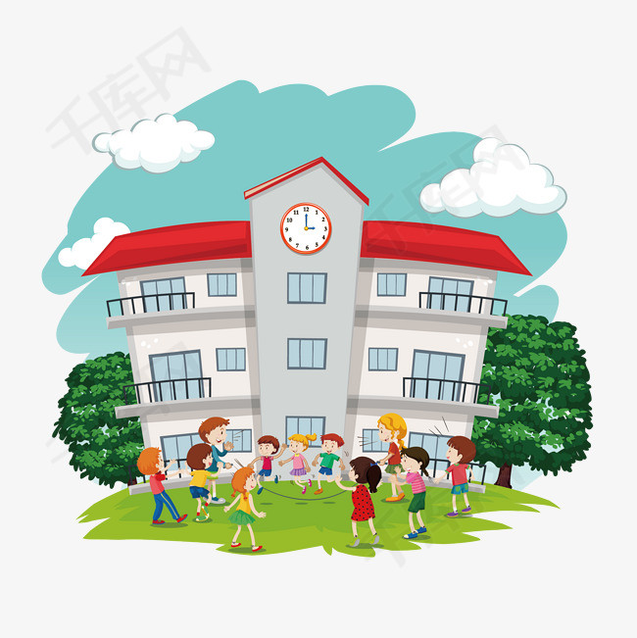
Can you introduce your school?

Slide 3
Integrated skills
A1)Daniel is writing an article about different schools. Listen to him introducing Sunshine Middle School and complete the first column in the table below.
 | Sunshine Middle School | Woodland School | Rocky Mountain High School
Number of students
Number of teachers |  | 66
How long is the summer holiday？
1,309
90
8 weeks

Slide 4
 | Sunshine Middle School | Woodland School | Rocky Mountain High School
How much time do students spend on homework every day？
Do students wear uniforms？ |  | /
Do students do morning exercises？ | yes | / | no
3 hours
yes

Slide 5
A2) Listen to their conversation and complete the rest of the table above.
 | Sunshine Middle School | Woodland School | Rocky Mountain High School
Number of students
Number of teachers |  | 66
How long is the summer holiday？
How much time do students spend on homework every day？
Do students wear uniforms？ |  | /
Do students do morning exercises？ | yes | / | no
1,309
308
1,215
90
85
8 weeks
6 weeks
12 weeks
3 hours
2 hours
1 hour
yes
no

Slide 6
A3) Help Daniel complete his article with the information in Part A1.
Woodland School is smaller than Rocky Mountain High School. There are （1）_________（more/fewer/less） teachers and （2） _________ （more/ fewer/ less） students at Woodland School than at Rocky Mountain High School. Sunshine Middle School has （3） _________ （more/ fewer/ the most） teachers and students of the three.
Chinese students have （4） _________ （more/ fewer/ less）
fewer
fewer
the most
more

Slide 7
weeks off for the summer holiday than British students. British students spend （5） _________ （more/ fewer/ less） time doing homework than Chinese students. Among the three schools，American students spend （6） _________ （the least/ few/ less） time on homework， and they have （7） _________ （long/ longer/ the longest） summer holiday. Chinese students spend （8） _________ （the most/ the fewest/ the least） time on homework. They work （9） _________ （hard/ harder/ the hardest）.
less
the least
the longest
the most
the hardest

Slide 8
知识点
number of 意为“……的数量”。
1
此处number of . . . 前省略了冠词the， the number of意为“……的数量”。“the number of ＋可数名词复数”作主语时，谓语动词用单数形式。
eg：The number of the students in our class is 50. 我们班的学生数是50。

Slide 9
辨析：the number of 和a number of
【重点】
a number of 意为“许多、若干”，修饰可数名词复数，“ a number of＋可数名词复数”作主语时，谓语动词用复数形式。number 前可以用large， small 修饰表示程度。
典例
In our hospital， the number of women doctors ______ larger and larger. （西宁）
A. is B. are C. be D. been
A

Slide 10
知识点
spend /spend/ vt. 花费（时间或金钱）
2
考向一
spend time （in）doing sth. 表示“花时间做某事”。其中介词in可省略。
【重点】
eg: She spends two hours doing her homework every day. 她每天花两个小时做家庭作业。

Slide 11
考向二
spend time/money on sth. 表示“在某事物上花费时间/金钱”。
【重点】
eg：My mother spends some time on her work every day. 我妈妈每天花一些时间在工作上。
典例
—It's reported that Chinese ______ more than 40 minutes a day reading WeChat（微信）.
—It's true. But I think WeChat is taking too much of our time. （襄阳）
A. spend B. cost C. pay D. take
A

Slide 12
Study skills
B) Millie is writing in her diary. Complete her entry with the correct forms of the words in brackets.
Today we had an English test. We have a (1)________(month) test on each subject. I looked through the questions (2) ________ (quick). I could (3) ________ (easy) answer all of them.
To me, learning foreign languages is (4)________ (real) fun. I read English newspapers and magazines every day. I read very (5)________ (slow) at first, but I am doing better now. I also keep writing in English about my(6) ________ (day) life. I learn to use English better this way. (7)________ (usual)I watch English videos at weekends. I always have a (8) ________ (love)time！
monthly
quickly
easily
really
slowly
daily
Usually
lovely

Slide 13
知识点
3
look through 浏览
eg： He looked through the exam paper quickly， and then wrote down the answers.
他快速地浏览了试卷，然后写下了答案。
归纳：与look相关的短语
look after 照看；look at看；look like看起来像；look down on瞧不起；look forward to期待；look out of 向……外看；look for寻找；look around环顾

Slide 14
典例
— I found my sister _______ my things and taking my new magazines. What should I do？
— I guess you should tell her it's not right. （乐山）
A. looking through B. looking up
C. looking for
A

Slide 15
知识点
4
keep doing sth. 意为“一直做某事”。
eg： He kept working all day. 他整天都在不停地工作。
考向
keep的用法
短语 | 含义及用法 | 示例
keep （on） doing sth. | 意为“继续做某事”， “不断或重复做某事”，表示动作的持续或反复。 | Don't keep on interrupting me！ 别老是跟我打岔！
keep sb. do­ing sth. | 意为“让某人一直做某事”。 | I'm sorry to keep you waiting. 对不起，让你久等了。

Slide 16
短语 | 含义及用法 | 示例
keep. . . from doing sth. | 意为“阻止……做某事”，相当于stop. . . (from) doing sth. 和prevent. . . (from) doing sth. 。 | The heavy snow kept us from getting to school on time. 大雪使我们没能按时到达学校。
keep ＋sb. / sth. ＋形容词 | 意为“使某人/某物保持某种状态”。 | We must keep our classroom clean and tidy. 我们必须保持教室整洁干净。
keep＋形容词 | 构成系表结构。意为“保持某种状态”。 | You must exercise a lot and keep healthy. 你必须多锻炼，保持健康。

Slide 17
一、根据汉语提示完成句子
1. My cousin likes playing (国际象棋).
2. This model boat looks like a (真实的)one.
3. It is necessary to respect the old people in our (日常的)life.
4. He went to school after he had a (快速的)breakfast.
5. She (花费)two hours doing her homework every day.
chess
real
daily
quick
spends

Slide 18
二、用所给词的适当形式填空
6. This is a （week） magazine.
7. Don't keep （do） that. It's bad for your eyes.
8. I have only half an hour for my hobbies at (much).
9. He is the best student in our class and he can finish the homework （easy）.
10. I spent most of my time （learn） to play the piano last year.
weekly
doing
most
easily
learning

Slide 19
三、单项选择
11. I'll spend as much time as I can in an old people's home. （齐齐哈尔）
A. help B. to help C. helping
12. There a number of books in the library and the number of them increasing. （烟台）
A. has； is B. have； are
C. are； is D. is； are
C
C

Slide 20
13. My mother is ill in hospital. I have to my grandparents at home. （绵阳）
A. look for B. look at C. look up D. look after
14. The big fire kept and firefighters tried their best to save the injured（伤者）from it.
A. burn B. burning C. to burn D. burnt
D
B
【点拨】考查keep doing sth.“一直做某事”，句意：那场大火一直在燃烧，消防员尽他们最大的努力从大火中挽救伤者。故选B。

Slide 21
本节课主要学习了以下知识点，请同学们及时巩固练习：
number of
spend
look through
keep doing sth.

