Slide 1
Where are you from? Section B
Unit 1 Topic 2
WWW.PPT818.COM

Slide 2
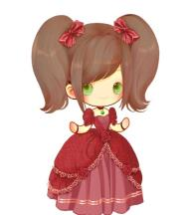
What’s her name?
Her name is Jane.
Where is she from?
She is from Canada.
Jane
Canada

Slide 3
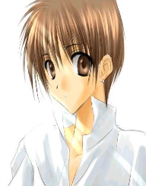
What’s his name?
His name is Yukio.
He is from Japan.
Where is he from?
Yukio
Japan

Slide 4
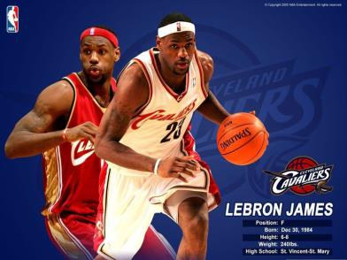
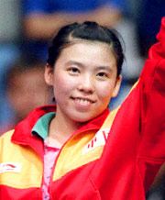
He is …
He is from …
She is …
She is from …

Slide 5
1b Look at these pictures. Ask and answer
the following questions in pairs.
Who’s he/she? Where’s he/she from?
Who is he?
He is Zhai Zhigang.
Where is he from?
He’s from China.
= He is from China.
Zhai Zhigang / China

Slide 6
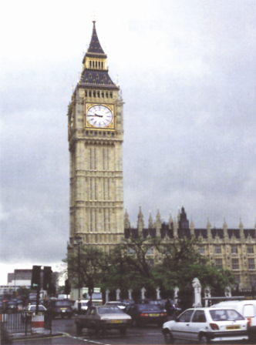
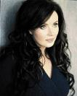
Who is she?
She is Sarah Brightman.
Where’s she from?
She’s from England.
= She is from England.
Sarah Brightman / England

Slide 7
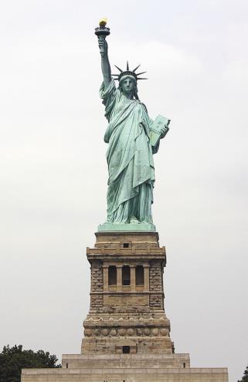
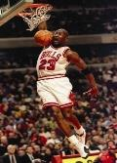
Who is he?
He is Michael Jordan.
Where is he from?
He’s from the U.S.A.
= He is from the U.S.A.
Michael Jordan/ the U.S.A.

Slide 8
1c Collect some photos of famous people. Ask and answer the questions in groups.
Who’s he/she?
Where’s he/she from?

Slide 9
Who is he?
He is Harry Potter.
Where is he from?
He is from England.
Harry Potter

Slide 10
Who is he?
He is Michael Phelps.
Where is he from?
He is from the U.S.A.
Michael Phelps

Slide 11
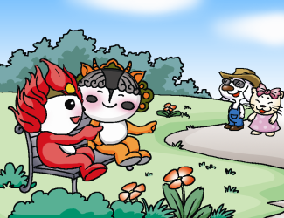
2b Pair work
Look at the picture and complete the conversation. Then practice in pairs.
Huanhuan: _____ are they?
Yingying: _____ are Dingding and
Nana.
Huanhuan: Oh, is Dingding from the
U.S.A.?
Who
They

Slide 12
Yingying: No, ____ isn’t. He’s from
Japan.
Huanhuan: ______ is Nana from?
Yingying: ______ is from England.
he
Where
She

Slide 13
3 Listen and say. Then mark the intonation.
1.Are you from Japan ? ( ) No, we aren’t.( )
2. Where is he from? ( ) He’s from England.( )
3. Is she from Shanghai?( ) No, she isn’t.( )
4. Are they from Canada? ( ) Yes, they are.( )

Slide 14
一般疑问句与特殊疑问句
你知道吗?
一般疑问句
朗读时一般用升调，其答语用降调。
Are you from the U.S.A.?
Is he Li Ming?
Is she Jane?
肯定与否定回答：
Yes, I am./ No, I’m not.
Yes, he/she is./ No, he/she is not.

Slide 15
你知道吗?
特殊疑问句
朗读时一般用降调，其答语用降调。
Where are you from?
Where is he/ she from?
He’s from England.

Slide 16
Be的用法
连系动词be是am, is, are三者的原形，一般不直接出现在句子中，而是以am, is, are的形式出现。因此建议用歌谣熟记be的用法:
我用am, 你用are，is用在他、她、它;
所有复数都用are。

Slide 17
用be动词的适当形式填空
Amy ____ her sister.
2. His name _____ Kate.
3. — What ____ your phone number?
— It _____284-2942.
4. — ______ you Cara?
— No, I _____ Gina.
5. Her brother’s name _____ John.
6. His family name _____ Li.
is
is
is
is
Are
am
is
is

Slide 18
Sum up
（1） Who is she?
She is Deng Yaping.
（2） Where is she from?
She’s from China.
（3） Are they from England?
No, they aren’t.
(4) 升、降调用法和be动词的用法。

Slide 19
Homework
（1）采用对话的形式介绍你熟悉的人
（姓名、出生地）。
（2）在作业本上抄写课文1a 和 2句子。
Notes:
19

