Slide 1

Module 12
Unit 2 Stay away from windows and heavy furniture.
WWW.PPT818.COM

Slide 2

Learning targets
lrning
★ Key words & phrases:
earthquake, warn, inside, under, window, keep, helpful, power, clear, calm, brave, keep calm, in short
★ Key sentences:
1. Keep calm, especially when you are with other people.
2. Be brave and be helpful.
3.You can be safe and you can also help others.
★To understand the passage on safety and first aid in an earthquake.

Slide 3
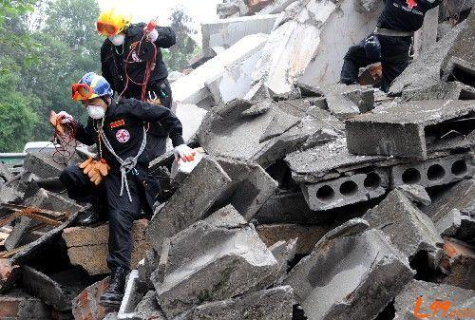
Lead-in
What do you think what happened?
It's an 7.0-magnitude earthquake. It hit Ya'an, Sichuan in 2013.

Slide 4
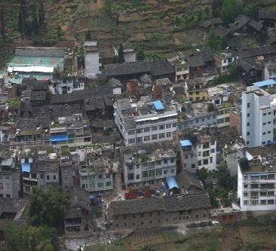
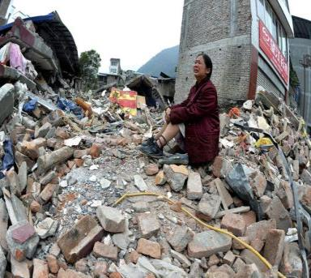
This is the largest natural calamity after Wenchuan Earthquake on May 12, 2008.
这是继2008年5月12日汶川大地震后，最大的自然灾害。

Slide 5
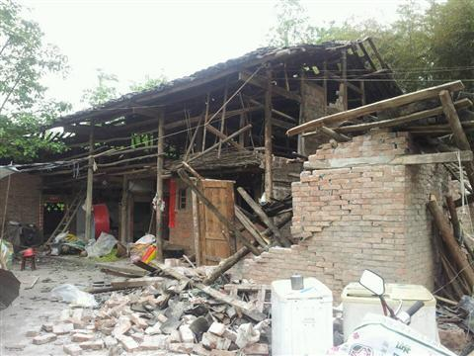
What did the earthquake turn our homes into?
The houses have
been
destoried.

Slide 6
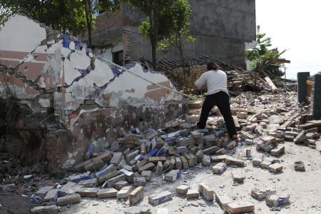
People's
normal
life
have
been
sharply
changed.

Slide 7

Remember: These things should be avoided
when an earthquake happens:
standing close to a building
2. standing under a tree
(because buildings and trees may fall on you )
3. going too close to power lines
( because you may be badly affected by electricity if they fall on you)

Slide 8
Words and expressions
earthquake n. 地震
warn v. 警告；告诫
inside adv. 在里面；向室内
prep. 在……里面
adj. 里面的；内部的
under prep. 在 ……正下方；在……下面
keep v. 保持；留在

Slide 9
window n. 窗户
clear adj. 明确的;清澈的;清楚的
v. 扫除;消除（嫌疑）;使清楚;使干净
keep clear of 不和......接触
calm adj. 镇静的；沉着的
brave adj. 勇敢的；无畏的
helpful adj. 有用的;提供帮助的
power n. 电；电力

Slide 10
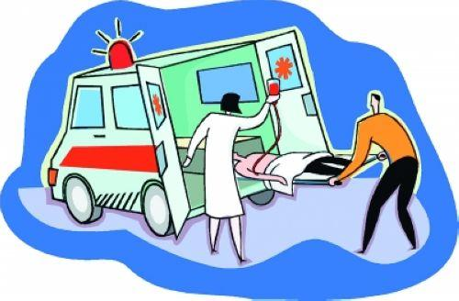
jump out of 跳出
stay away from 远离
in short 简言之
have no idea about 不知道
be careful of 当心
run out of 从……跑出
make sure of 确保

Slide 11
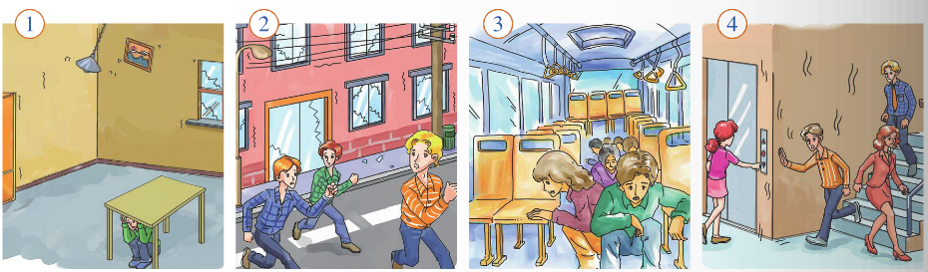
Pre-reading
1. Work in pairs. Look at the pictures and
ask and answer the questions.
1. Where are the people?
2 .What are they doing? Why?

Slide 12
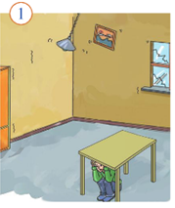
Inside the room
Hide under a table.

Slide 13
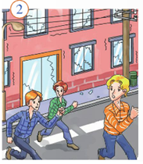
Outside the building
Move away from the
building.

Slide 14
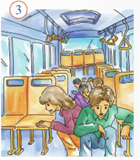
In the bus
Stay in the bus.

Slide 15
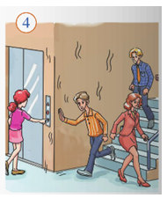
In the building
Leave the building but don’t use the lift.

Slide 16
2. Look at the title of the passage and think
about what to do in an earthquake.
Stay away from windows and heavy furniture.
Do not jump out of high buildings.
Hide under a table!
Leave the building but don’t use the lift!
And…

Slide 17

3. Read the passage and check your answer to Activity 2.
What to do in an earthquake
Earthquakes always happen suddenly, so it is difficult to warn people about them. Usually people have little or no idea about what to do during an earthquake, so here is some advice:
Inside
1 Do not jump out of high buildings.
2 Hide under a table. Stay away from windows and
heavy furniture. Keep clear of fires.
3 Leave the building quickly when the ground stops
shaking, but do not use the lift.
keep clear of sth.
清除；摆脱；没有；不接触

Slide 18
4 Keep calm, especially when you are with other people. Be brave and be helpful.
Outside
1 Move away from buildings, because parts of a building may fall on you.
2 Do not stand near street lights or under power lines.
3 Stay away from bridges and trees. If you are in a bus or a car, stay in it.
4 In the mountains, be careful of falling rocks.
5 On a beach, run away from the sea and more quickly to higher ground.
In short, follow what you learnt in school. You can be
safe and you can also help save others.

Slide 19
4. Read the sentences. Decide if the following actions are right (√) or wrong (×).
When the earthquake started…
1 …I hid under a table.
2 …Sam sat on his desk.
3 …Alice ran out of the building.
4 …Peter and Helen stayed in their car.
5 …my family and I moved away from the beach.
(√)
(×)
(×)
(√)
(√)

Slide 20
5. Answer the questions. Use the words and
expressions in the box.
brave inside keep calm power lines
street lights warn
1 What is difficult to do before an earthquake?
2 Where should you stay before the ground stops
shaking?
3 What should you do when you are with other
people?
4 What shouldn’t you stand near or under in the
street?

Slide 21
Answer:
1. It’s difficult to warn people before an earthquake.
2. We should stay inside.
3. We should keep calm and be brave.
4. We shouldn’t stand near power lines or under street
lights in the street.

Slide 22
6.Work in pairs. Do the following research.
Inside your school
Make a list of safe places and dangerous places at
your school if an earthquake happens.
Note where the nearest stairs and doors to the
outside of the school buildings are.
Outside your school
Make a list of places near your school. Note if they
are safe or dangerous.
Note where the streets go, and where street lights
and power lines are.

Slide 23
7. Write some instructions about what to do in
an earthquake.
Go out and meet on the playground.
Do not use the lift.
Stay away from the blackboard.
You must stay away from the blackboard. It could
fall on you.
Don’t sit under the window.
You mustn’t under the window. It could break.
Now work in pairs. Check and share your instructions.

Slide 24
Language points
1. Earthquakes always happen suddenly, so it is difficult to
warn people about them.
warn v．警告；告诫。常用短语：
①warn sb.of/about sth.警告某人注意某事物。
例：Someone warned the boy of/about the danger of swimming
in the river.有人警告这个男孩注意在河里游泳的危险之处。
②warn sb.(not) to do sth.警告某人(不要)做某事。
例：His parents warned him not to play with fire. 他的父母警告他不要玩火。

Slide 25
2. Stay away from windows and heavy furniture.
stay away from...远离…… 例：His doctor told him to stay away from the junk food. 他医生告诉他远离垃圾食品。
3. Keep calm, especially when you are with other people.
keep calm是“系动词+形容词”构成的短语。其他能作系动词的行为动词有: become, feel, look, seem 等。例：
① Everybody became quiet. 所有人都安静下来了。
② He looked a little nervous. 他看上去有点儿紧张。
4. Be brave and be helpful.
helpful adj.有帮助的。它是由help加后缀­ful变化而来的。例：Your suggestions are very helpful.你的建议十分有用。

Slide 26
【链接】与helpful构成类似的词还有：
hope(希望)→hopeful(有希望的)
color(颜色)→colorful(多彩的)
use(使用)→useful(有用的)
peace(和平)→peaceful(和平的)
harm(伤害)→harmful(有害的)
power(力量，电)→powerful(强大的)
5. In short, follow what you learnt in school.
in short的意思是“总之，简言之”。例：In short, I am interested in all of the sports. 总之，我对一切运动都感兴趣。

Slide 27
6. You can be safe and you can also help save others.
【辨析】other、the other、others、the others与another
词(组) | 用法 | 例句
other | 泛指其他的，另外的。 | Do you have any other questions？你还有别的问题吗？
the other | 特指两者中的另一个。 | I have two bikes.One is white，and the other is red.我有两辆自行车。一辆是白色的，另一辆是红色的。
others | 意为“其余的”，泛指剩余的另一些，但并非全部。others＝other＋可数名词复数。 | Some people like reading，but others like playing computer games.一些人喜欢阅读，但另一些人喜欢玩电脑游戏。
the others | 意为“其他的”，特指剩余的全部。 | There are sixty students in our class.Twenty of them are boys and the others are girls.我们班有60名学生。20名男生，其余的是女生。
another | 泛指“另一个”，后接可数名词单数或“数词(大于1)＋复数名词”。 | The coat is too big.Please show me another one.这件大衣太大了，请给我看看另一件。

Slide 28

助记口诀
another单数限不受，
one、the other就两头，some others复数瞅，
other接复其余有，
the others特指另外走。

Slide 29


7.Note if they are safe or dangerous.
safe adj. 安全的。其名词形式是safety(安全)，反义词是dangerous（危险的）。
例：This kind of car is safe.这种汽车是安全的。

Slide 30
Exercise
一、用所给词的适当形式填空。
1. Anna gave me some _________ (help) advice on how to use a computer.
2. When the earthquake happened，his father took him to the ________(safe) because it is _________ (danger) to stay in the room.
helpful
safety
dangerous

Slide 31

二、单项选择。
1.Two tigers ran out of the zoo and the government warned people ______ them.
A．on B．in
C．about D．with
2.The old man told the children to______ fire，because it is dangerous.
A．stay out B．get out
C．come out D．stay away from

Slide 32
3. —I can't stand swimming in cold rivers in winter.
—But it's ________ for your health.You know I
often swim in rivers in different seasons.(湖北
襄阳中考)
A．helpful B．harmful
C．painful D．careful
4. We can't do it that way—but whether it will work is ________ matter.(安徽中考)
A．other B．another C．each D．every

Slide 33
Homework
Write a passage about how to protect oneself in earthquake. Use the words like earthquake, warn, inside, under, window, keep, clear, calm, brave, must, because and so on. About 80 words.

