Slide 1
Unit 5 Do you have a soccer ball?
Section A(1a～1c)
WWW.PPT818.COM

Slide 2
1．have的用法
(1)have为实义动词，意为“有”。常用句式为“某人＋have (has)＋某物”，表示“某人有某物”。当主语为第三人称单数时，have用其第三人称单数形式has。
(2)have作动词，还有“吃，喝”之意。
【常用短语】
have a class上课
have a look看一看
have a rest
休息一会儿
have a walk散步
have lunch吃午饭

Slide 3
(3)含有have的句子变否定句要在have前加don't。
含有has的句子变否定句要在has前加doesn't，has变为have。
2．—Do you have a ping­pong bat？你有一个乒乓球拍吗？
—Yes，I do.是的，我有。
句型Do you have…？用来询问对方是否拥有某物。回答用Yes，I do./No，I don't.若要了解第三方是否拥有某物，可用Does he/she have…？来询问。回答用Yes，he/she does./No，he/she doesn't.

Slide 4
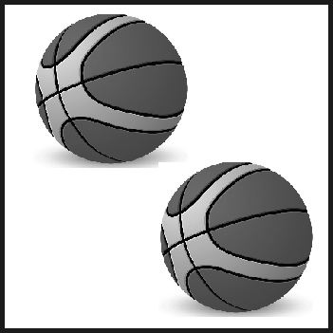
一、根据句意及首字母或图片提示写单词。
1．____ you know him?
2．I ______ a ping­pong bat.
3．—Where is my soccer_____?
—It's under the bed.
4．She has a____________
Do
have
ball
volleyball
5．They have two__________
basketballs

Slide 5
二、用do的适当形式填空。
6．—____ you have a tennis ball?
—Yes，I ___．
7．—______ Jim have a ping­pong bat?
—No，he _______．
8．—______ your brother have an MP4?
—Yes，he ______．
9．—____ they have a new TV?
—Yes，they ___．
10．—____ you have a computer?
—No, we ______．
Do
do
Does
doesn't
Does
does
Do
do
Do
don't

Slide 6
三、单项选择。
B
B
C
B
C
11.______ they have a soccer ______？
A．Do，balls B．Do，ball C．Does，ball
12．They ______ a good model plane.
A．are B．have C．has
13．—Do ______ have a red pen?
—Yes，I do.
A．he B．she C．you

Slide 7
14．—Do you have a volleyball?
—______．
A．Yes，I am B．Yes，I do
C．Yes，I don't
15．We ______ five basketballs.
A．have not B．doesn't have
C．have

Slide 8
四、按要求完成句子。
16．I have a math book.(改为否定句)
I _______ _______ a math book.
17．Jim has a soccer ball.(改为一般疑问句)
______ Jim _____ a soccer ball?
18．Do they have watches？(改为单数形式)
_____ he _____ a_______ ?
19．Do Jim and Bill have a TV？(作否定回答)
No，_____ ______．
don't
have
Does
have
Does
have
watch
they
don't

Slide 9
20．Do you have a radio？(作否定回答)
___，___ _____ ．
21．Do they have a tennis bat？(作肯定回答)
____，____ ____．
22．My volleyball is under_the_bed．(对画线部分提问)
______ is _____ volleyball?
No
I
don't
Yes
they
do
Where
your

Slide 10
五、从方框中选答语。
C
F
D
E
B
A
23．Do you have a basketball?
24．Is this your baseball?
25．What's in the box?
26．Do they have a volleyball?
27．Are these your soccer balls?
28．Where is my tennis ball?

Slide 11
A．It's on the desk.
B．No，they aren't. They're Tom's.
C．No，I don't.
D．Three tennis bats.
E．Yes，they do.
F．Yes，it's mine.

