Slide 1
Unit 4 What's the best movie theater?
Section A (Grammar Focus-3c)
WWW.PPT818.COM

Slide 2
Read Grammar Focus and then complete the chart.
________________________________________________ (可以去的最好的影院是那家？) | Town Cinema.____________________ _______________________________________________________ ( 它离家最近，并且你能最快地买到票。)
_____________________________________ (镇上最差的服装店是那家？) | Dream Clothes. It is ________ (差) than Blue Moon. It has ___________ (最差) service.
What do you _________ (认为) 970AM? | I think 970AM is pretty ______ (差). It has the worst music.
What's the best movie theater to go to?
It's the closest to home.
And you can buy tickets the most quickly there.
Which is the worst store in town?
worse
the worst
think of
bad

Slide 3
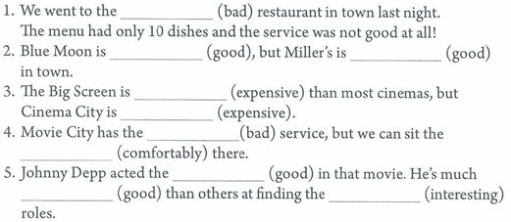
Fill in the blanks.
worst
good
best
more expensive
the most expensive
worst
most comfortable
the best
better
most interesting

Slide 4
Think of three stores in your town. Fill in the chart. Then writen sentences using the information in the chart.
Service | best: | worst:
Quality | best: | worst:
Price | cheapest: | most expensive:

Slide 5
Think of three restaurant near your home. Fill in the chart. Then talk in your group and choose the best one.
Restaurant | Danny's
How much is a meal?
How far is it from your home? | 10 minutes by bus
Is the service good?
Is the food good?

Slide 6
小结训练
1）Dick sings ______, she sings _______ than John, but Mary sings the _______ in her class. (well)
2）He is _______ at learning math. He is much _______ at Chinese and he is the ________ at English.(bad)
3）Annie says Sally is the _______ (kind) person in the world.
4）The white flower is ________ . The yellow flower is _____________ than the white flower. The red flower is _________________ of the three. (beautiful)
5）He is __________ than any other boy in the class.(clever)
well
better
best
bad
worse
worst
kindest
beautiful
more beautiful
the most beautiful
cleverer

Slide 7
最高级常用到的句型：
1）特殊疑问词 + be + the + 最高级，A, B, or C?
eg. Which city is the most beautiful, Beijing, Shanghai or Fuzhou?
你最喜欢哪个城市，北京，上海还是福州？
2）主语 + be + 序数词 + 最高级 + 名词单数 + 表示范围的短语。
eg. The Yellow River is the second longest river in China.
黄河是中国第二长的河流。
3）主语 + be + one of + the + 最高级 + 复数名词 + 表示范围的短语。
eg. She is one of the tallest girls in her calss.
她是班上最高的女孩之一。

