Slide 1

Module
5
Look after yourself
Unit 2 Get off the sofa!
WWW.PPT818.COM

Slide 2
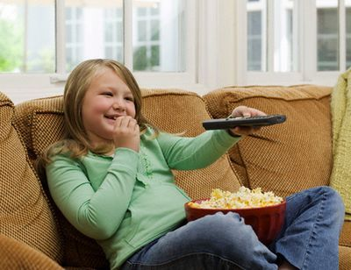
Warming up
Do you like sitting on the sofa and watching TV?

Slide 3
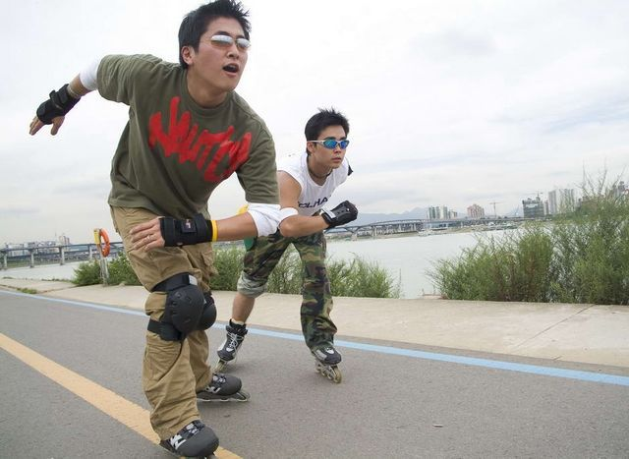
Do you like doing exercise every day?

Slide 4
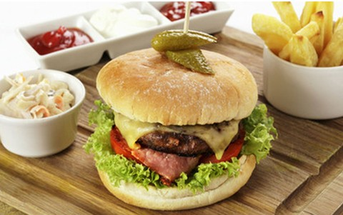
Do you often eat fast food?

Slide 5
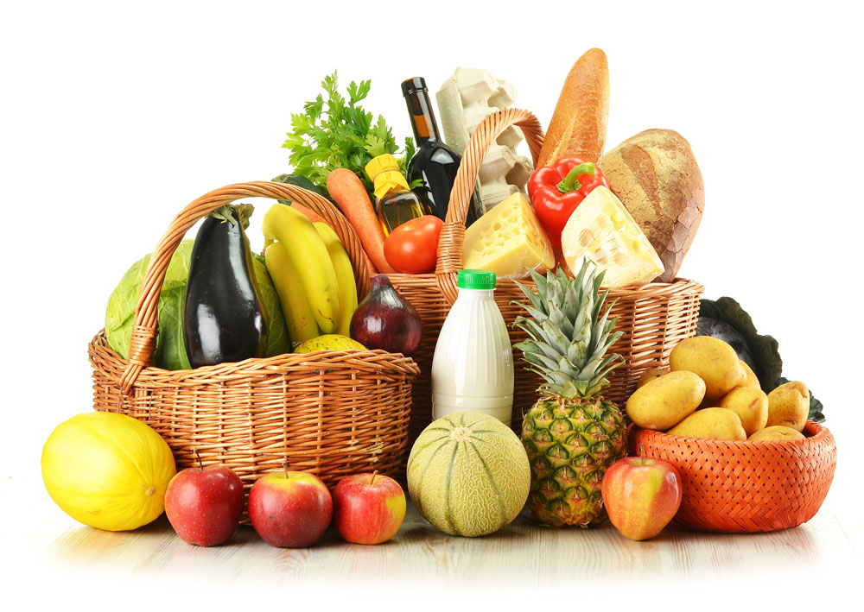
Do you often eat fruit and vegetables?

Slide 6
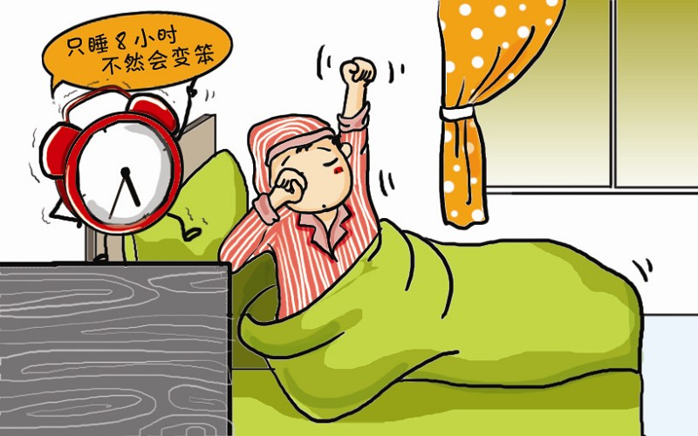
Do you have eight hours’sleep a night?

Slide 7

Do you talk to your parents or your teacher when you are in trouble?

Slide 8
New words
thanks to 多亏; 归功于
health care 医疗保健(服务)
expect v. 预料; 预计
require v. 需要
physical adj. 身体的; 体力的
effort n. 力气; 精力
once in a while 偶尔; 有时; 间或
harm v. 损害; 伤害

Slide 9
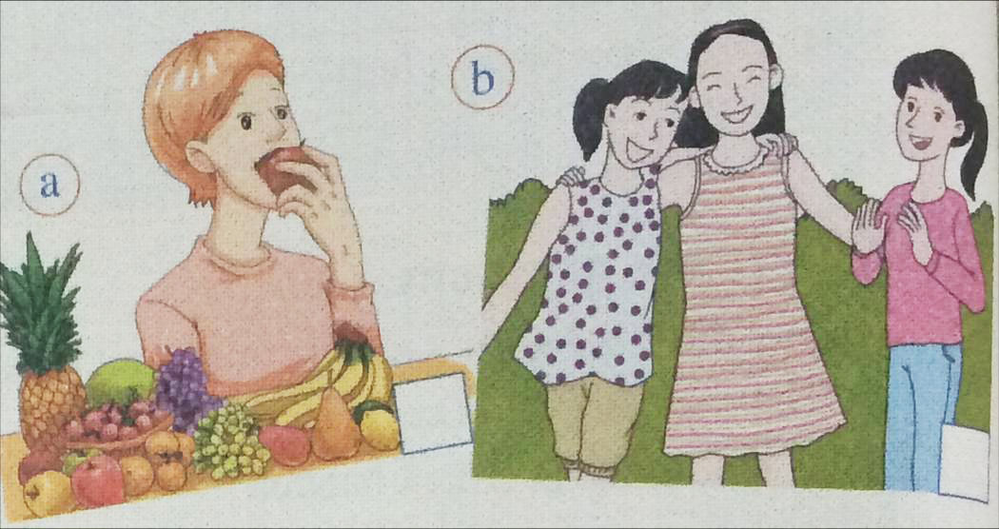
1. Look at the pictures. What do the pictures tell you?

Slide 10
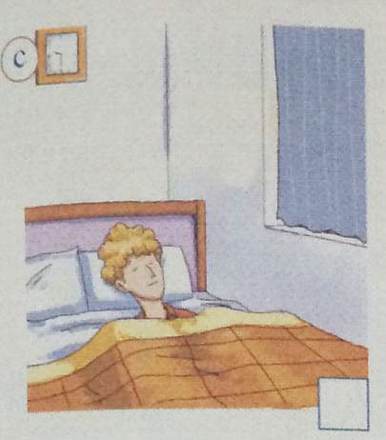
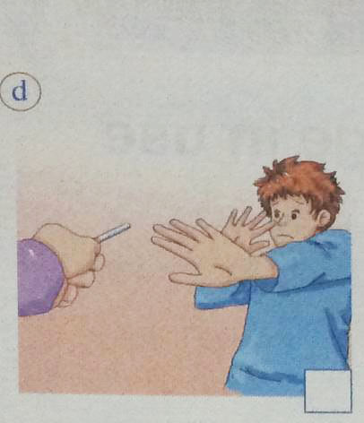
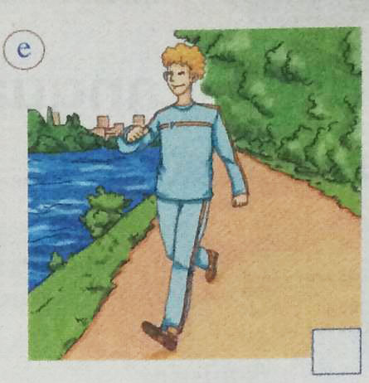

Slide 11

Listen to the passage and answer the questions.
1. Do people live longer than before?
Yes, they did.
2. Is eating fruit and vegetables good
for your health?
Yes, it is.

Slide 12

Watch and read

Slide 13

Read the passage and answer the questions.
Five rules for a healthy life
Thanks to better health care, most people are living healthier and longer lives. Someone who is born today can expect to live about thirty-five years longer than someone who was born in the nineteenth century. It is even thought that in the future more and more people will celebrate their hundredth birthdays. Here are five rules for a healthy life.
be born in 出生在
in the future 将来

Slide 14
be comfortable to do sth. 做某事是舒服的
1 Get off the sofa!
Sure, it is comfortable to sit on the sofa and watch TV. But doctors say you should get off the sofa. To keep fit, you have to walk at least 10,000 steps every day. In the past, people's job required more physical effort. They often had to walk for miles every day. When farmers were working in the fields, they were keeping fit at the same time. Think about it: Do you get the same amount of exercise today as they did in the past?
get off 下车，离开，出发
in the fields 在田野中，在某方面
at the same time 同时

Slide 15
2 Eat healthy food
It is important to eat food that is fresh and natural, for example, fruit and vegetables. Fast food is not healthy. You should only have it once in a while. Eating too much of the wrong food will harm your health.
3 Rest while you can!
When we were babies, we slept for much of the night. Teenagers do not need as much sleep as babies, but it is important for you to get about
跟在名词后的从句叫做定语从句
for example 例如
it is important to do sth. 做某事是重要的
it is important for sb to do sth.对某人来说做某事是
重要的。

Slide 16
at weekends 在周末
eight hours' sleep a night. At weekends, you have got more time, so use it not just for your friends, but for rest too.
4 Do not worry. Be happy!
Many people believe that happiness is important for our general health. Sometimes it is not easy to be a teenager because of the difficulties of school, exams or friendships. If you are worried about something, talk to your parents or your teacher.
eight hours' sleep 八小时的睡眠
跟在谓语后的从句叫做宾语从句
be (not) easy to do sth. 做某事（不）容易
be worried about 为.....担忧，烦恼

Slide 17
5 Say no to smoking!
Yes, you knew I was going to say this! It is so important. Smoking is not cool. It is dangerous. It harms nearly every part of your body. Think about how your family and friends will feel, and think about what it will do to your health.

Slide 18
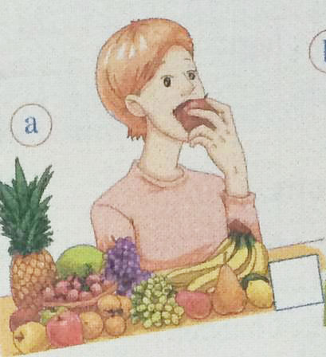
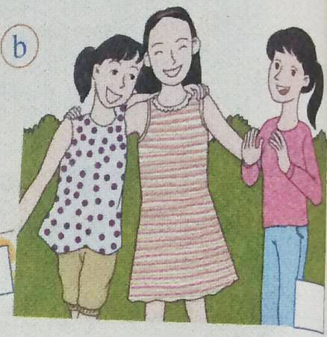
2. Read the passage and match the rules with the pictures.
2
4
3
5
1

Slide 19
3. Read the passage again and answer the questions.
1. What are the five rules for a healthy life according to the writer?
Get off the sofa!
Eat healthy food!
Rest while you can!
Do not worry. Be happy!
Say no to smoking!

Slide 20
2. Are people today getting the same amount of exercise as they did in the past? Why?
No, they aren’t. Because in the past, people’s jobs required more physical effort.
3. Why is it sometimes difficult to be a teenager?
Because of the difficulties of school, exams or friendships.

Slide 21
4. Who do you think the passage is written for?
It is written for teenagers.

Slide 22

Complete the passage with the words in the box.
effort expect harm health sofa
Exercise is very important. If you make a(n) (1) _____ to do exercise for thirty minutes a day, you can (2) _______ to be in good (3) ______. However, if you are always sitting on the (4) _____ and do no exercise at all, you will put on weight and (5) ______ your health.
effort
expect
health
sofa
harm

Slide 23

1. Thanks to better health care, most people are living healthier and longer lives.
多亏了更好的医疗服务, 现在大多数人都 能生活地更健康, 寿命更长。
thanks to+名词/动词ing, 表示“多亏, 归 功于”。

Slide 24
e.g. I made much progress thanks to his help.
多亏有他的帮助, 我才有这么大的进 步。
health care表示“医疗服务”。
e.g. Old people can get good health care in
our neighbourhood.
我们小区的老人能得到好的医疗服
务。

Slide 25
2. Someone who is born today can expect to live about thirty-five years longer than someone who was born in the nineteenth century.
今天出生的人期望能比19世纪出生的人多活大约35年。

Slide 26
expect to do sth.表示“预料做某事, 预计
做某事”。
e.g. We expect to get more gold medals
in the coming Olympic Games.
在下一届的奥运会上我们预期要拿
更多的金牌。

Slide 27
3. To keep fit, you have to walk at least
10,000 steps every day.
为了保持健康, 你每天必须要走至少
10000步。
keep fit 表示“保持健康”。
e.g. She tries to keep fit by jogging
everyday.
她每天慢跑以保持健康。

Slide 28
4. In the past, people’s jobs required more
physical effort.
在过去, 人们的工作需要更多的体力。
require表示“需要”。
require + n./ to do sth./doing sth./that从句
e.g. Theses pets require a lot of care.
这些宠物需要悉心照顾。
The situation requires that he be
present.
这种情形需要他在场。

Slide 29
5. You should only have it once in a while.
你可以偶尔吃一次。
once in a while表示“偶尔, 有时, 间或”。
e.g. He went to see them once in a
while.
他偶尔去探望他们。

Slide 30
6. Eating too much of the wrong food will
harm your health.
吃太多不合适的食物会损害你的健康。
harm v./n. 表示“损害, 伤害”。
do harm to … 表示“对……造成伤害”。
e.g. Be careful, or the sharp stone may
harm your foot.
当心点, 否则那尖锐的石头会伤到你
的脚。

Slide 31
7. Say no to smoking!
拒绝吸烟！
say no/yes (to…) “(向……说) 不/行”。
e.g. Their offer was so good that I couldn’t
say no.
他们提出的条件太好, 我无法拒绝。
Did you say yes to her invitation?
你接受她的邀请了吗？

Slide 32


Slide 33
5. Read the passage again. Think of one more example of what you should or should not do for each rule.
Doctors say you should exercise for at
least half an hour each day.

Slide 34
6. Think of more rules and examples of your own.
Eat more vegetables and fruit and less meat or fat
Drink more water instead of coke or other unhealthy drinks
Learn to relax ourselves
Sleep early at night and get up early in the morning
Do regular exercises, such as running or playing badminton

Slide 35
7. Write a passage called My rules for a healthy life.
Include the rules and examples you have written in Activity 5 and 6.

Slide 36
Exercises
1. His life was saved ___ better medical
technology.
A. thank to B. thanks to
C. thank for D. thanks for
2. Our parents _____ us to get higher
education.
A. worry B. believe C. expect D. harm
B
C

Slide 37
3. We face the same difficulty ____
everyone does in the beginning of the
business.
A. for B. to C. as D. with
4. Everyone should ______ drinking when
driving.
A. say no to B. say yes to
C. say hello to D. say thanks to
C
A

Slide 38

Finish the written task.

Slide 39


