Slide 1
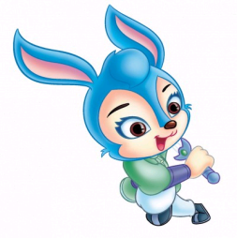

Module 9 Friendship
Unit 3 Language in use
WWW.PPT818.COM

Slide 2
Revision
Language practice
Could you explain what happened then?
Can you tell me how she’s different?
Could I ask if you’ve mentioned this to her?
Do you know why she treats you like that?
I did not know who she was.
I asked her why she smiled at me that day.

Slide 3

The Object Clause宾语从句
宾语从句的引导词
1. 当从句为陈述句时, 用连词 that 引导;
2. 当从句为一般疑问句时, 用 if / whether (但whether可以与or not连用, if不能);
3. 当从句为特殊疑问句时, 用when, where, how, why, who, what 等疑问词引导。
宾语从句的语序
不管是一般疑问句还是特殊疑问句,宾语从句都要用陈述语序。

Slide 4
Match the two parts of the sentences. There may be more than one possibility.
I asked her ...
I do not remember ...
I cannot find out ...
I do not understand ...
I could not decide ...
...when I should call her.
...why he looks worried.
...if she would like to go with me.
...how long he would be away.
...where I met her for the first time.

Slide 5
Complete the conversation with if, what, when, whether or why.
Jo: Hi, Anna. Did you get the invitation to the end-of-term concert?
Anna: Yes, I did.
Jo: Could you tell me (1) __________ you’re going to come?
Anna: Yes, I’d love to.
Jo: That’s great. What about Tony? Do you know
(2) __________ he’s coming?
Anna: Yes, he’s coming. Don’t forget, he’s in the school band.
Jo: So do you know (3) __________ the band will play at the concert?
Anna: Of course! But I don't know (4) ________ they’re playing.
Jo: I think they’re playing first.
if / whether
if / whether
if / whether
when

Slide 6


Anna: Do you know (5)__________ Tony has written a new song for the concert?
Jo: Yes, he told me that he had, but I think it’s a surprise.
Anna: I've heard that Arthur isn’t going to play the piano at the concert. Do you know (6)________?
Jo: Yes. He’s broken his arm.
Anna: Oh dear, that’s terrible!
if / whether
why

Slide 7
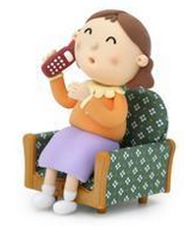
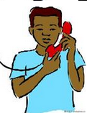
Complete the conversations with the expressions in the box.
I’m afraid you have the wrong number
Can I help you
May I speak to Jack
hold the line
I'll call back later
Jack isn’t there right now
Who’s calling

Slide 8
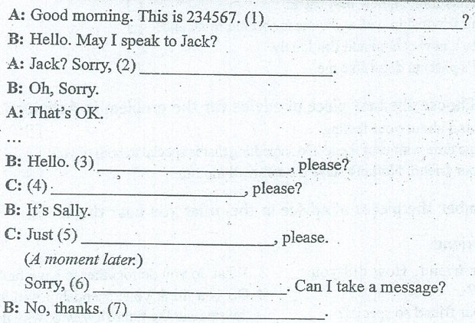
b
a
c
g
d
f
e

Slide 9


Complete the conversation with the words in the box.
    include lonely suggestion trust worried
worried
A: Why are you so (1)___________?
B: I’ m new here and the students in my class don’t
(2) __________ me. I feel so (3) __________. Can you help me?
A: I see. It takes some time before they (4)________ new students
in their circle of friends. My (5) ____________ is: Keep trying to
make friends.
B: OK. I'll try.
trust
lonely
include
suggestion

Slide 10

Complete the passage with the correct form of the word and expressions in the box.
circle of friends
follow
full of
hidden treasure
stay in touch
When my grandmother died, I felt my heart break because I loved her so much. Many dark days (1) _________ when I tried to recover from my loss. She was (2) __________ love for everyone in the family and every piece of advice she gave me was a (3)_______________. She has a wide (4)________________ and they often came to see her. She (5)______________ with them until her last days.
followed
full of
hidden treasure
circle of friends
stayed in touch

Slide 11

Write about a friend.
Describe your friend. How did your friendship start?
What makes your friend so special?
What do you do together to have fun?
Do you think your friendship will stay the same in the future? Why or why not?

Slide 12
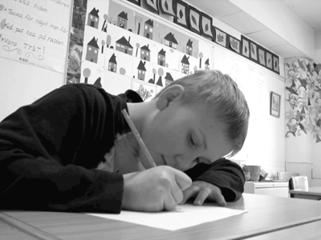
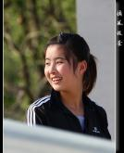
Around the world
Module task:
Making a poster about friendship

Slide 13


Practice
Ⅰ. 填空
1. The teacher asked _______ day yesterday it was.
2. I wondered _________ she was still in China.
3. Nobody knows ________ he will come back to America next year or not.
4.My father told me ______the earth goes around the sun.
what
if/whether
whether
that

Slide 14
Ⅱ. 句型转换
1. Why don’t you go boating on the river? （改为同义句）
______ ______ go boating on the river?
2. My sister is helping my mother wash clothes now.
（用just now替换now）
My sister ______ my mother wash clothes _____ _____.
3. Please tell me, “Why does Sally miss her parents?”
（改成含宾语从句的复合句）
Please tell me ______ ______ _______ ______ _______.
4. I wanted to know, “Is he doing his homework?”
（改成含宾语从句的复合句）
I wanted to know _________ ______ _______ _______ his homework.
Why not
helped just now
why Sally misses her parents
if/whether he was doing

Slide 15
Homework
Write a few sentences about friendship such as “We all need friendship.” and “Our friendship will last forever.”

Slide 16
The world is but a little place, after all.
海内存知己，天涯若比邻。

