Slide 1
Unit7 lesson3
Guo Yang is running.
WWW.PPT818.COM

Slide 2
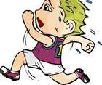
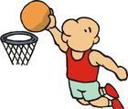
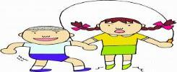
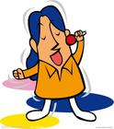
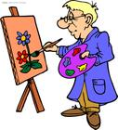
run
play basketball
skip
What are you doing? I'm ing.
sing
draw
read

Slide 3
What are you doing? I'm ing.
What is he doing? He is ing.

Slide 4
What 's she doing?
She's reading.

Slide 5
What 's he doing?
He's playing basketball.

Slide 6
What 's she doing?
She's dancing.
.

Slide 7
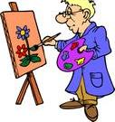
What 's he doing?
He's drawing.

Slide 8
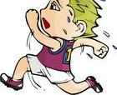
What 's he doing?
He's running.

Slide 9
Today is our sports day.

Slide 10
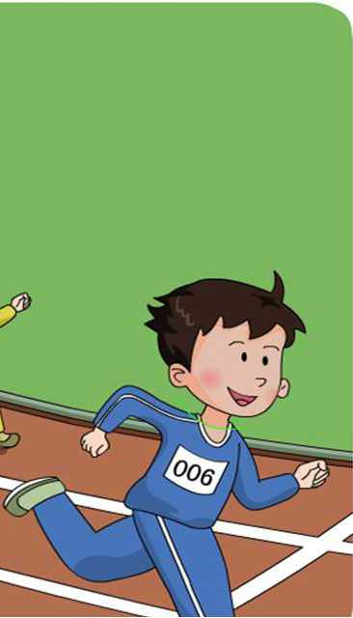
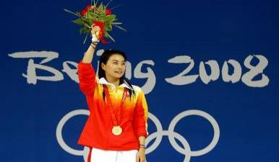
What's Guo Yang doing?
Guo Yang is running.
He is the winner.

Slide 11
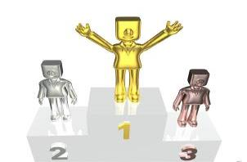
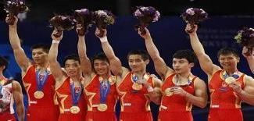
He is the winner.
They are winners.

Slide 12
1.What’s Wang Hong doing?
She’s .
2.What’s Danny doing?
Danny’s .

Slide 13
1.What’s Wang Hong doing?
She’s ( ) .
doing the long jump

Slide 14
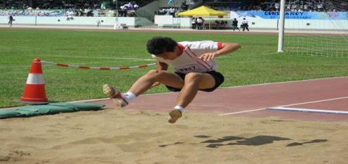
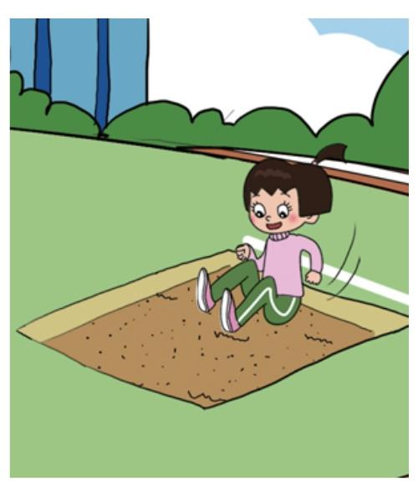
long jump
He’s doing the long jump.
She's doing the long jump.

Slide 15
2.What’s Danny doing?
Danny’s( ) .
doing the high jump

Slide 16
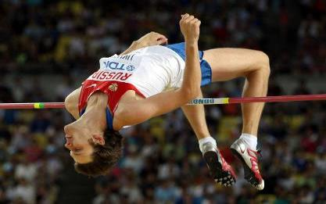
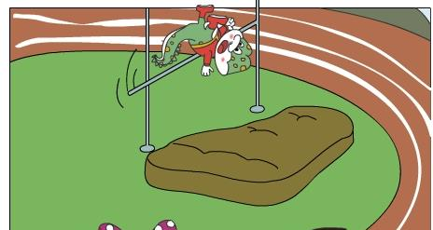
high jump
He’s doing the high jump.
Now,Danny is doing the high jump.

Slide 17
Let’s imitate the text.(仿读）

Slide 18
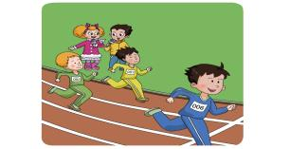
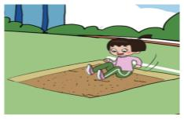
Guo Yang is _____.
He is the winner!
Wang Hong is _______.
Denny is ________.

Slide 19
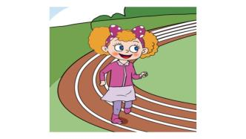
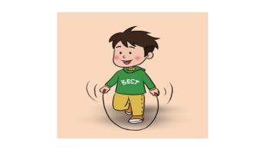
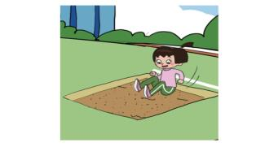
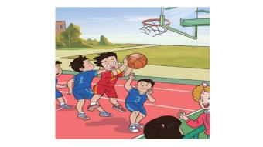
What’s ______doing?
She’s________./ He’s________.

Slide 20
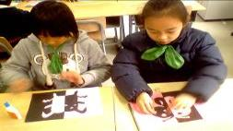
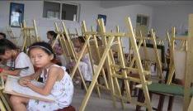
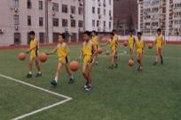
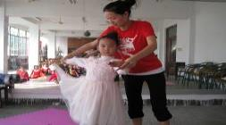
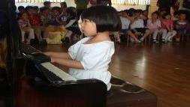
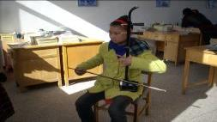
Talk about our school life.
A: What’s she doing?
B: She’s .
A: What’s he doing?
C: He’s .
A: What’s she doing?
D: She’s .
making things
drawing
playing basketball
dancing
playing the piano
playing the erhu

