Slide 1
What colour is it?
第2课时
WWW.PPT818.COM

Slide 2
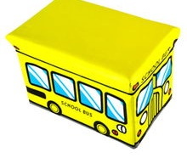
I have a yellow bus.
yellow

Slide 3
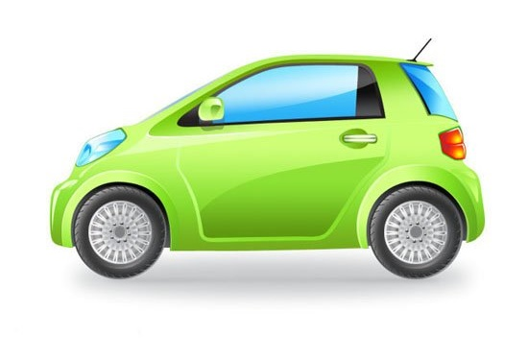
What colour is it?
It’s green.
green

Slide 4
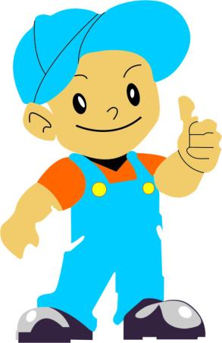
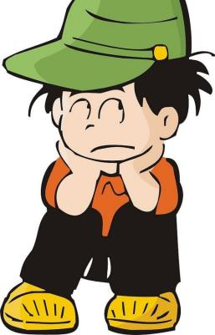
Hi, Gao Wei.
I have a new bus.

Slide 5
Really! What
colour is it?
Guess.

Slide 6
No!
Red?
No, no!
Blue?
No, no, no!
Green?

Slide 7
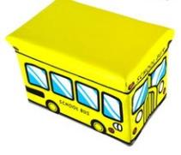
Yellow?
Yes!

Slide 8
Peter: Hi, Gao Wei. I have a new bus.
Gao Wei: Really! What colour is it?
Peter: Guess.
Gao Wei: Red?
Peter: No.
Gao Wei: Blue?
Peter: No, no!
Gao Wei: Green?
Peter: No, no, no!
Gao Wei: Yellow?
Peter: Yes!

Slide 9
Let’s sing
Who is wearing green today?

Slide 10
Homework
1.Sing the song again.
2.Use “What colour is it?” to make a dialogue.

Slide 11
Thank You.

