Slide 1
Unit 6 Time
Lesson 2 It’s time for class.
WWW.PPT818.COM

Slide 2
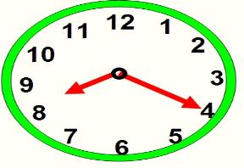
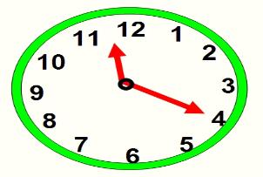
What time is it?
It’s eight twenty.
It’s eleven twenty.

Slide 3
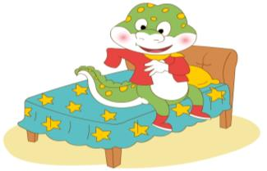
What time is it?
It’s seven o’ clock.
It’s time for get up.

Slide 4
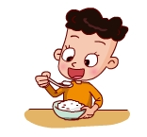
What time is it?
It’s twelve o’ clock.
It’s time for lunch.

Slide 5
Listen and find the times.
说出你听到的时间。

Slide 6
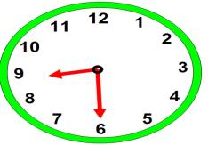
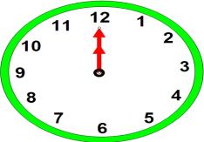
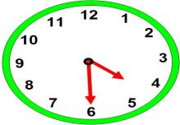
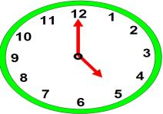
It’s eight thirty.
It’s twelve o’ clock.
It’s four thirty.
It’s five o’ clock.

Slide 7
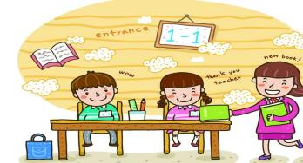
It’s eight thirty.
It’s time for _____ .
class

Slide 8
It’s twelve o’ clock.
It’s time for _____ .
lunch

Slide 9
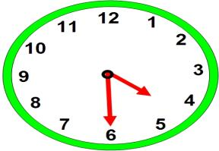
It’s four thirty.
It’s time for _______ .
go home

Slide 10
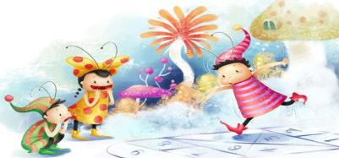
It’s five o’ clock.
It’s time for _____ .
games

Slide 11
Eight thirty, eight thirty.
It’s time for class.
Twelve o’ clock, Twelve o’ clock.
It’s time for lunch.
Four thirty, four thirty.
It’s time for go home.
Five o’ clock, five o’ clock.
It’s time for games.

