Slide 1
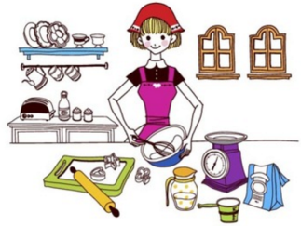
Unit2 I’m Cooking in the Kitchen
陕旅版
四年级下册
WWW.PPT818.COM

Slide 2
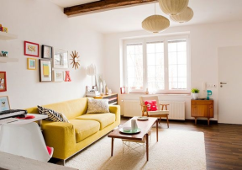
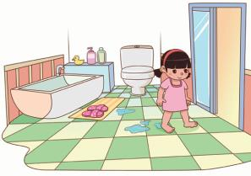
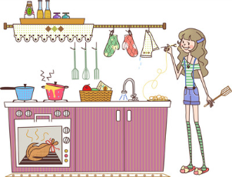
>>Review
Look and say
bedroom
living room
bathroom
kitchen

Slide 3
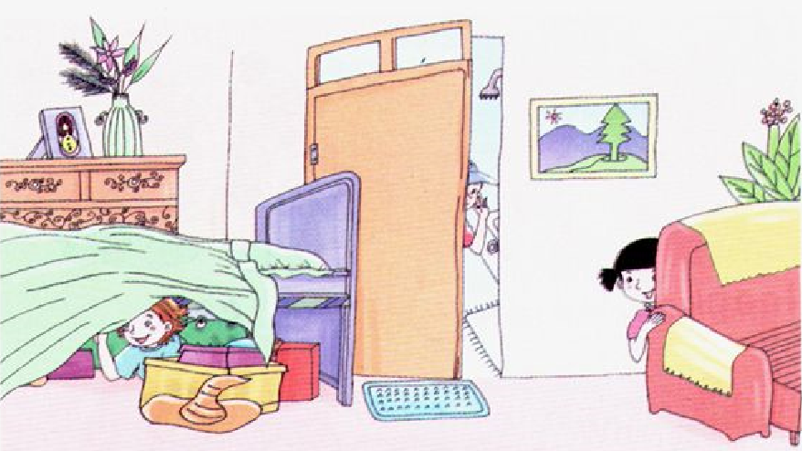
>>Review
Look and find
Where is …?

Slide 4
>>Warm-up
Game 1
句子接龙
I like to…
I like to…
…
I like to…
I like to…

Slide 5
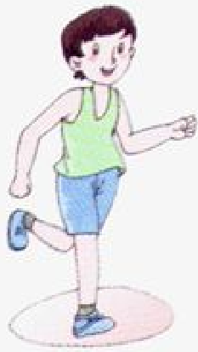
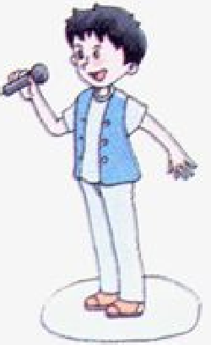
>>Lead-in
Listen and do
Run.
Jump rope.
Dance.
Sing a song.

Slide 6
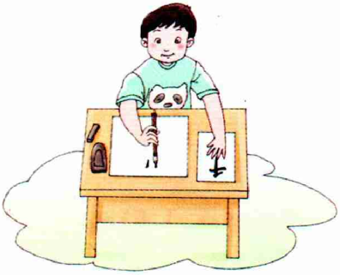
>>Presentation
Let’s learn
read
write

Slide 7
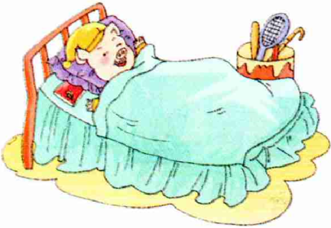
>>Presentation
Let’s learn
sleep
eat

Slide 8
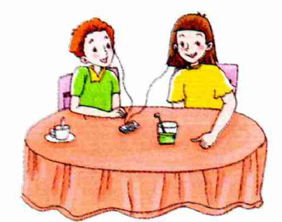
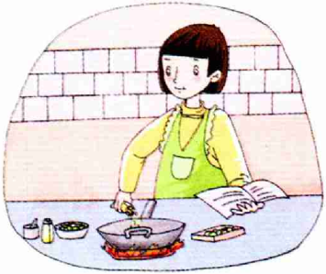
>>Presentation
Let’s learn
listen
cook

Slide 9
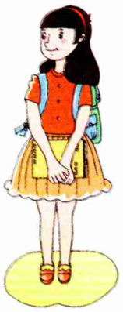
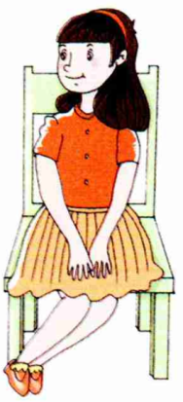
>>Presentation
Let’s learn
stand
sit

Slide 10
>>Practice
read write sleep eat
listen cook stand sit
Magic fingers
Game 2

Slide 11
>>Practice
Look and say

Slide 12
>>Practice
Look and say

Slide 13
>>Practice
活动1
大转盘
read
sit
listen
sleep
cook

Slide 14
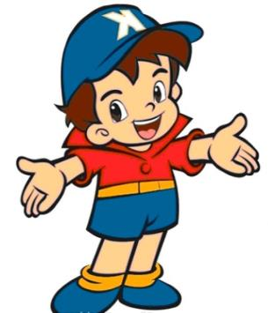
>>Practice
活动2
I say you do
Read!

Slide 15
>>Summary
本课所学的动词单词有哪些？
read write sleep eat
listen cook stand sit

Slide 16
>>Homework
1. 听课文录音并跟读，按照正确的语音、语调朗读并表演课文对话。 2.正确书写本课所学单词5遍，并让家长听写1遍。
3. 预习A Let’s talk。
close

