Slide 1
Unit 3 Lesson 18
Three Kites in the Sky
WWW.PPT818.COM

Slide 2
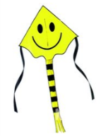
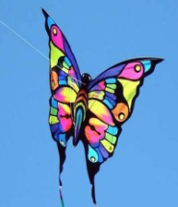
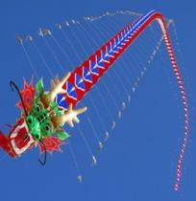
Warm-up
Which kite do you like, why?

Slide 3
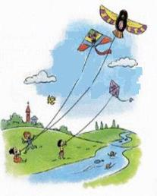
Story time
Fast reading
How many kites are there in the story?
Three.
What are the kites’ name?
Kylie, Karla, Krista.

Slide 4
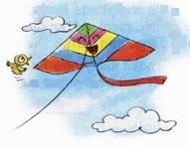
Story time
Intensive reading
Is Kylie a beautiful kite?
Yes, she is.
Will everyone look up at her?
Yes, they will.
Will everyone like her?
Yes, they will.

Slide 5
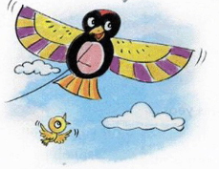
Story time
Intensive reading
Is Karla a strong kite?
Yes, she is.
Can she fly high and fast?
Yes, she can.
Will everyone like her?
Yes, they will.

Slide 6
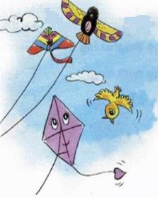
Story time
Intensive reading
Is Krista a beautiful kite?
No, she isn’t.
Can she fly high or fast?
No, she can’t.
Will everyone like her?
No, they will not.

Slide 7
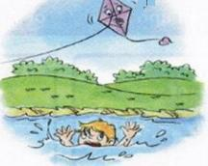
Story time
Intensive reading
What does Krista see?
She sees a boy swimming in the lake.
Does the boy need help?
Yes, he does.
Who helps the boy?
Krista.

Slide 8
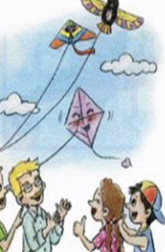
Story time
Intensive reading
Is Krista afraid of water ?
Yes, she is.
Will everyone remember her?
Yes, they will.

Slide 9
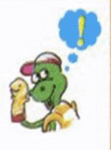
Story time
Intensive reading
What can you learn from the story?
To be a brave and selfless person.
舍已为人

Slide 10
Read the story again and check the words you meet.
second third
tail wind
only remember

Slide 11
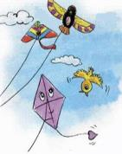
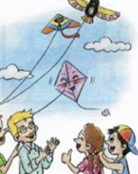
Retell the story
Say something about the pictures.

Slide 12
Summary and evaluation
What have you learned in this class?
A excellent B good C adequate D need improvement
内容 | 学生自评 | 小组互评
我能认真听老师讲课，听同学发言
遇到我会回答的问题主动举手了
活动中坚持使用英语来交际
我能积极参与小组讨论活动，能与他人合作。

Slide 13
Homework
Try to retell the story.

