Slide 1
Unit 1 Friends
Grammar
WWW.PPT818.COM

Slide 2
Who is the cleverest?
My brother is fourteen.
I am four years older than he.
My father is twenty-six years older than I.
My mother is two years younger than my father.
How old is my mother?
Key: Forty-two

Slide 3
Comparatives and superlatives
比较级与最高级

Slide 4
Practice1
large thin
easy good
nice bad
pretty beautiful
big important
many happy
larger
largest
thinner
thinnest
easier
easiest
better
best
nicer
nicest
worse
worst
more beautiful
prettier
prettiest
most beautiful
more important
bigger
biggest
most important
more
most
happier
happiest

Slide 5
close slim wide early fine
sad bored hot much cheerful
tidy funny little far generous
归类：1) “e”结尾：+r , +st_______________________________
2) “y”结尾：y变i +er , +est_____________________________
3) 双写：双写最后字母+er , +est_________________________
4)多音节或部分双音节: more+… , most+…
_____________________________________________________
5)不规则：牢记！________________________________________
close wide fine
early tidy funny
slim sad hot
bored cheerful generous
much little far

Slide 6
the rules
We use comparatives (比较级) to compare（比较）______________________________.
We use superlatives （最高级） to compare （比较）_______________________________.
We put __________ after the comparatives (比较级).
We put _____________ before the superlatives （最高级）.
两者之间比较
三者或三者以上比较
than
the

Slide 7
Practice2
hers
mine
His
more than
1. His rice is ________________ hers .
more than
2. Her rice is ________________ mine.
3. His rice is ________________ of all .
the most

Slide 8
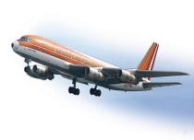
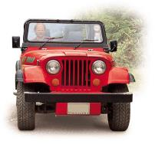
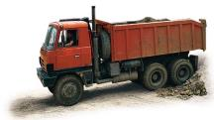
truck
plane
jeep
1. A plane is ____________ a jeep .
faster than
2. A jeep is ____________ a truck .
faster than
3. A plane is ____________ of all /of the three .
the fastest

Slide 9
￥2.5
￥2
￥2.5
￥1
mine
his
yours
1. My tomatoes are ___________________ yours.
more expensive than
more expensive than
2. His tomatoes are ___________________ mine.
the most expensive
3. His tomatoes are ___________________ of all .

Slide 10
Daniel
Kitty
Millie
1. Millie is ____________ Kitty.
taller than
taller than
2. Kitty is _____________ Daniel.
the tallest
3. Millie is _____________ of all. /of the three .

Slide 11
Consolidation
Comparatives and superlatives 形容词比较级和最高级用法

Slide 12
Who is ______ than you at singing in your family?
A. good B. well C. better D. best

Slide 13
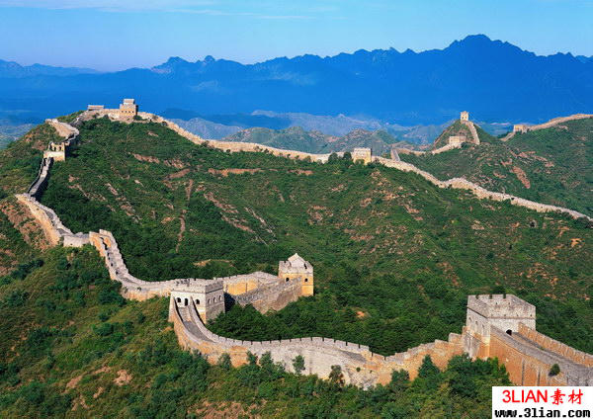
The Great Wall is ___________wall in the world.
the longest
(long)

Slide 14
我要买商店中最贵的打印机。
I’d like to buy ______ ______ _______
printer in the shop.
the most expensive

Slide 15
English is ____ for me to learn than maths.
easy B. easier
C. the easier D. easiest.

Slide 16
You are a lucky dog!
Congratulations!

Slide 17
I am so sorry!
You are not so lucky!

Slide 18
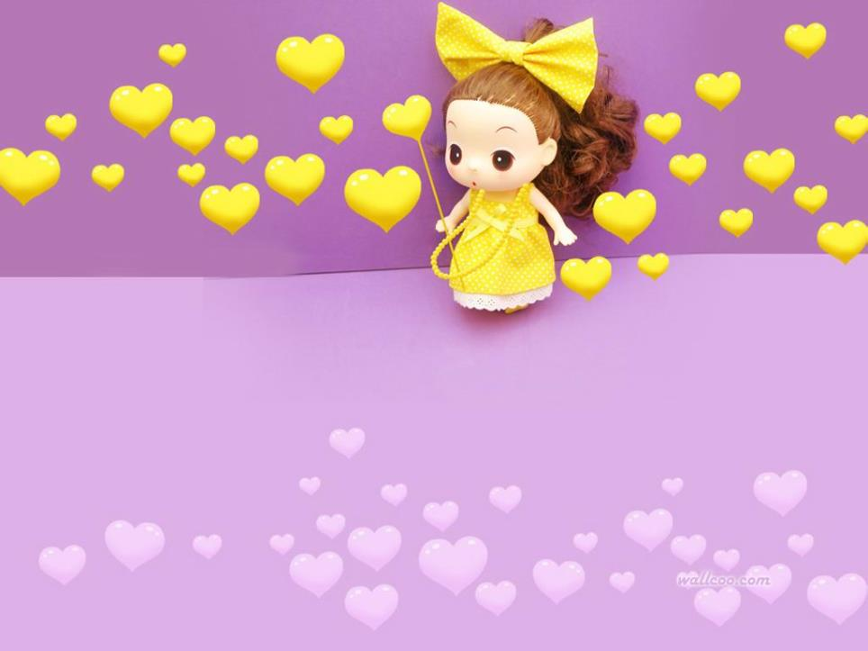
1.Preview comparatives and superlatives.
2.Finish the exercises.
Homework

