Slide 1
Unit 3
Healthy or unhealthy
WWW.PPT818.COM

Slide 2
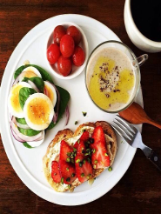
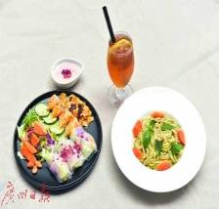
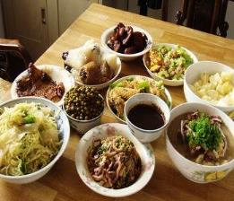
How many meals are there in a day？
breakfast
lunch
supper/dinner

Slide 3
Do you have breakfast?
---Yes, we/I do.
What did you have for breakfast this morning?

Slide 4
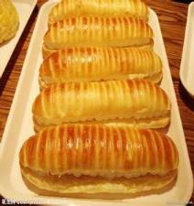
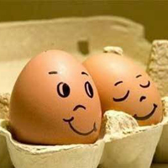
healthy

Slide 5
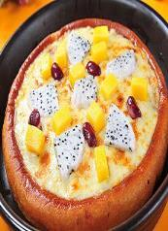
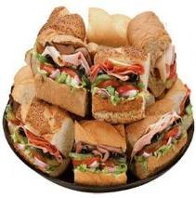
pizza
hamburger
sandwich

Slide 6
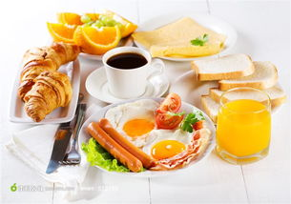
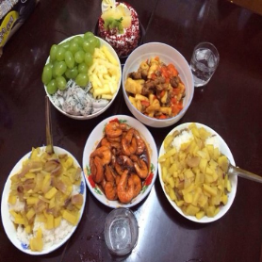
what did you have for breakfast this morning?
----I had...

Slide 7
1. what did Joe have for breakfast?
2. what did Alice have for breakfast?
3. what did Jill have for breakfast?

Slide 8
• a lot of / some（修饰可数名词和不可数名词）
eg：I have some/ a lot of bread.
I have some/ a lot of apples.
• a little （用于肯定句中,修饰不可数名词）
eg: There is a little water in the glass.
• many (修饰可数名词)
eg: He eats many vegetables every day.
• too much 太多的......（修饰不可数名词）
eg：Do not drink too much water in the evening.
• much too非常，太......
eg: It is much too cold.

Slide 9
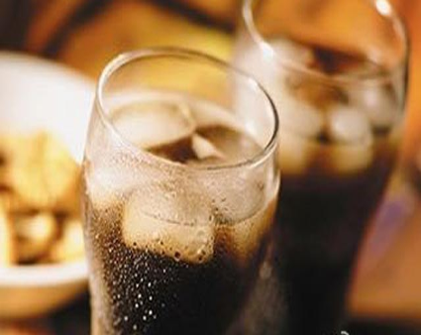
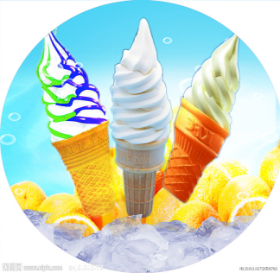
exercises
You can have a little_____, but not too much.

Slide 10
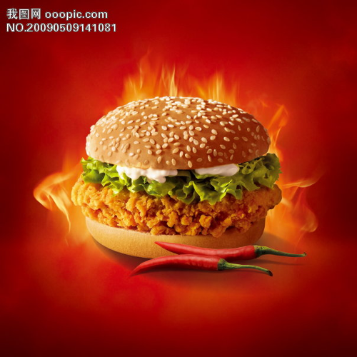
some
You can have ______hamburgers, but not too many.

Slide 11
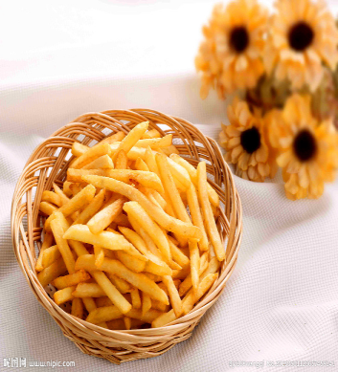
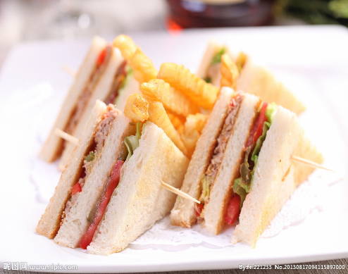
You can have some______, but not too many.

Slide 12
Which is health?

Slide 13
Healthy children eat...
They drink...
Healthy children do not...
Healthy children often...

Slide 14
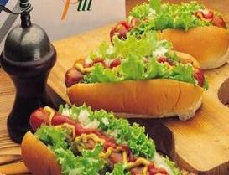
share your book
In America, people like eating hot dogs and a lot of fast food like hamburgers and pizza. I think it is unhealthy.
In Japan, people often eat_____. They also eat a lot of____. I think it is_____.
fish
noodles
healthy

Slide 15
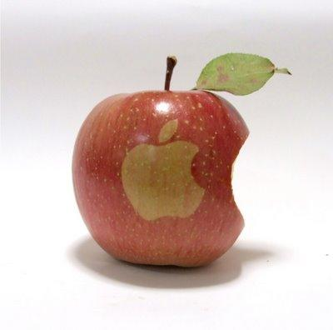
An apple a day keeps the doctor away!

