Slide 1




Module 12 Save our world
Unit 1 If everone starts to do something ,the world will be saved
WWW.PPT818.COM

Slide 2




Tasks
Lead-in
Save our world
Text Study
Assignment
Pronunciation and speaking

Slide 3
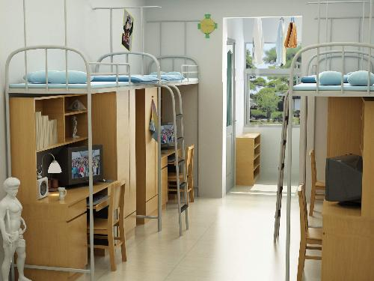
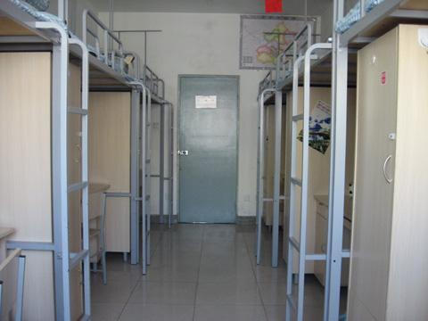
Campus life
Tasks
Lead-in
Text Study
Assignment
Pronunciation and speaking
Freshmen’s dorm

Slide 4
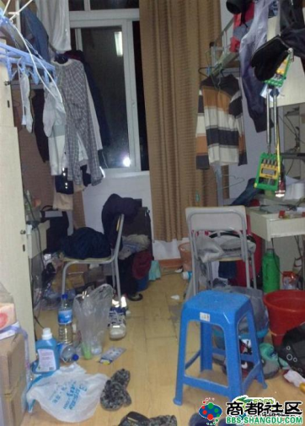
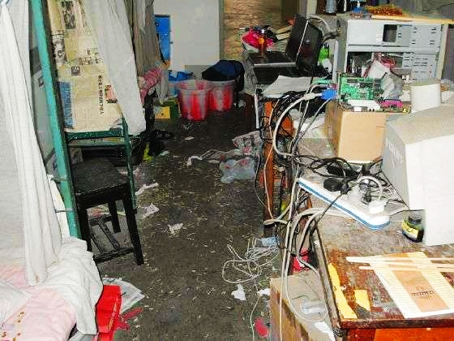
Campus life
Tasks
Lead-in
Text Study
Assignment
Pronunciation and speaking
Four years later…

Slide 5
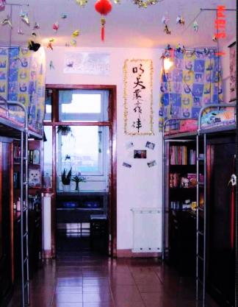

Campus life
Tasks
Before
After
Lead-in
Text Study
Assignment
Pronunciation and speaking
clean & tidy
dirty & messy

Slide 6



A Slideshow
Tasks
Lead-in
Text Study
Assignment
Pronunciation and speaking

Slide 7
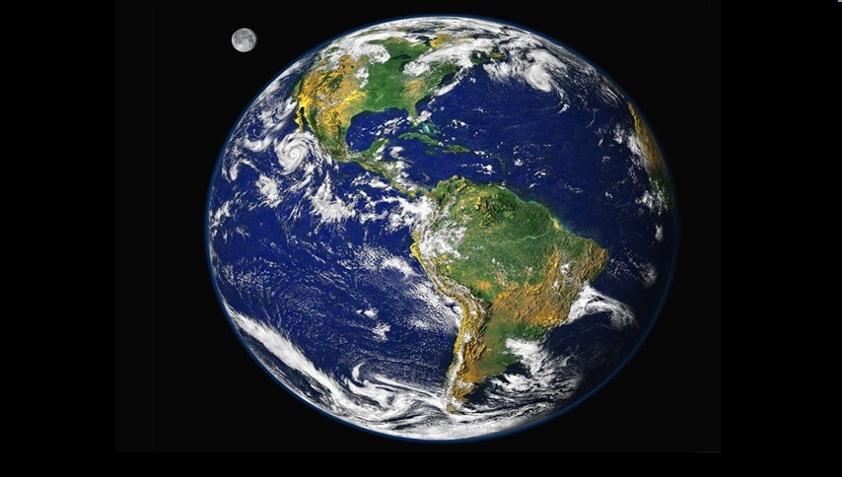
This beautiful planet is the earth—our only HOME.

Slide 8
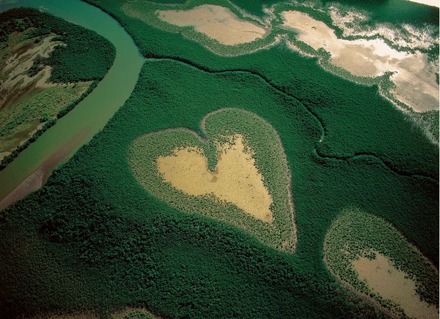
We once lived in a favorable environment.

Slide 9
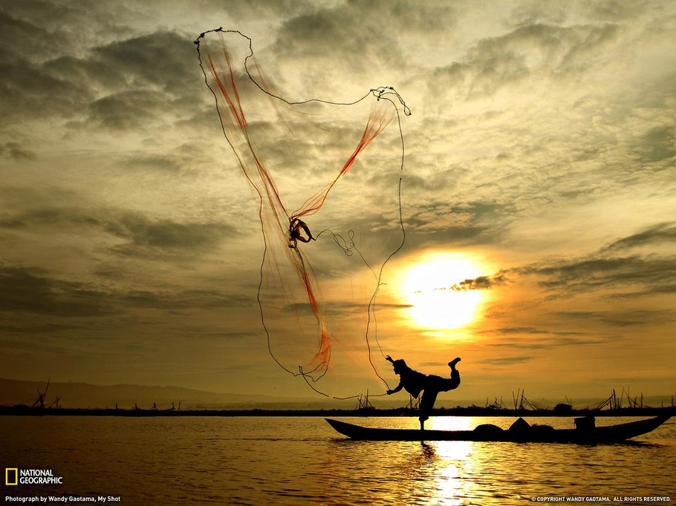
Man and Nature lived in harmony

Slide 10
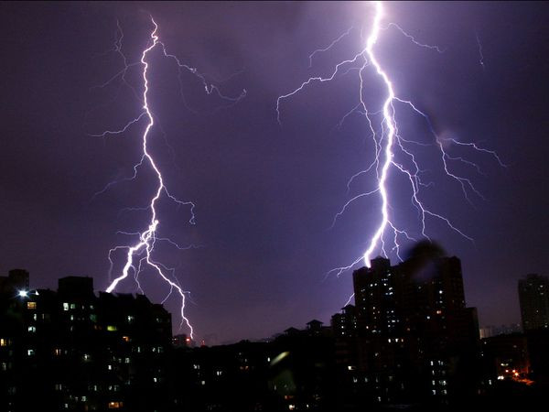
Then a strange blight crept over and everything began to CHANGE.

Slide 11
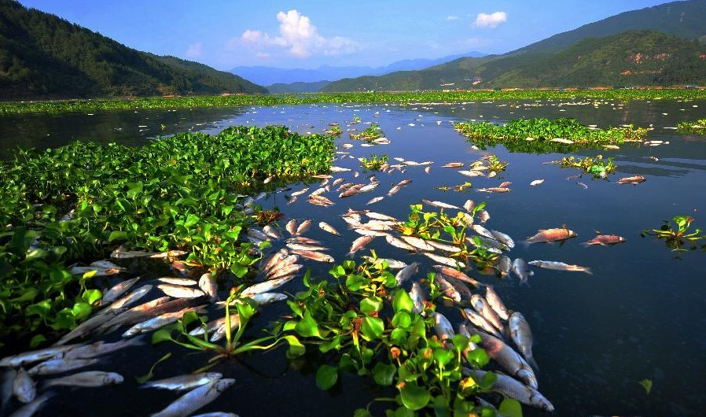
We are now living in a heavily polluted environment.

Slide 12
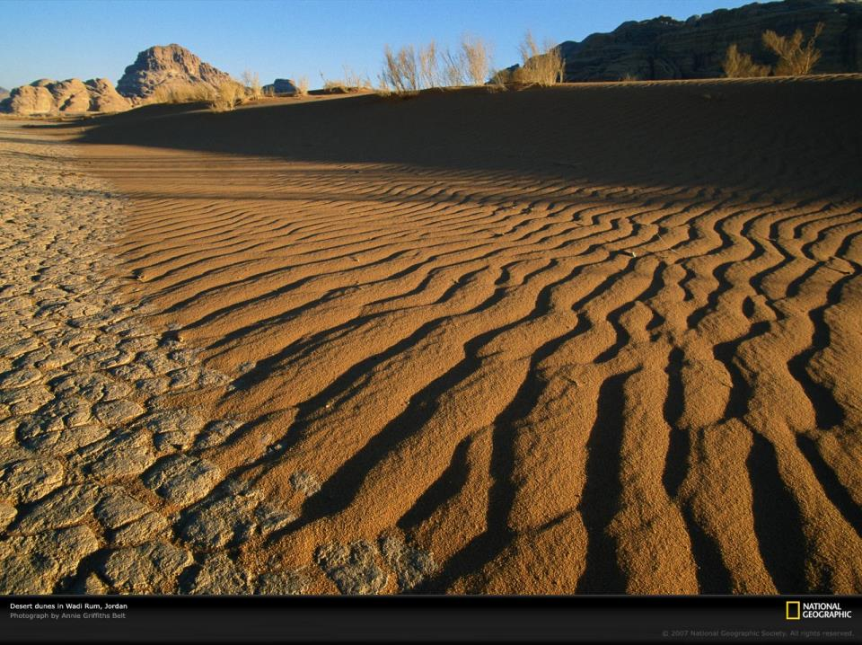
Serious desertification is occurring…

Slide 13
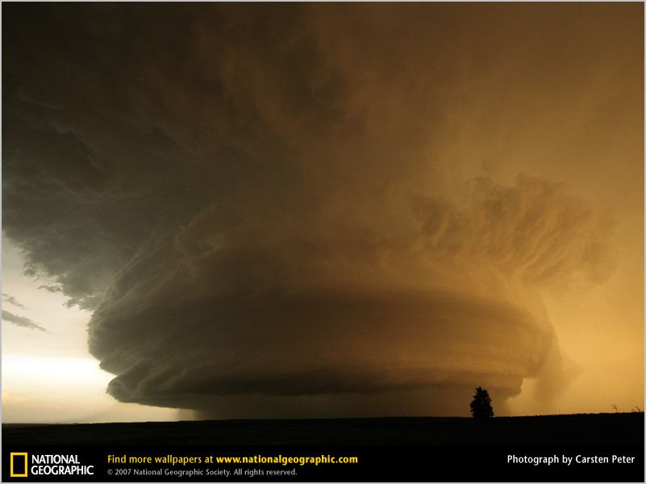
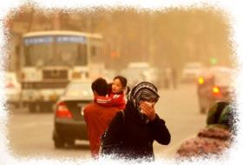
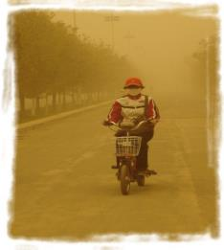
The sky is not clear but dusty.

Slide 14
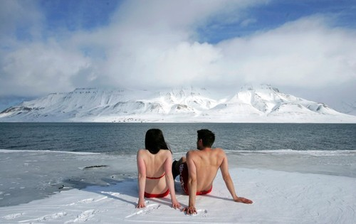
Global Warming & Climate Change become major threats.

Slide 15
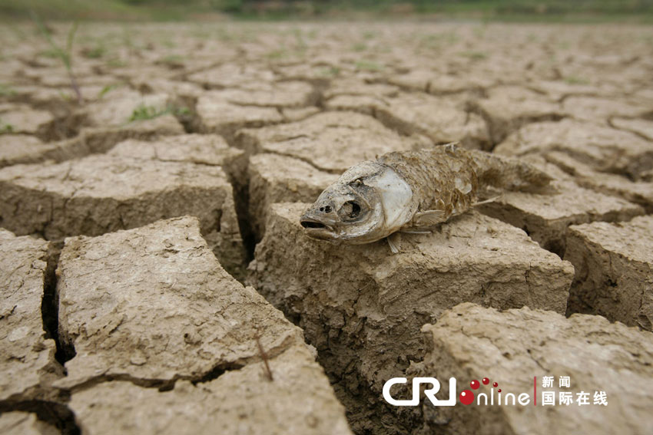
The worst drought in 100 years hit Southwest China.

Slide 16
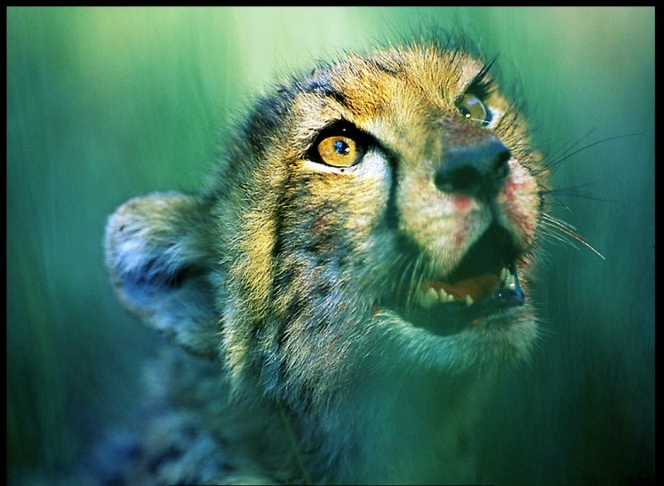
Animals and plants are at risk of becoming extinct.

Slide 17
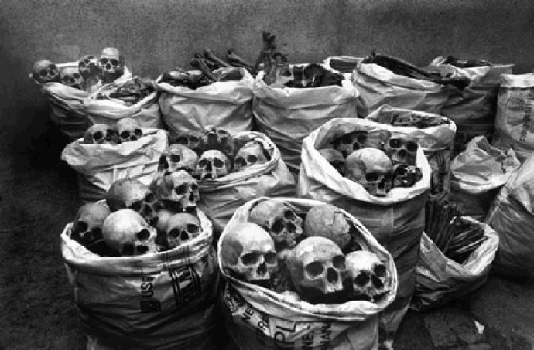
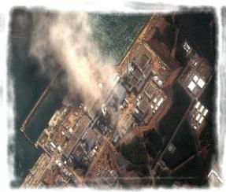
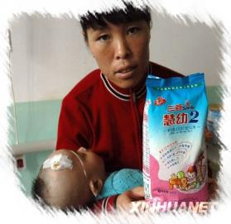
Japan Nuclear Crisis
With massive use of chemicals in some places, there is a shadow of death.

Slide 18
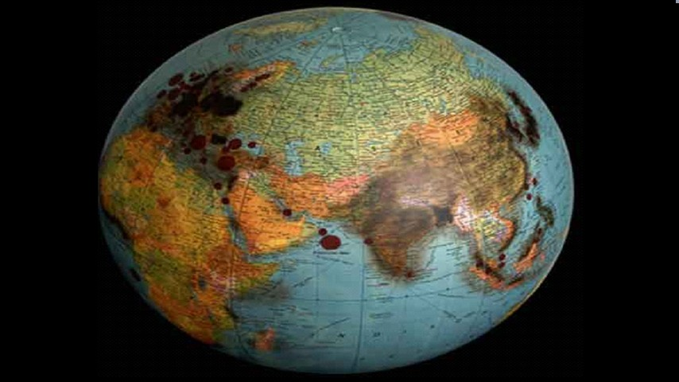
We are harming our planet in so MANY ways.

Slide 19
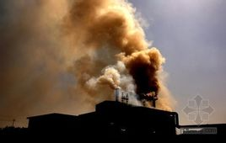
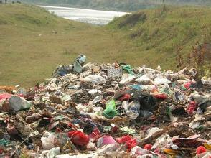
Work in pairs . Look at the pictutres and talk about them . Use the words in the box to help you.
Tasks
factory pollute recycle waste
Lead-in
Text Study
Assignment
ponunciation and speaking

Slide 20


Listen and complete the sentences
Tasks
Lead-in
1. The factory is causing a lot of _____.
2. There should be some ____to stop the pollution.
3. We can ____waste products ,such as___and paper in a recycling centre.
pollution
rules
Text Study
recycle
glass
Assignment
ponunciation and speaking

Slide 21
If everone starts to do something ,the world will be saved
Tasks
Lingling: After our lesson on the environment, I’m worried about the future. Pollution is our great enemy, and we have to fight it. If the rivers are polluted, farmers can’t use the water for their crops.
Tony: And in some places, pollution from factories spreads over cities and villages. It makes people ill, and may even kill them. Pollution is a danger to our health.
Betty: And there are so many cars on the roads. They use so much oil and cause pollution as well.
Lead-in
Text Study
Assignment
ponunciation and speaking

Slide 22
If everone starts to do something ,the world will be saved
Tasks
Daming: But we’re only students. We can’t do anything about factories and cars.
Betty: It’s no use talking about things we can’t do. we’ve got to think of things we can do!
Daming: Such as …?
Lingling: Do you think we can make our school a green school?
Daming: What’s a green school?
Lingling: At a green school, every class collects waste which can be recycled or used again. Then the school sells the waste and uses the money to help students in poor areas.
Lead-in
Text Study
Assignment
pronunciation and speaking

Slide 23
If everone starts to do something ,the world will be saved
Tasks
Daming: Nice idea!
Betty: Students at a green school also learn ways to save energy and recycle at home. That means less waste.
Tony: That’s a good idea. Though pollution is heavy now, I don’t think it’s hopeless. If everyone starts to do something, the world will be saved.
Lead-in
Text Study
Assignment
ponunciation and speaking

Slide 24
Now complete the notes.
Tasks
Pollution problems
Lead-in
farmers can't use them
to water their crops
Text Study
1. If the river are polluted ,_______________________
________________________.
2. In some places ,pollution from factories ______________________________________________.
3. The cars on the roads__________________________
________________.
spreads over cities and villages
use so much oil and
cause pollution
Assignment
ponunciation and speaking

Slide 25
Now complete the notes.
Tasks
What the students can do
Lead-in
collects waste
recycled or used again
sells the waste
in poor areas
Text Study
4. Supports a green school : every class _____________
which can be _____________________.Then the school
_________________to help students ________________.
5. Students learn ________________________________.
That means _______________.
ways to save the energy
less waste
Assignment
ponunciation and speaking

Slide 26
Complete the passage with the correct form of the words in the box.
Tasks
cause enemy factory kill oil pollute spread
enemy
Lead-in
Pollution is our great (1)______.Pollution from (2)_______is a danger to health ,and may even (3)________people .Factories sometimes (4)__________the rivers ,and farmers cannot use the water for their crops .Pollution(5) ______over cities and villages ,and that (6)_________even more danger .Cars use a lot of (7)________and cause pollution too.
factories
kill
Text Study
pollute
Assignment
spreads
causes
ponunciation and speaking
oil

Slide 27


Fun with English: “Clean & Green”
Tasks
Lead-in
Paper
Text Study
Plastic
& metal
Glass
Assignment
Compost
Pronunciation and speaking

Slide 28

Listen and mark the words which the speakers links .
Tasks
1. After our lesson on the environment ,I 'm worried about the future .
2. Students at a green school also learn ways to save energy and recycle at home .
Lead-in
Text Study
Assignment
Now listen again and repeat
ponunciation and speaking

Slide 29
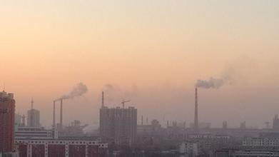
Listen and mark the words which the speakers links .
Work in pairs .List the pollution problems in your place . Choose one problem and say what should be done about it .
Tasks
Lead-in
Text Study
Assignment
ponunciation and speaking
---The air pollution inour city is getting worse.What can we do to stop?
---I think we can ride our bicycles to school more.

Slide 30
Summary
The changing global environment
Words for describing the environment
What
have
we
learnt?
Text understanding
Ways to develop the paragraphs

Slide 31

Homework
Recite the diagoue
homework
Do the exercise book on page 178

