Slide 1
We should obey the rules.
WWW.PPT818.COM

Slide 2
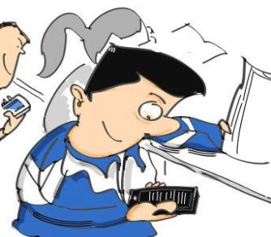
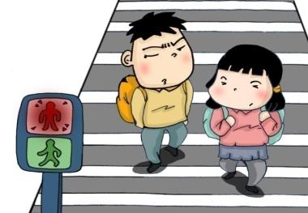
Warm-up
Discuss
Look at the photos.
What do you think of them?

Slide 3
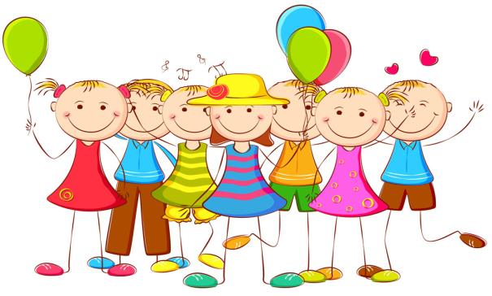
Lead-in
What class rules do you have?
What do you think of the class rules?

Slide 4
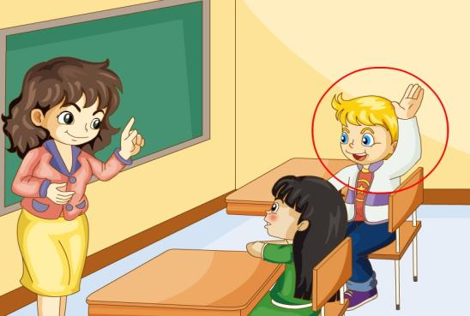
actively
He talks actively in class.

Slide 5
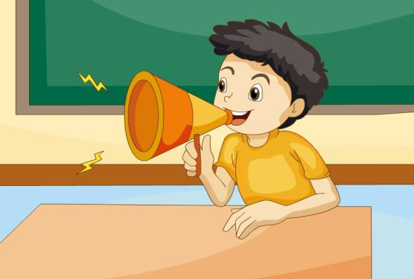
make noise
Please don’t make noise in class.

Slide 6
Practice
Just talk
He knows the school ________ very well.
He comes to school ________.
He listens carefully and talks ________.
He never makes ________ in class.
His group is making a list of ________ rules.
rules
early
actively
noise
class

Slide 7
Class Rules
Listen carefully and talk actively.
Hand in your homework on time.
Don’t be late for school.
Don’t make noise in class.

Slide 8
Practice
Right or Wrong?
Hand in your homework on time.
Be late for school.
Make noise in class.
Listen carefully and talk actively.

Slide 9
Group Work
Class Rules
Let’s make a list of class rules together!

Slide 10
怎样制定和表达我们的班规？
例如：
Listen carefully and talk actively.
Hand in your homework on time.
Don’t be late for school.
Don’t make noise in class.

Slide 11
Thank you.

