Slide 1
Module 6 Unit 1
It allows people to get closer to them.
WWW.PPT818.COM

Slide 2
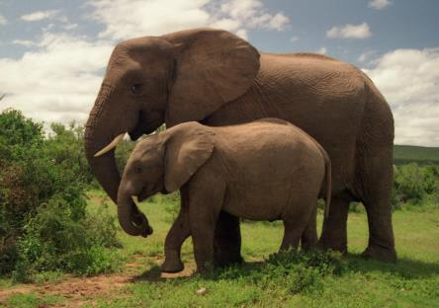
Animals in the zoo.
Elephants

Slide 3
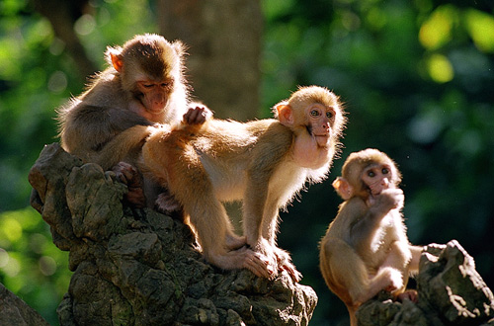
Monkeys

Slide 4
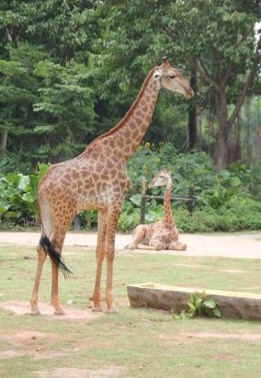
Giraffes

Slide 5
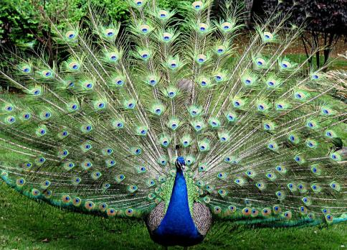
Peacock

Slide 6
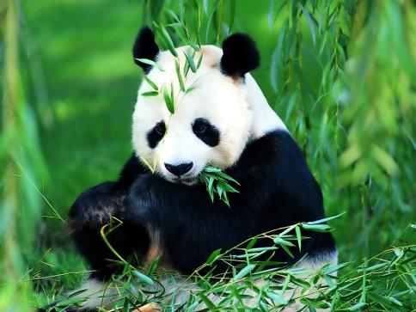
Panda

Slide 7
Words and expressions
/sneIk/
/nek/
/θIn/
/'deIndʒə/
in danger
at last
/'IntərestId /
/ə'laʊ/
snake
蛇 n.
neck
颈；脖子 n.
thin
薄的，细长的adj.
danger
危险；危害n.
处于危险中
最后；终于
关心的；感兴趣的adj.
interested
允许；准许v.
allow

Slide 8
think of
/prə'tekt/
/waIld/
/grəʊ/
(grew)/gru:/
/I'nʌf/
/pi:s/
in peace
想到；想出
保护；保卫v.
protect
野生的adj.
野生环境n.
wild
grow
变得；生长v.
逐渐
take away
夺去；拿走
enough
足够的；充分的adj.
peace
和平；太平 n.
和平地；平静地

Slide 9
/'nəʊtIs/
look after
/reIz/
布告；告示n.
notice
照顾；照管
筹集（钱款）；抚养；养育v.
raise

Slide 10
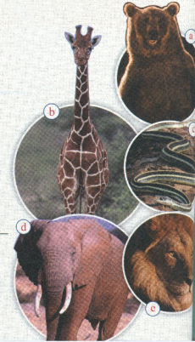
1. Look at the pictures and do the quiz.
Use the words in the box.
Practice
bear elephant giraffe
lion snake
1 I am tall and I have a
long neck. ______
2 I am the tiger’s cousin.______
3 I am long and thin._____
4 I am big and I have a
very long nose. ____
5 I am brown and I live in
the forest. ______
giraffe
lion
snake
elephant
bear

Slide 11
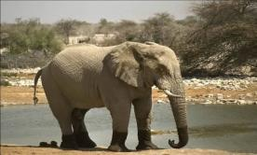
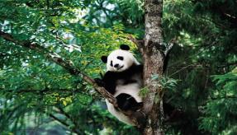
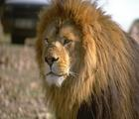
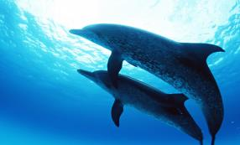
Guessing Game: Who am I?

Slide 12
I am orange and black, and I am the king in the forest.
I am the tiger’s cousin, and I like eating small animals.
tiger
lion

Slide 13
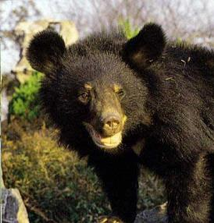
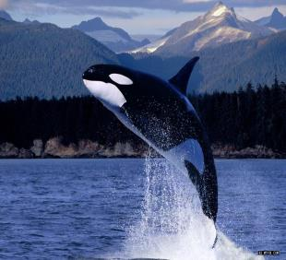
I am brown or black and I lived in the forest.
I am very big and live in the sea.
bear
whale

Slide 14
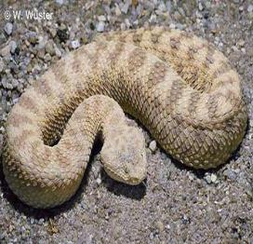
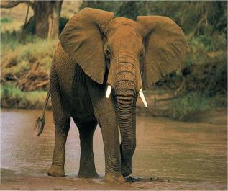
I am long and thin.
I am very big and have a very long nose.
snake
elephant

Slide 15
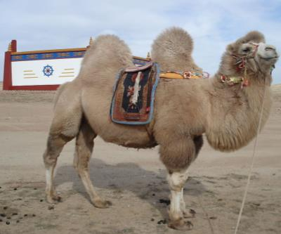
camel
I can walk a long way
without drinking.

Slide 16
2. Listen and answer the questions.
1 What is this week’s Animal World about?
This week’s Animal World is about snake.
2 Which animals are in danger?
Animals such as pandas, lions, elephants
and bears are in danger.

Slide 17
Everyday English
_{… at last!}
_{Help!}
_{What can we do?}

Slide 18
Then listen and read
(Lingling and Betty are leaving the zoo.)
L: Did you like the zoo?
B: Yes! I saw the pandas at last! But I am more interested to see the pandas in the Wolong
Panda Reserve, because it allows people to get closer to them.
L: It’s sad to think of the pandas and other animas in danger.
B: We need to protect them better.
L: Yes. Many wild animals don’t have a safe place to live, because villages and farms are growing bigger and are taking away their land and forests.

Slide 19
B: Also, often there isn’t enough clean water. I think we all need to help animals live in peace. Look, there’s a notice.
L: It says,” Help! We want to save animals in danger,
and we need your help.”
B: But what can we do?
L: It says, “Your money pays to look after the animals.”
That means we can give money to help protect the
animals.
B: Maybe we can raise some money at school. Let’s
find out what else we can do to save as many animas
as possible.

Slide 20
Now complete the table.
Why many animals are in danger | What we can do to help
1. Many animals don’t have a safe place to live, because
villages and farms are
growing bigger and are
taking away their land
and forests.
2. Often there isn’t enough clean water.
Raise some money at school.
Find out what else we can do to save as mammy as animals as possible.
Work in pairs. Discuss and more information
to the table.

Slide 21
Blank filling
4. Complete the passage with the words
and expression in the box.
allows danger enough
in peace protect raise
Many wild animals, such as pandas, are in (1)________. We need to (2)__________ them! Often there is not(3) __________water or forests, so the animals do not have a safe place to live.
danger
protect
enough

Slide 22
Blank filling
The Wolong Panda Reserve (4) ___________ people to get closer to the pandas. And pandas live (5)_________there. You can help us
(6) ________ money to protect pandas and other wild animals.
allows
in peace
raise

Slide 23
Language Points
I saw the pandas at last!
at last = in the end 最后、终于
他终于取得了好成绩。
He got good marks ________.
我们昨天终于吃了烤鸭子.
Yesterday we ate roast duck _______ .
at last
at last

Slide 24
finally/ at last/ in the end
这三个都可以作“最后”讲，但用法不同。
Finally 表动作的发生顺序是在“最后”，
无感情色彩，只用于过去时，它居句首时
较多。
Ⅱ. at last 表经过一定曲折之后某事才发生，强调努力的结果，带有较强的感情色彩，须用一般过去时。

Slide 25
Ⅲ. in the end 表事物发展的自然顺序的“终结”，有时或与 finally相互替换，但用于对将来的预测，则只能用in the end。如：
① Did the man in the shop understand him
at last?
② Finally he went to see the famous man
himself.
③ I hope that everything will turn out all
right in the end.

Slide 26
2. But I am more interested to see the pandas in the Wolong Panda Reserve, because it allows people to get closer to them.
1) interested 是 interest 的形容词形式，一般
用来修饰人。常用句型为：be interested in
sth. 对…….感兴趣。
拓展： take interest in 对…… 感兴趣
place of interest 名胜古迹
I don’t know whether he is interested in this
subject. 我不知道他是否对这一主题感兴趣。

Slide 27
2) to get close to them 在句中作宾语补足语，
类似的结构还有：
ask sb to do sth 请求某人干某事
need sb to do sth 需要某人干某事
Mum asked me to help her with the dishes.
妈妈让我帮她洗餐具。
I need you to help me with the cooking.
我需要你帮我做饭。

Slide 28
3. It’s sad to think of the pandas and other
animas in danger.
想起熊猫和其他濒临灭绝的动物来，真让人伤心。
in danger 表示“处于险境，处于危险中” 例如：
The girl is very ill and her life is in danger.
那个女孩病得很重，生命垂危。
My friend drove so fast that I really felt my
life was in danger.
我朋友开车太快，我觉得自己有性命之危。

Slide 29
It’s + adj. + (for sb) + to do sth.
做某事对某人来说怎样
1) 看英语电影对我们来说是有趣的。
__________________________ English films.
2) 弹好钢琴对他来说是不容易的。
___________________________the piano well.
It’s interesting (for us) to see
It’s not easy (for him) to play

Slide 30
4. Because villages and farms are growing bigger
and are taking away their land and forests.
因为村庄和农场越来越大，侵占了他们的土
和森林。
take away “把…带走或拿走；减去”。例如：
Please take these chairs away.
请把这些椅子拿走。
If you take four away from twelve, you get
eight. 12 减4等于8。

Slide 31
5. We need to protect them better.
1)结构： (not) need to do Sth
(不)需要干……
他需要买一支新钢笔。
He _____________ a new a pen.
我们昨天不需要清洁教室。
We __________________ the classroom
yesterday.
needs to buy
didn’t need to clean

Slide 32
2) protect vt. 保护
Please wear the sunglasses to protect your eyes from strong sunlight.
请戴上太阳镜，保护你的眼睛免受强光伤害。
protect…from / against… 保护……免受……
prevent…from doing…
stop…(from)doing…
keep…from doing…
discourage…(from)doing…
阻止……做……

Slide 33
Pronunciation and speaking
5 Listen and mark when the speaker pauses.
1 It allows people to /get closer to the pandas.
2 We want to / save animals in danger,
and we need your help.
3 We can give money / to help protect the animals.
Now listen again and repeat.

Slide 34
6. Work in pairs. Ask and answer the
questions.
1 Why do you visit the zoo?
2 Where do most animas live?
3 Do you think animas are happy in the zoo?
4 What can we do to help the animals?

Slide 35
7. Talk with your partner about what we
can do to protect animals in danger.
－ To protect … we should …
－ We need to … to protect …
Now share your ideas with the rest of the class.
What do they think?

Slide 36
complete the sentences
1. The surprising thing was to hear how many animals _______________ (在险境中).
2. …we are ___________(占据) their lands and forests.
3. Let’s ________ (找出) what we can
do to save them.
are in danger
taking away
find out

Slide 37
4. I was ________________ (更有兴趣)to see the pandas.
more interested
5. Many animals _____________________
(没有生存的地方).
6. We __________ (需要) protect them
better.
have no place to live in
need to

Slide 38
翻译下列词组
1. at last _________________
2. in peace _______________
3. in danger _____________
4. too…to… ___________________
5. 对…感兴趣 ________________
终于
和平的
在危险中
太…以至于不能…
be interested in

Slide 39
单项选择
B
1. It’s interesting _____ this game.
A. play B. to play
C. playing D. played
2. __ is really hard __ them to climb the mount.
A. This, to B. This, for
C. It, for D. It, to
3. We need ____ the housework at weekends.
A. to do B. doing C. do D. does
C
A

Slide 40
Homework
Learn the useful words and expressions of this unit by yourself.

