Slide 1
Unit 7 Know Our World
Let’s Learn Geography
WWW.PPT818.COM

Slide 2
Learning aims:
1. Talk about the countries.
2. Be proud of one’s country.
Learning important points:
1. Talk about the geography.
2. Learn something about the foreign countries.
Learning difficult countries:
What languages do they speak in other countries?

Slide 3
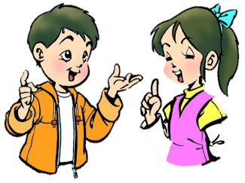
Free talk
What’s your favourite subject?
What is geography?
Do you like geography?
Why or why not?

Slide 4
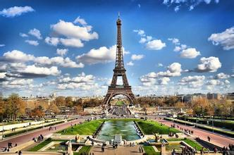
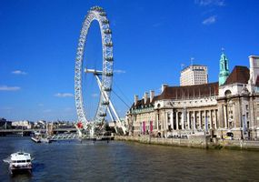
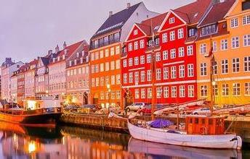
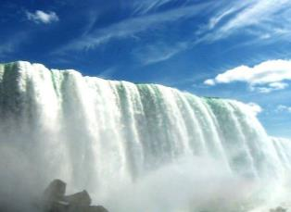
Enjoy some pictures

Slide 5
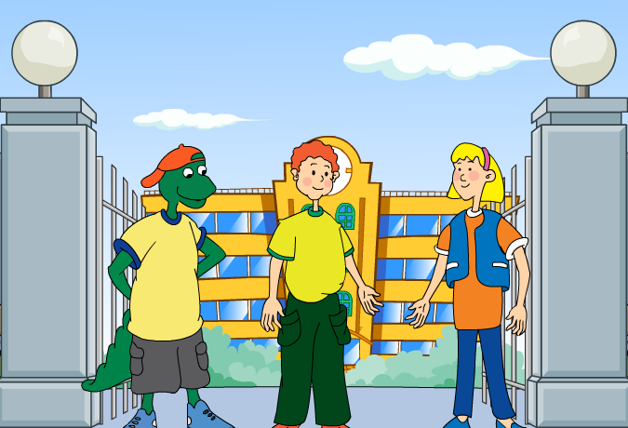
Watch the cartoon

Slide 6
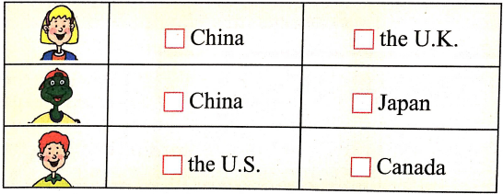
Let’s Do It!
Which countries have they been to?

Slide 7
Read the lesson and write true(T) or false(F).
1. Brain wants to visit Japan someday. （ ）
2. Jenny has never been to any Asian countries. （ ）
3. Brian’s father has travelled to several different continents. （ ）
4. Danny’s mother has a friend in Antarctica. （ ）
F
F
T
F

Slide 8
Fill in the blanks with the words in this lesson.
1. A: Which country has the largest p__________?
B: China, of course.
2. A: Is Taiwan an i_____?
B: Yes. It is in the Pacific.
3. A: I like all fruits e______ bananas.
B: Really? I don’t like them, either.
4. Mr. Wang has gone a_____, so I won’t see him this week.
5. The people in Japan speak J________.
opulation
sland
xcept
broad
apanese

Slide 9
Language points.
1. Have you ever been abroad, Danny? 你曾经出过国吗，丹尼？
be abroad意为“在国外”，go abroad意为“出国”。abroad 是表示地点的副词，其前一般不加介词to。
如：
My father is abroad now. 我爸爸现在在国外。

Slide 10
2. I speak a little Chinese.
我讲一点儿汉语。
(1) a little修饰不可数名词, 意为“有一点儿；有一些”，表示肯定的含义。如：
Don’t worry. There is a little time left.
不要担心。还有点儿时间。
(2) a little 可修饰形容词、副词及比较级, 相当于a bit。如：
I felt a little tired after walking so far.
走了这么远之后，我觉得有点儿累。

Slide 11
辨析： few; a few; little; a little
(1) few用来修饰可数名词，few表示否定意义，意为“没有；几乎没有”。如：
He is new here. He has few friends here. 他是新来的。他在这儿没有朋友。
(2) a few也用来修饰可数名词，但它表示肯定意义， 意为“有几个；有一些”。如：
There are a few apples in the basket.
篮子里有一些苹果。

Slide 12
辨析： few; a few; little; a little
(3) little用来修饰不可数名词，little表示否定意义，意为“没有；几乎没有”。如：
There is little water in the bottle.
瓶子里几乎没有水了。
(4) a little也用来修饰不可数名词，但是它表示肯定意义， 意为“有一点儿”。如：
I can speak a little French now with his help.
在他的帮助下，现在我会讲点儿法语了。

Slide 13
Exercise
I. 根据汉语或首字母提示，完成单词。
1. Allan will go ______ (到国外) next month.
2. I’d like to visit some places we have learnt about in _________ (地理) lessons.
3. Students from all over the ______ (世界) come to study at Oxford.
4. Tokyo is the capital city of J_________.
5. He left his _________ (村庄) and went to work in Guangzhou.
abroad
geography
world
apan
village

Slide 14
II. 句型转换，每空一词。
1. The population of the city is 2,000,000. (对划线部分提问)
_________ _______ the population of the city?
2. There are ten people in her team. (对划线部分提问)
_________ _________ _________ are there in her team?
What is
How many people

Slide 15
3. China is the largest country in Asia. (改为同义句)
China is _______ than _______ _______ country in Asia.
4. I have been to Hong Kong. (改为一般疑问句)
_________ _________ been to Hong Kong?
5. My mother hopes that she can visit some countries in Africa. (改为简单句）
My mother _____ _____ visit some countries in Africa.
larger any other
Have you
hopes to

Slide 16
III. 根据所给汉语提示，翻译下列句子。
1. 他们通过电子邮件的方式联系对方。
They ________ each other ____ ________.
2. 今天下午去滑冰怎么样？
___________ ______ going skating this afternoon?
3. 我有一个住在纽约的笔友。
I have a pen pal _________ _________ in New York.
contact by e-mail
What / How about
who lives

Slide 17
Homework
1. Read and listen the text again.
2. Finish off your exercise book.
3. Write about some countries that you like to
visit.

Slide 18
Thank You

