Slide 1
Lesson 18 Never Catch a Dinosaur
WWW.PPT818.COM

Slide 2
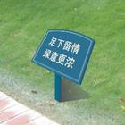
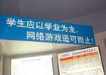
Do you know more warnings in the daily life? Let’s see together !
Take care of the grass, they have lives as us, too.
Never give up learning, net games are harmful!

Slide 3
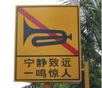
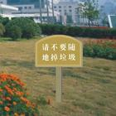
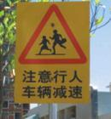
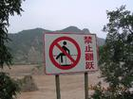
Keep quiet!
No litters!
Slow down !
Don’t jump over!

Slide 4
Never catch a dinosaur!
Read the diary and pay attention to these sentences.
1. You could have prevented the accident. (But you didn’t!)
2. You have warned him to use the ladder.
3. She watched me climb higher and higher.

Slide 5
Warming up
If you fall down from a high place, what would happen?
What would you do if you see someone falling down?

Slide 6
Listening task:
( )1. Danny felt terrible because of his careless.
( )2. Li Ming broke his leg at the age of seven.
( )3. Li Ming tried to climb a ladder, but he fell down.
( )4. Li Ming’s mother caught him and saved him.
( )5. It took Li Ming about 90 days to recover.
T
T
F
F
T

Slide 7
Reading task: Answer the questions
Did Danny write to Li Ming?
When did Li Ming have an accident?
Who took Li Ming to the hospital?
How long did it take Li Ming to recover?
Keys:1.Yes, he did.
2.When he was seven years old.
3.His mother.
4.Three months.

Slide 8
Language notes
1. I liked your new rule. 我喜欢你的新规定。
rule n. 规则；法规；规定；章程
the rules of basketball篮球比赛规则
the rules of tennis网球规则
The school rules must be obeyed. 学校的规定必须遵守。
【拓展】：
rule vt., vi. （常与over连用）统治；支配
Who rules this country? 谁统治这个国家？
Try not to let your heart rule your head. 别让感情支配理智。

Slide 9
2. You advised him to use a ladder, but he didn’t listen. 你建议他用梯子，但他不听。
advise sb. to do建议某人做某事，其否定形式为advise sb. not to do=advise sb. against sth.
He advised me to go to see a doctor.他建议我去看医生。

Slide 10
3. She watched me climb higher and higher. 他看我爬得越来越高。
higher and higher 越来越高
比较级+and+比较级，译为：越来越
When spring comes, the day gets longer and longer. 当春天来的时候，白天变得越来越长了。

Slide 11
达标测评
I. 单项选择
1.The old man has warned me ______ under the tree when it is raining heavily.
A. to stand B. not to stand
C. standing D. not standing
2.It took me two hours _____ my homework last night.
A. finish B. to finish
C. finishing D. finished
B
B

Slide 12
II. 根据汉语提示完成句子
1.有人警告我们不要购买那辆黑色轿车。
We were warned ____ ___ ____ the black car.
2.别那样做了，好吗？
_____ _____ that again, will you?
3. 他建议你做些什么？
What does he ______ you ___ ___?
not to buy
Don’t do
advise to do

Slide 13
Goodbye!

