Slide 1
初中英语外研版版八年级下
Module3 Journey to space
Unit2 We have not found life on any other planets yet.
WWW.PPT818.COM

Slide 2
Review
1
Presentation
2
Language Points
3

Slide 3
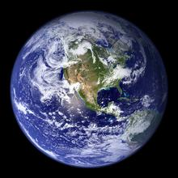
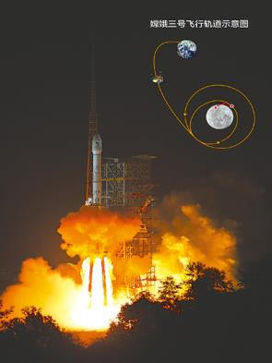
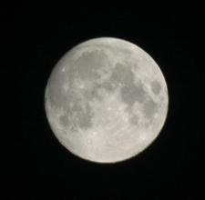
Review
earth
moon

Slide 4
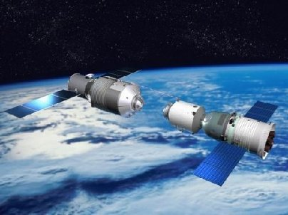
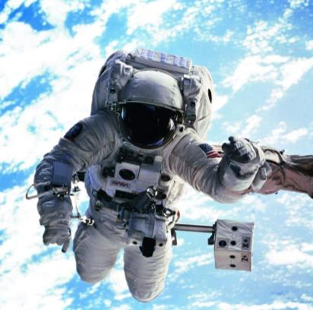
spaceship
astronaut

Slide 5
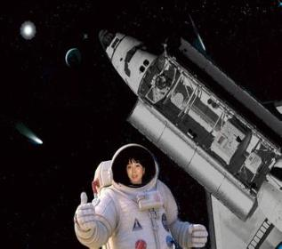
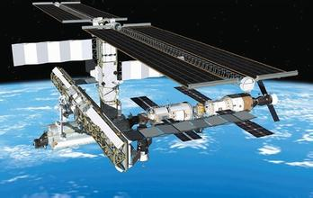
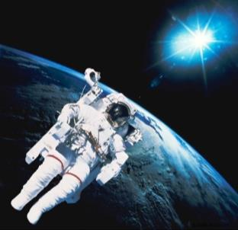
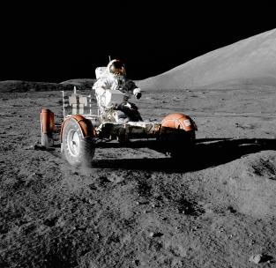
space travel

Slide 6
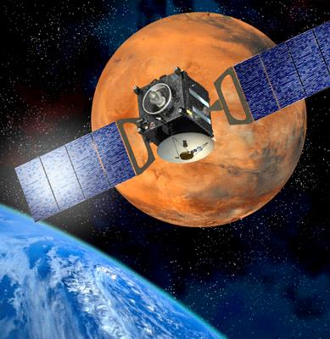
Scientists have sent spaceship to Mars. The journey has taken several months.

Slide 7
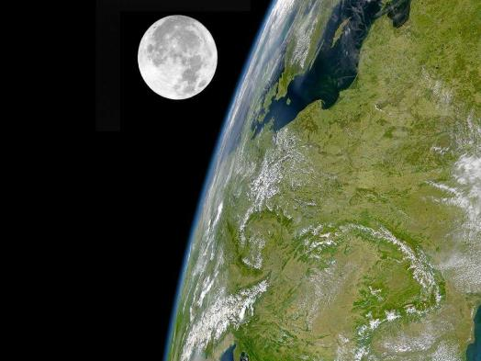
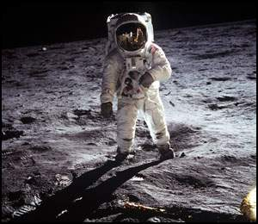
Astronauts have already been to the moon.

Slide 8
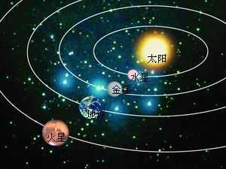
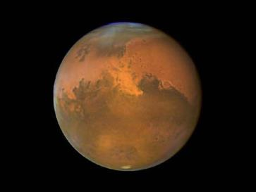
No one has been to Mars yet, because Mars is very far away, much farther than the moon.

Slide 9
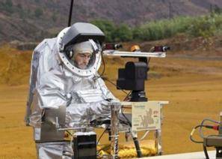
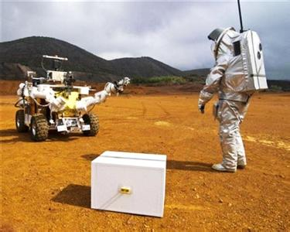
Lots of scientists are working hard in order to send astronauts to Mars one day.

Slide 10
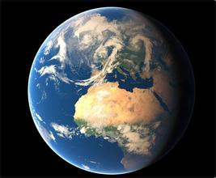
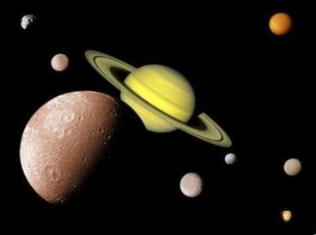
Presentation
Read the passage.
Scientists think that there has been life on the Earth for hundreds of millions of years. However, we have not found life on any other plants yet.

Slide 11
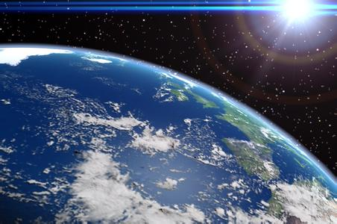
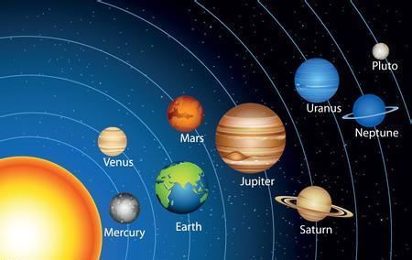
The Earth is a plant and it goes around the sun.

Slide 12
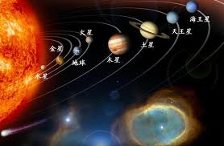
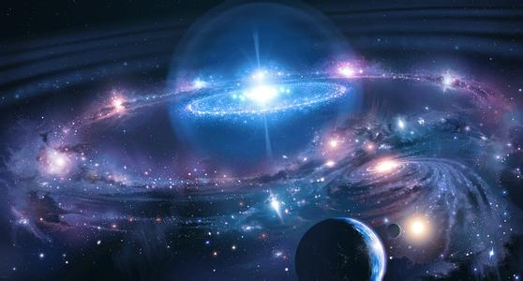
Seven other planets also go around the sun. None of them has an environment like that of the earth, so scientists do not think they will find life on them.

Slide 13
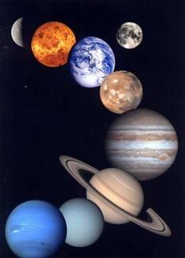
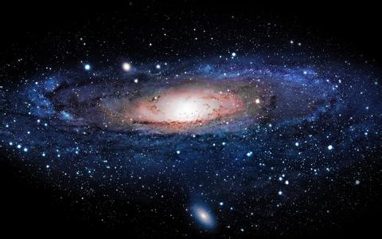
The sun and its planets are called the solar system, and our solar system is a small part of a much larger group of stars and planets, called the Galaxy or the Milky Way.

Slide 14
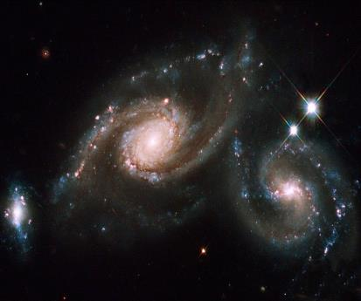
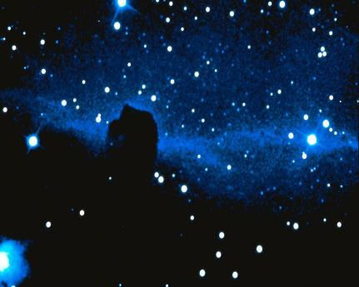
There are billions of stars in the Galaxy, and our sun is only one of them.

Slide 15
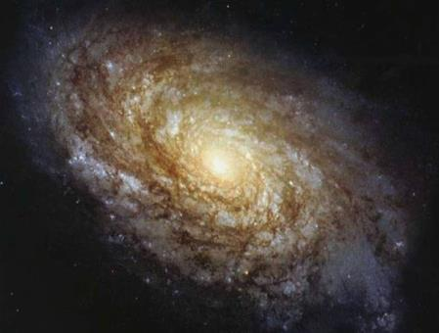
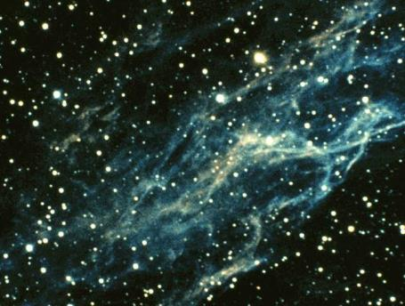
Scientists have also discovered many other galaxies in the universe. They are very far away and their light has to travel for many years to reach us. So how large is the universe? It is impossible to imagine.

Slide 16
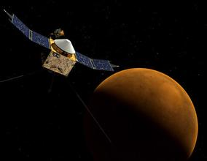
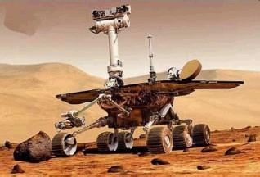
Scientists have sent spaceship to the planet Mars to take photos. They have even sent spaceships to travel outside the solar system.

Slide 17
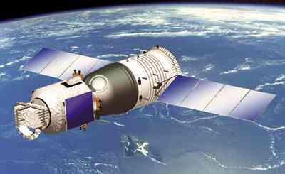
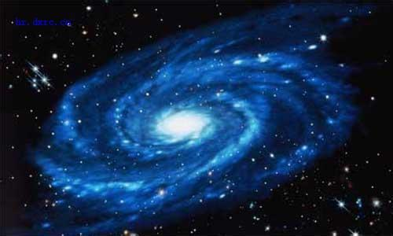
However, no spaceship has travelled far enough to reach other stars in our Galaxy.

Slide 18
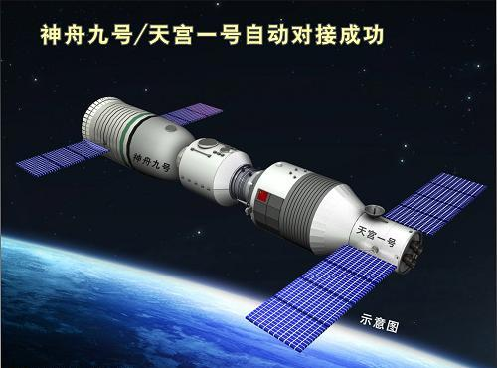
Work in pairs
Look at the picture and talk about what you know about Chinese spaceships.
Shenzhou-9 is a manned spaceship.

Slide 19
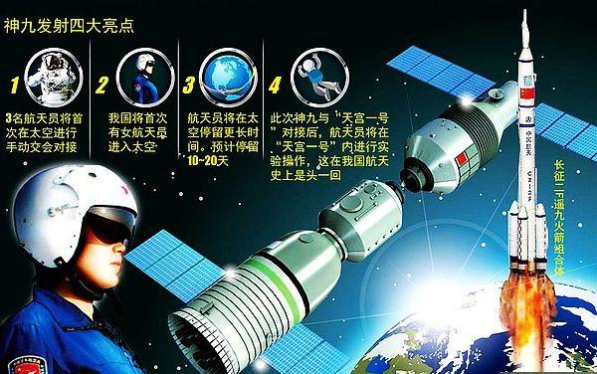

Slide 20
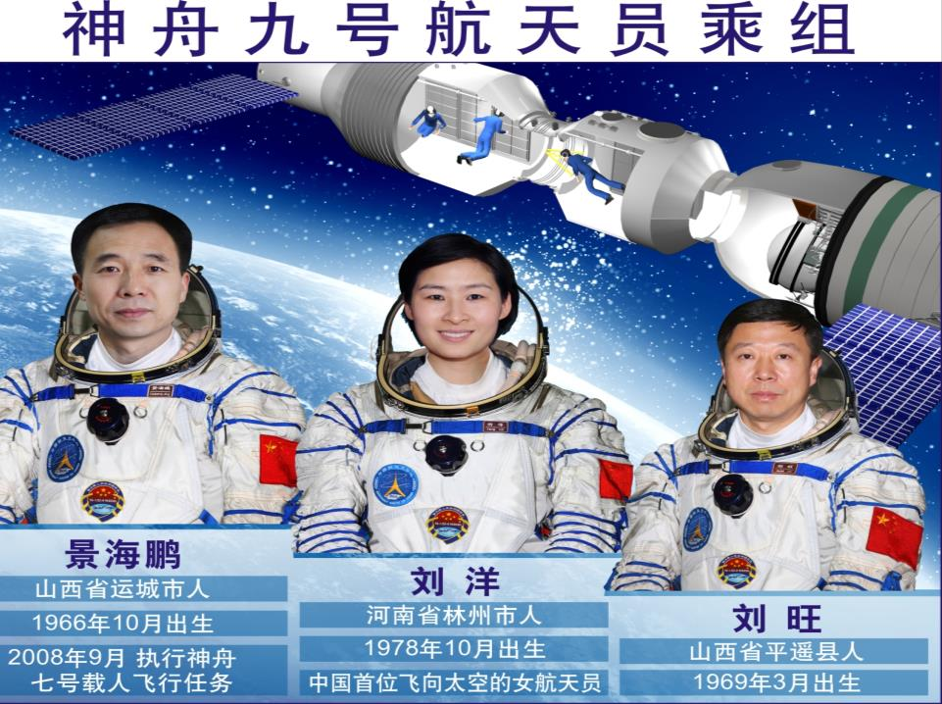

Slide 21
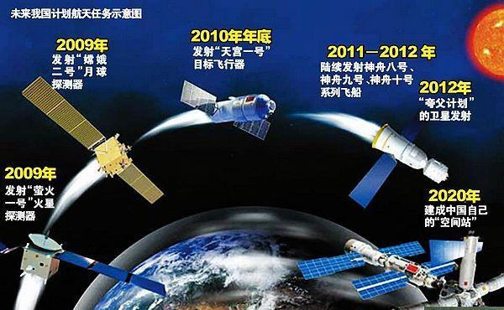

Slide 22
Listen and read

Slide 23
Read the passage and choose the best title for it.
1. Anyone out there?
2. Life on the earth
3. The sun and other stars
4. The stars at night
√

Slide 24
Check (√) the true sentences.
×
1. The earth is a star.
2. The sun is a star.
3. There is more than one galaxy in the universe.
√
√

Slide 25
√
4. The light from the stars in other galaxies has travelled for a long time to reach us.
5. Scientists have received many messages from space.
6. Spaceships have visited most of the universe.
×
×

Slide 26
Complete the passage with the words and expression in the box.
communicate environment none solar system universe
Is there life on other planets? There are seven other planets in our (1) ____________, but (2)______ of them has a(n) (3)____________ like that of the earth.
solar system
none
environment

Slide 27
Spaceships from the earth have done surveys of the other planets, but they have not found any life there. Why has no one from other planets tried to (4) _____________ with us? It is true that scientists have not discovered life on other planets in the (5)_________ yet, but some scientists believe that they will find it some day.
communicate
universe

Slide 28
Language points
1. Scientists think that there has been life on the Earth for hundreds of millions of years.
科学家认为地球上的生命已经有亿万年
了。
millions of 数百万 hundreds of 数百 thousands of 成千上万 billions of 数十亿

Slide 29
e.g. There are billions of stars in the Galaxy, and our sun is only one of them.
银河系中有数十亿颗恒星，我们的太 阳只是其中的一个。
2. However, we have not found life on any other planets yet.
然而，我们还没有在任何其他行星上 发现生命。

Slide 30
yet 用于否定句和疑问句，意思是“还，尚”。not … yet 的意思是“还没，尚未”，表示某事物在某一时间尚未发生，但未来也许会发生。例如：
I haven’t learnt any farther information yet.
我还没有得到进一步的信息。
Have you received her letter yet?
你收到她的来信了吗？

Slide 31
3. None of them has an environment like that of the earth, so scientists do not think they will find life on them.
他们中没有一个有像地球这样的环境，因 此科学家们认为在他们上面找不到生命。
none of … 表示（三个以上）一个也没
有。做主语时，谓语动词可用单数或复数。

Slide 32
e.g. None of us has/have been to the Mars.
我们中没一个去过火星。
5. … our solar system is a small part of a much larger group of stars and planets, called the Galaxy or the Milky Way.
...... 我们的太阳系只是一个由恒星和行 星组成的星系的一小部分，这个星系比太阳系大得多，称作银河系或银河。

Slide 33
这里的the Galaxy专指“银河系”，也可以称作 the Milky Way。而galaxy则泛指“星系”。
e.g. Scientists have discovered a distant galaxy.
科学家们发现了一个遥远的星系。

Slide 34
6. So how large is the universe? It’s impossible to imagine.
所以宇宙有多大？我们无从想象。
句型: It is + 形容词 + to + 动词原形，意思是“做某事很……”
e.g. It is difficult to read these words. 读这些单词很难。

Slide 35
7. With so many stars in the universe, are we alone, or is there life out there in space?
宇宙中有这么多星球，我们是孤独的 吗？或者太空中还有其他生命存在呢？
with + 名词 + 介词短语，表示伴随情况，意思是“带着……”。

Slide 36
e.g. Mr. Zhang is coming with a book in his hands.
张老师手里带着一书进来了。
alone 在句中作形容词，不作定语只做表语，也可作副词。意思是“独自地”。
e.g. She was alone in that dark room.
她独自一人呆在那黑屋子里。

Slide 37
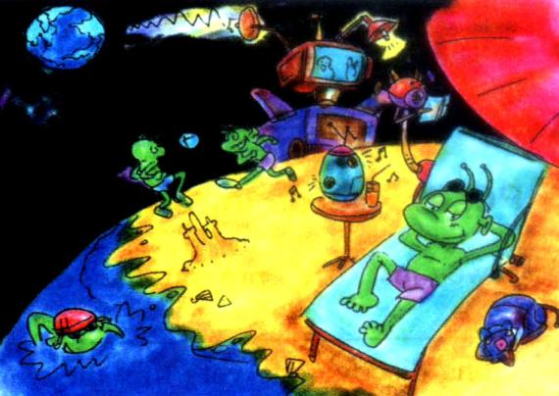
Writing
Look at the picture from a science story for children and answer the questions.

Slide 38
What have the scientists just received?
(a message from one of our spaceships)
They have just received a message from one of our spaceships.
1. Where has the spaceship landed?
(Mars)
It has landed on Mars.

Slide 39
2. What has the spaceship discovered?
(people on Mars)
3. Why have the people on Mars not
sent us a message? (do not know how to)
It has discovered people on Mars.
We do not know how to send us a message.

Slide 40
4. Why have the people on Mars not
visited us on the earth?
(do not know how to)
We do not know how to visit us on the earth.

Slide 41
Write a passage to describe the picture. Use your answers to the questions in Activity 5 to help you.
We have just received a message from our spaceship to Mars … ____________________________________________________________________________________________________________________________________

Slide 42
Exercise
1. — Is Tom at home?
— No, he______ to town.
A. has been B. has gone
C. goes D. will go
2. He promised to pick me up at the school gate. However, he _______ yet.
A. didn’t arrive B. doesn’t arrive
C. isn’t arriving D. hasn’t arrived

Slide 43
3. — What is the weather like this summer here?
— There ____ very little rain.
A. has B. has been
C. are D. have been
4. A number of tourists ______ Yangzhou many times because it is such a beautiful city.
A. have been to B. has been to
C. has gone to D. have gone to

