Slide 1
外语教学与研究出版社 六年级 | 下册
Module 2 Unit 1
When are we going to eat?
WWW.PPT818.COM

Slide 2
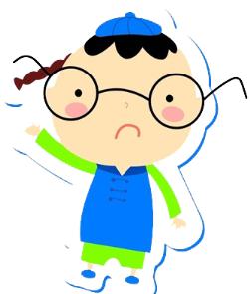
外语教学与研究出版社 六年级 | 下册
Free talk!
Warm up
What are you going to do this Sunday?

Slide 3
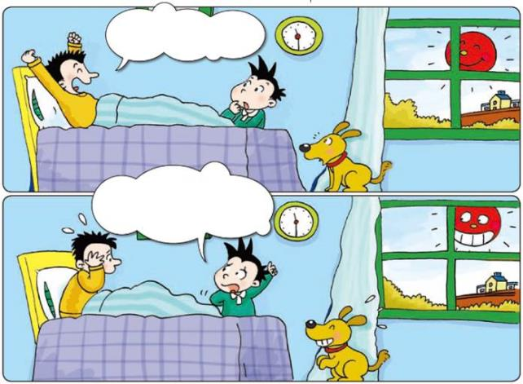
外语教学与研究出版社 六年级 | 下册
Look, listen and say
I’m going to get up and have breakfast.
Breakfast?
It’s half past eleven. You are going to have lunch!

Slide 4
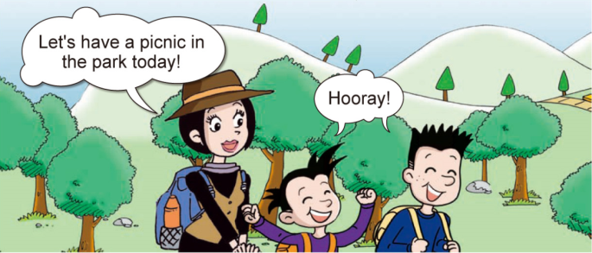
外语教学与研究出版社 六年级 | 下册
Presentation
Daming, Simon and Simon’s mum are in the park. What are they going to do? Let’s have a look!

Slide 5
外语教学与研究出版社 五年级 | 上册
Ask and answer
1. When are they going to eat?
At half past twelve.
2. What time is it now?
It’s half past eleven.
3. What are the ducks doing?
They’re eating sandwiches.

Slide 6
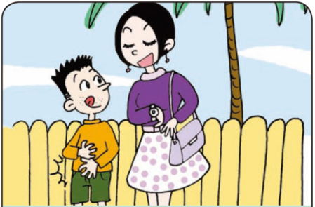
外语教学与研究出版社 六年级 | 下册
Practice
Listen and say
Simon: I’m … When …?
Mum: At ...

Slide 7
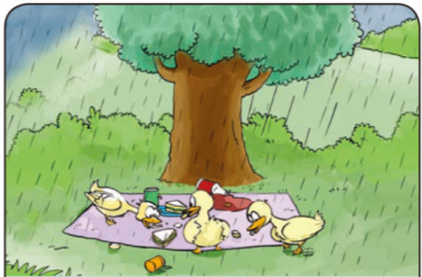
外语教学与研究出版社 六年级 | 下册
Daming: Look at … What …?
Simon: They’re ...

Slide 8
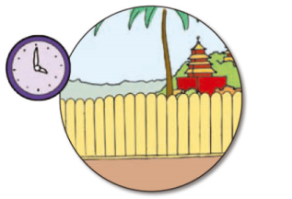
外语教学与研究出版社 六年级 | 下册
Look and write
A: When are we going to the park?
We’re going to the park at four o’clock.

Slide 9
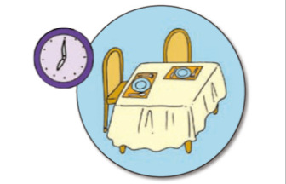
外语教学与研究出版社 六年级 | 下册
A: When are we going to eat?
We’re going to eat at seven o’clock.

Slide 10
外语教学与研究出版社 六年级 | 下册
A: When are we going to school?
We’re going to school at half past seven.

Slide 11
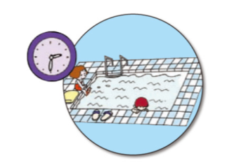
外语教学与研究出版社 六年级 | 下册
A: When are we going to swim?
We’re going to swim at half past two.

Slide 12
外语教学与研究出版社 六年级 | 下册
Homework
1. 将Daming他们的对话改写成简短的一篇小短文。
2. 用be going to 句型写五个句子。

Slide 13
谢谢观看！

