Slide 1
Unit 7
Films
Integrated skills
WWW.PPT818.COM

Slide 2
Objectives
To learn to understand the cinema guide
To learn to talk about some kinds of the film

Slide 3
There are many famous film festivals around the world. People can enjoy different types of films at these film festivals.
Which film festivals do you know?

Slide 4
Film festivals around the world
Tokyo Film Festival

Slide 5
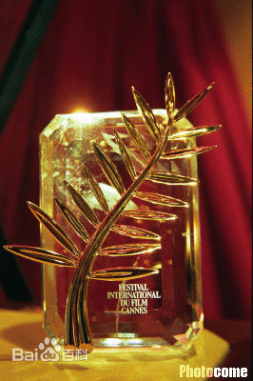
Cannes International Film Festival
戛纳国际电影节

Slide 6
Shanghai International Film Festival
上海国际电影节

Slide 7
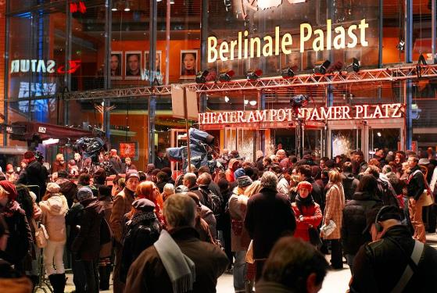
Berlin International Film Festival
柏林国际电影节

Slide 8
Toronto International Film Festival
多伦多国际电影节

Slide 9
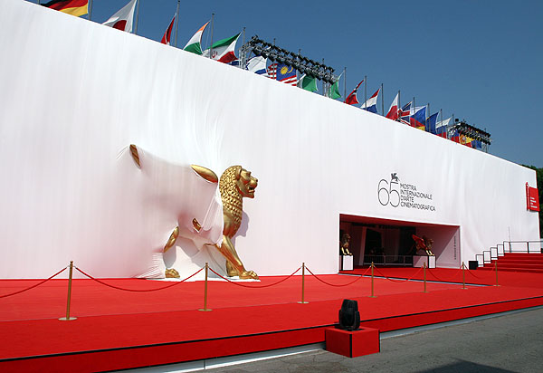
Venice Film Festival
威尼斯电影节

Slide 10
If you want to watch a film, where can you find information about what films are on ?
newspaper
Internet
magazine
hotline

Slide 11
A Film Festival
A1 There is a film festival in
Sunshine Town. Sandy wants
to write about some of the
films. Help her complete part
of her notes according to the
guide below.

Slide 12
Film Festival Cinema Guide
Olympic Cinema Olympic Road | Sunshine Cinema Sunshine Road | ABC Cinema Forest Road
Now showing Tales of old Beijing Suitable for all ages Ticket price: ¥40 | Now showing The World of Dinosaurs Suitable for all ages Ticket price: ¥ 40 | Now showing Love Ship Not suitable for children Ticket price: ¥60 (¥30 on Tuesdays and before 6.00 p.m. on Fridays

Slide 13
A2
Sandy is calling the festival hotline to find out more about the films. Listen to the information carefully and help Sandy complete the rest of her notes in Part A1.

Slide 14
Tales of Old Beijing
Type of film: a (1)_______ documentary
that shows you what Beijing
was like (2) ___________ ago.
3-hour
many years
Name of cinema: (3) ________________
on (4) _____________
Story: the story of (5) _________________
______________
Olympic Cinema
Olympic Road
a family that lived
in the hutongs

Slide 15
The world of Dinosaurs
Type of film: a (6) _____________ film
about (7) __________
Name of cinema: (8)________________
on (9)______________
Story: (10) _______________ is chosen
to be the (11) __________of the
dinosaur family.
science fiction
dinosaurs
Sunshine Cinema
Sunshine Road
a baby dinosaur
future king

Slide 16
Love Ship
Type of film: a (12)_________ film
Name of cinema: (13)______________ on
(14)____________
Story : a woman falls in love with a man
when she travels (15) _________
but when they start to (16)_____
__________ together, something
terrible happens.
romantic
ABC Cinema
Forest Road
on a ship
plan
their future

Slide 17
A3
Sandy is writing the report now. Help her complete it. Use the information in Part A1 on page 101 to help you.
What is on at the local cinemas?
Here is some information about the films showing at the local cinemas.
Tales of Old Beijing is now showing at (1) _________ Cinema in (2) _____________.
Olympic
Olympic Road

Slide 18
It is a (3)____________which is suitable
For (4) _________. It tells the story of a
family that (5)_____________________.
Sunshine Cinema on _____________ is now showing a film called The World of Dinosaurs. It is a ____________ film, which brings _________ alive on screen. A _____________ is chosen to be the ___________ of the dinosaur family. This film is suitable for ________.
documentary
all ages
once lived in a hutongs
Sunshine Road
science fiction
dinosaurs
baby dinosaur
future king
all ages

Slide 19
Love Ship is showing at ____________ on ___________. It is a ________ film that is not suitable for _________. It is about a woman who falls in love with a man when she travels _________, but something terrible happens when they start to _______________ together. The ticket price is ____ but there is a special offer on ________ and before ________ on Fridays.
ABC Cinema
Forest Road
romantic
children
on a ship
plan their future
¥ 60
Tuesdays
6 p.m.

Slide 20
B Speak up: I don't like
horror films.
Sandy and Daniel are talking about different kinds of films. Work in pairs. Talk about films with your partner. Use the conversation below as a model.
Sandy: Daniel, this Saturday’s talk on films
has been cancelled. Shall we go to
the cinema instead?
Daniel: Good idea. What's your favourite

Slide 21
kind of film, Sandy?
Sandy: I like romantic films. They usually
have beautiful stories. What about
you?
Daniel: I like action films. They're really
exciting. What do you think about
horror films?
Sandy: I don't like horror films. They're
terrible.
Daniel: Neither do T. They seem to be full
of mysteries, but in fact, they’re
quite stupid.

Slide 22
Listen Sandy and Daniel’s conversation and answer questions:
What is Sandy’s favourite kind of
film? Why?
Sandy likes romantic films because they usually have beautiful stories.
2. What is Daniel’s favourite kind of film? Why?
Daniel likes action films because they are really exciting.

Slide 23
3. What does Daniel think of horror
film?
Daniel doesn’t like horror films because they seem to be full of mysteries, but in fact, they are quite stupid.

Slide 24
Speak up
We’ve learnt a lot about different kinds of films. Do you still remember what they are?

Slide 25
Sample conversation
S1: I’m going to cinema tonight. Would
you like to go with me?
S2: I’d love to. What’s your favourite
kind of film?
S1: I like science fiction films. I love its
interesting stories. What about you?

Slide 26
S2: I like cartoons because they’re
usually funny. What do you think
about action films?
S1: I don’t like action films. I think
some of them are awful.
S2: Neither do I. They make me feel
stressed. I don’t like people
fighting all day.

Slide 27
Useful expressions
I like / don’t like …
I love / dislike …
… makes me laugh / cry.
… is my favourite / least favourite.
I like / don’t like … films because …
I’m not interested in …
I find … very boring / interesting.
… is stupid / interesting.

Slide 28
Homework
Read and recite Part B: speak up.
Master the new words and phrases that we’ve learnt today.

Slide 29
Thank you!

