Slide 1
Unit 3 Health
How can we keep healthy?
WWW.PPT818.COM

Slide 2
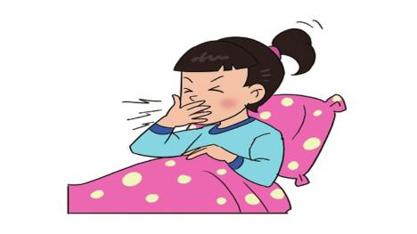
What’s wrong with you?
I cough.
I have a bad cold.

Slide 3
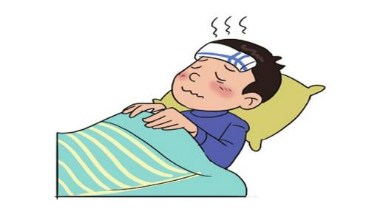
What’s wrong with you?
I have a fever.

Slide 4
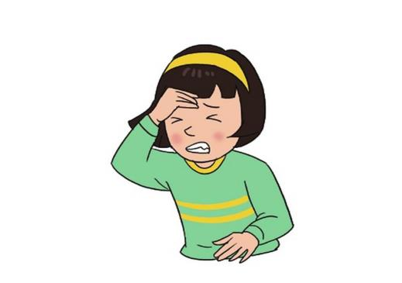
What’s wrong with you?
I have a bad headache.

Slide 5
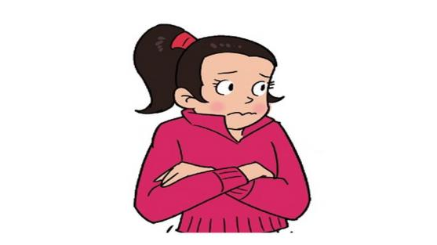
What’s wrong with you?
I feel cold.

Slide 6
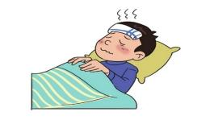
have a headache
have a fever
feel cold
cough
How can we do?

Slide 7
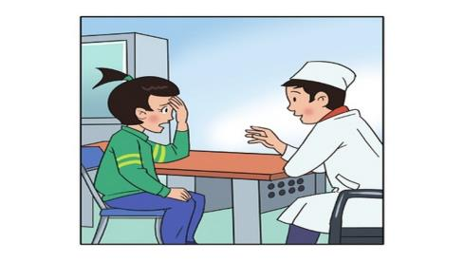
Let’s go and see
the doctor.
Take some medicine,
you’ll be all right.

Slide 8
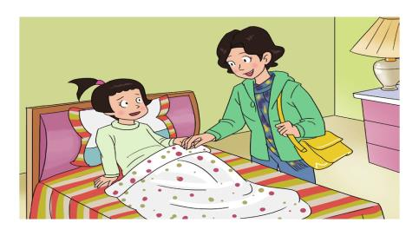
Take the medicine on time and drink some water.

Slide 9
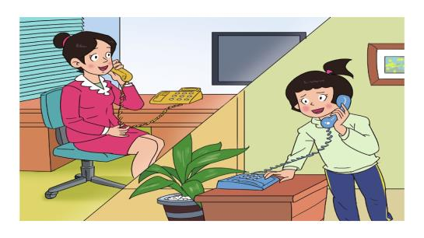
Take a good rest. You’ll get well soon.

Slide 10
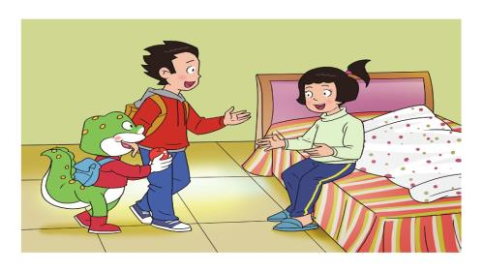
Here’s an apple for you.
An apple a day
keeps the doctor away .

Slide 11
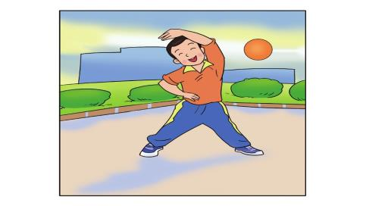
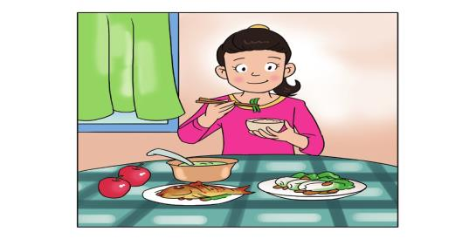
How can we keep healthy?

Slide 12
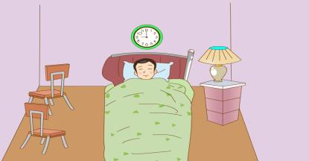
We should do sports everyday.
We should have enough sleep.
It makes us healthy and strong.

Slide 13
We should eat fruits and vegetables.
An apple a day
keeps the doctor away .

Slide 14
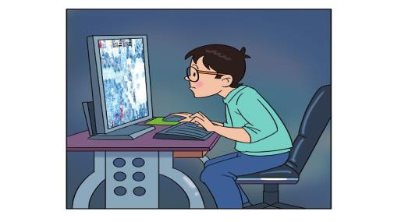
We shouldn’t play computer games for too long.
It’s bad for our eyes.

Slide 15
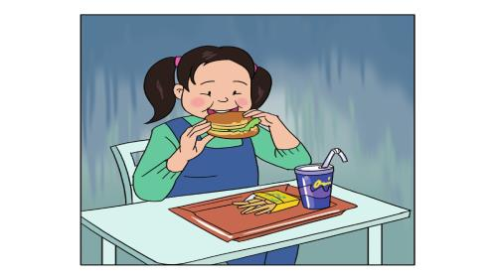
We shouldn’t eat too much junk food.
Junk food is not good for our health.
It makes us fat.

Slide 16
How can we keep healthy?
We should do exercise everyday.
We should take a good rest.
We should drink some water.
We shouldn’t……

