Slide 1
Unit 2 Exploring English
Section Ⅳ Developing ideas & Presenting ideas
WWW.PPT818.COM

Slide 2
教
材
语
篇
细
研
Notes:
2

Slide 3
Notes:
3

Slide 4
Notes:
4

Slide 5
Notes:
5

Slide 6
Notes:
6

Slide 7
Notes:
7

Slide 8
stories
different
with
had
Notes:
8

Slide 9
was told
the
confusing
who
higher
preparing
Notes:
9

Slide 10
语
言
基
础
自
测
Notes:
10

Slide 11
remind
comments
boots
Notes:
11

Slide 12
section
negative
exchange
forward
Actually
Notes:
12

Slide 13
exchange
remind
actually
negative
Notes:
13

Slide 14
in
with
in
on
Notes:
14

Slide 15
on
to
a
to
Notes:
15

Slide 16
play safe with
looking forward to
do a good job
Notes:
16

Slide 17
was about to
have a frog in your throat
in the outside world
Notes:
17

Slide 18
Not only did he
but
Notes:
18

Slide 19
Here is the present
Notes:
19

Slide 20
because she is eveloping very fast.
Notes:
20

Slide 21
who loves me most
Notes:
21

Slide 22
Notes:
22

Slide 23
Notes:
23

Slide 24
Notes:
24

Slide 25
of
Having been reminded
Notes:
25

Slide 26
Notes:
26

Slide 27
Notes:
27

Slide 28
Notes:
28

Slide 29
to exchange
with
Notes:
29

Slide 30
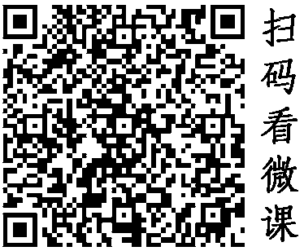
Notes:
30

Slide 31
Notes:
31

Slide 32
being treated
hearing
Notes:
32

Slide 33
delivered
Notes:
33

Slide 34
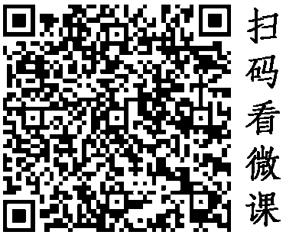
Notes:
34

Slide 35
Notes:
35

Slide 36
am
Notes:
36

Slide 37
Notes:
37

Slide 38
Notes:
38

Slide 39
Notes:
39

Slide 40
Notes:
40

Slide 41
Notes:
41

Slide 42
Notes:
42

Slide 43
Notes:
43

Slide 44
Notes:
44

Slide 45
Notes:
45

Slide 46
Notes:
46

Slide 47
Notes:
47

Slide 48
Notes:
48

Slide 49
Notes:
49

Slide 50
Notes:
50

Slide 51
Notes:
51

Slide 52
speaking of
confusing
reflect
do a good job
actually
exchange
Notes:
52

Slide 53
has some trouble understanding
Neither does he
Notes:
53

Slide 54
in which
spent a long time persuading
Notes:
54

Slide 55
Notes:
55

Slide 56
Notes:
56

Slide 57
Notes:
57

Slide 58
Notes:
58

Slide 59
Notes:
59

Slide 60
Thank you for watching !

