Slide 1
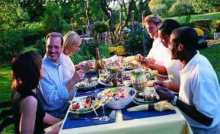
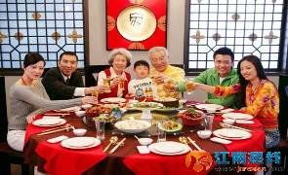
Unit 10 Different Tastes
WWW.PPT818.COM

Slide 2
本课时内容和目标：
复习和巩固本单元单词、课文。
学生能口头介绍中西饮食的不同和中国不同地域的口味。
学生能谈论自己的饮食爱好。同时四会学习单词“bun, pancake, salad, steak”
巩固句型：Do you know that …?
5. 了解更多其他国家的饮食文化。

Slide 3
老师们可以根据学生水平调整
单词出现的速度。
分两大组比赛，单词出现在哪一组的跑道上，请快速起立并读出该单词。
Group 2
Group 1
plenty of
dimsum
terrible
knife
also
plate
terrible
for example
chopstick
different
fork
for example
pancake
most
sour
bowl
western
chopstick

Slide 4
Let's review
We all know Chinese and Western food is often very different. Chinese people like eating rice or noodles, but western people eat bread. Chinese people use chopsticks and bowls but in the West, people usually eat their meals on a plate with a knife and fork.
But do you know that people in China have different tastes, too? People from Guanghou, for example, enjoy sweet and sour food most. They also eat plenty of delicious dimsum. In Beijing, people eat more noodles, pancakes and dumplings. They also like salty food. People from Sichuan love hot food. Some people think it’s too hot and tastes terrible. But I love Sichuan food!
PPT模板：www.1ppt.com/moban/ PPT素材：www.1ppt.com/sucai/
PPT背景：www.1ppt.com/beijing/ PPT图表：www.1ppt.com/tubiao/
PPT下载：www.1ppt.com/xiazai/ PPT教程： www.1ppt.com/powerpoint/
资料下载：www.1ppt.com/ziliao/ 范文下载：www.1ppt.com/fanwen/
试卷下载：www.1ppt.com/shiti/ 教案下载：www.1ppt.com/jiaoan/
PPT论坛：www.1ppt.cn PPT课件：www.1ppt.com/kejian/
语文课件：www.1ppt.com/kejian/yuwen/ 数学课件：www.1ppt.com/kejian/shuxue/
英语课件：www.1ppt.com/kejian/yingyu/ 美术课件：www.1ppt.com/kejian/meishu/
科学课件：www.1ppt.com/kejian/kexue/ 物理课件：www.1ppt.com/kejian/wuli/
化学课件：www.1ppt.com/kejian/huaxue/ 生物课件：www.1ppt.com/kejian/shengwu/
地理课件：www.1ppt.com/kejian/dili/ 历史课件：www.1ppt.com/kejian/lishi/

Slide 5
Chinese people Western people
通过复习本单元短语入手，让学生用此表格来简单复述中外和国内餐饮文化的差异从而进一步巩固本单元的学习内容，并为下面的各项活动作知识铺垫。
eat …
eat …
use …
eat …
with …
Guangzhou Beijing Sichuan
enjoy … food
like …
love …
eat … and …
eat plenty of …

Slide 6
Chinese people Western people
通过复习本单元短语入手，让学生用此表格来简单复述中外和国内餐饮文化的差异从而进一步巩固本单元的学习内容，并为下面的各项活动作知识铺垫。
eat rice or noodles
eat bread
use chopsticks & bowls
eat meals on a plate
with a knife & fork
Guangzhou Beijing Sichuan
enjoy sweet and sour food
like salty food
love hot food
eat noodles,
pancakes
and dumplings
eat dimsum

Slide 7
学生通过用enjoy, like, love介绍自己的饮食喜好，从而了解喜好的不同表达，这也是本文的要点之一。
Let's play
Now you all know that people in China have different tastes. Do you know that pupils in our class also have different tastes? Let’s see what everybody likes.

Slide 8
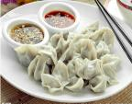
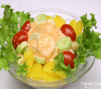
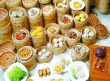
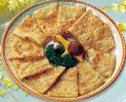
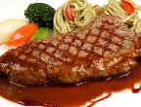
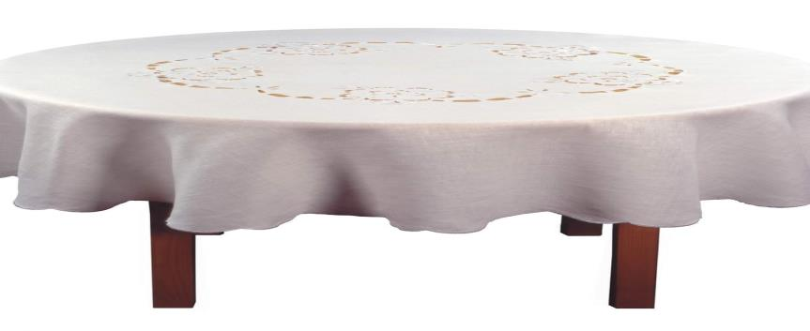
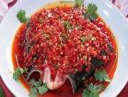
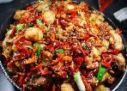
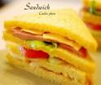
先让学生说食物名称，
借此学习三个新单词
salad
salad
steak
steak
bun
bun

Slide 9
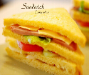
学生说出自己喜欢吃的东西。
引导学生用不同的动词表示喜欢
enjoy
like
love

Slide 10
Hello! I am Echo. I’m from Sichuan. I love hot food. I like to eat the fish and the chicken.
love

Slide 11
enjoy
like
love

Slide 12
Hello! I am ...I’m from ...
I … food. I like to eat the ...
enjoy

Slide 13
enjoy
like
love

Slide 14
Hello! I am ... I’m from ...
I … food.I like to eat ...
like

Slide 15
Let's talk
学生通过用enjoy, like, love介绍自己的饮食喜好，从而了解喜好的不同表达，这也是本文的要点之一，以达到上口的目的。老师可根据个人需要作增减。
Do you know that in Guangzhou we can find different foods from both China and the west?

Slide 16
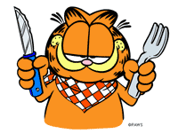
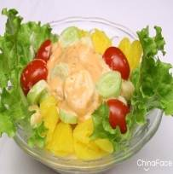
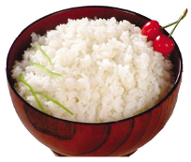
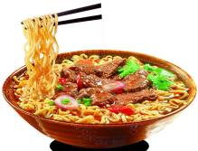
My name is Garfield.
I like Chinese food.
I enjoy noodles most.
They taste delicious.
看图，仿照例子描述词条。允许学生说图片以外的食品。

Slide 17
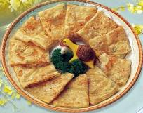
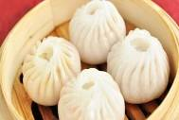
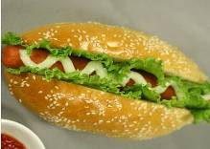
My name is .
I like food.
I enjoy most.
It tastes/ They taste .

Slide 18
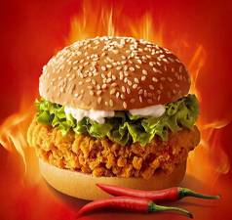
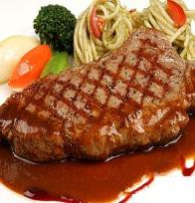
My name is .
I like food.
I enjoy most.
It tastes / They taste .

Slide 19
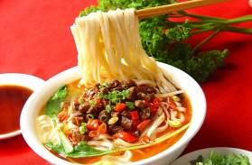
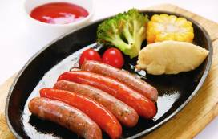
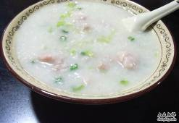
My name is .
I like food.
I enjoy most.
It tastes / They taste .

Slide 20
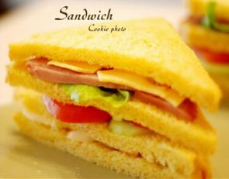
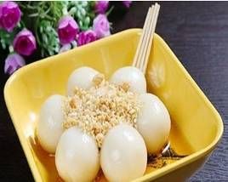
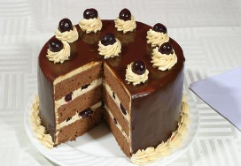
My name is .
I like food.
I enjoy most.
It tastes / They taste .

Slide 21
Do you know that people from different country like different food?

Slide 22
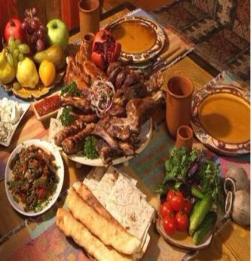
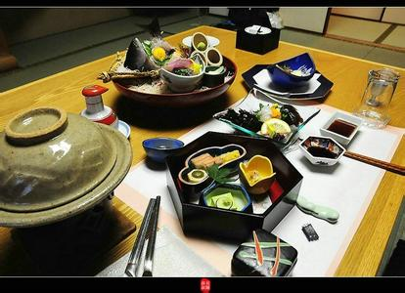
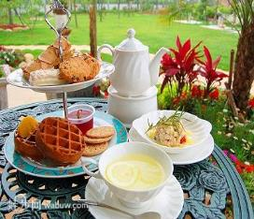
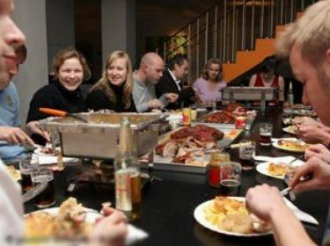
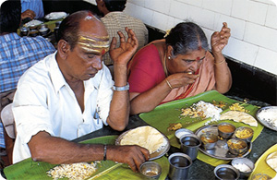
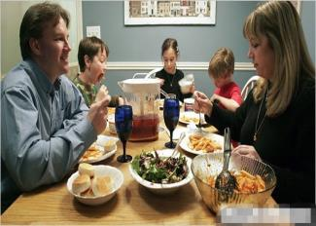
照片呈现用于跟学生谈论，文字帮助学生谈论照片，从而达到在图片情景和文字语境中理解中外餐饮文化差别和输入及练习目标语言的目的。
Different people like different food.

Slide 23
Listen & finish

Slide 24
People from different countries have different taste.
通过听力训练的方式学习各地餐饮习惯，同时通过插入大量的图片及介绍，加大学生的输入，以便让学生了解更多有趣的餐饮文化。这里提供的图片和文字老师不一定全用，可以根据实际选用。
Germans eat and .
They always eat their meals on a with a knife and fork.
They don’t like food.
bread
meat
plate
hot

Slide 25
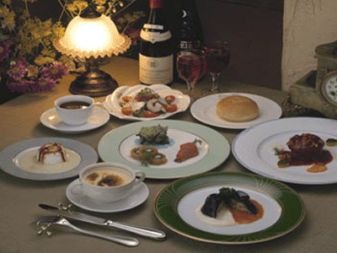
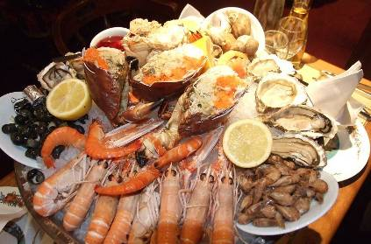
French people eat lots of bread.
They also eat their meals on a plate with a
and .
They like sea food(海鲜) , and
most.
knife
fork
soup
vegetables

Slide 26
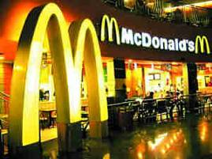
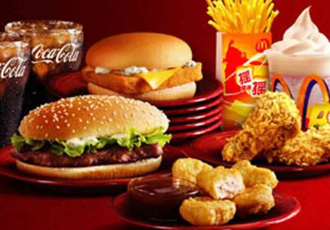
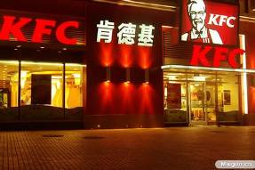
American people often eat food(快餐).
They usually eat their meals on a plate with their .
They like ,hot dogs and fried meat.
They love and sweet food. But they think sour food and hot food are terrible.
fast
hands
hamburgers
salty

Slide 27
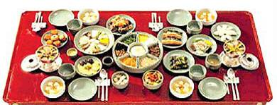
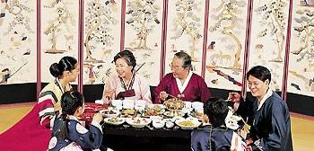
Korea people eat rice or .
They often use and bowls.
Cold dish(冷菜) and kimchi(泡菜) are their
.
They like food, too.
noodles
chopsticks
favourites
hot

Slide 28
Discuss & try

Slide 29
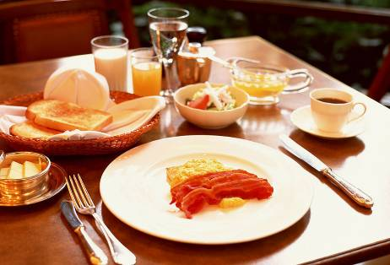
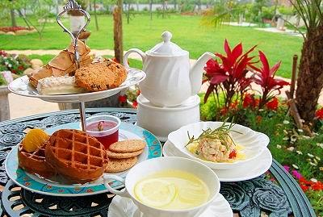
English people eat .
They also eat their meals on a with a knife and fork.
They have a time at about 4 p.m.
They like light(清淡的) and food.
They think hot food is terrible.
bread
plate
tea
fresh

Slide 30
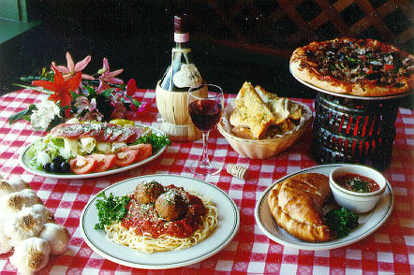
Italian people eat .
They also eat their meals on a plate with a and .
They love pizza most.
noodles
knife
fork

Slide 31
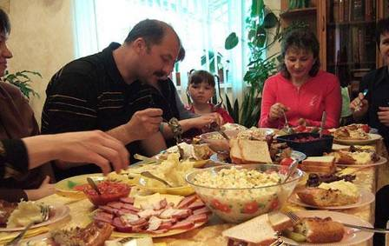
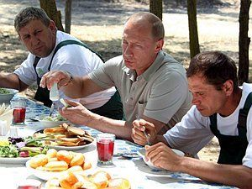
Russian people eat .
They always eat their meals on a plate with a
and fork.
They love food.
noodles
knife
sour

Slide 32
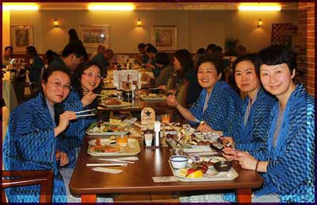
Japanese eat .
They often eat their meals with and .
Their favourite food is sushi（寿司）.
rice
chopsticks
bowls

Slide 33
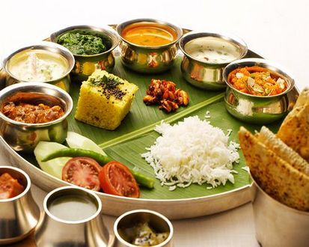
Indian people eat or .
They always eat their meals on a plate with their .
They love curry(咖喱) most.
And they enjoy hot food.
rice
pancakes
hands

Slide 34
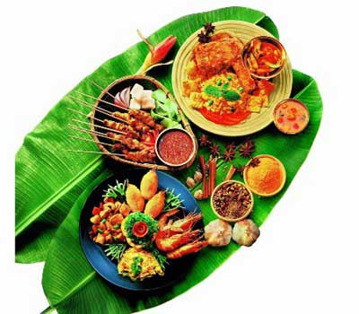
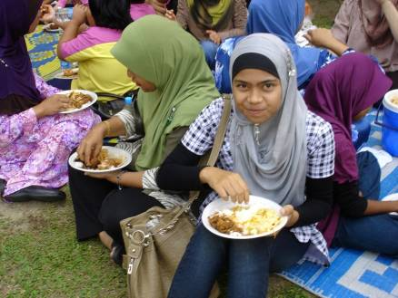
Malaysians eat .
They also eat their meals on a with their hands.
They like satay(沙爹) most.
And they love and hot food.
rice
plate
sour

Slide 35
听读、试背课文。
2. 与你的家人、同学交流“My Taste”这一话题。

