Slide 1
Unit 11
Sad movies make me cry
Section A 第2课时
WWW.PPT818.COM
Notes:
1

Slide 2
Review
would rather
drive sb. crazy / mad
have a lot in common
be friends with sb.
leave out
feel left out
so … that …
have fun
the more… the more…
宁愿
使人发疯/发狂
有很多相同之处
成为某人的朋友
忽略，不提及，不包括
感到受冷落
如此……以至于……
玩得开心
越……，就越……

Slide 3
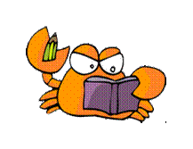
Free Talk
How do you feel about these photos?

Slide 4
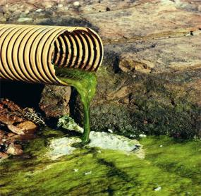
pollution
A: How do you feel about pollution?
B: It makes me kind of angry. How about you?
A: It makes me want to join a clean-up campaign.

Slide 5
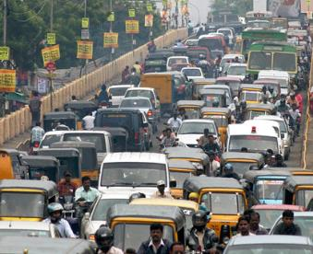
heavy traffic
A: How do you feel about …?
B: It makes me … How about you?
A: It makes me …

Slide 6
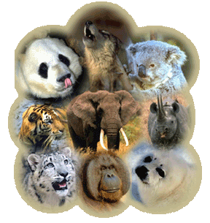
endangered
animals
A: How do you feel about …?
B: It makes me … How about you?
A: It makes me …

Slide 7
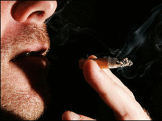
smoking
A: How do you feel about …?
B: It makes me … How about you?
A: It makes me …

Slide 8
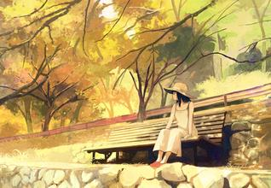
people who keep you waiting
A: How do you feel about …?
B: It makes me … How about you?
A: It makes me …

Slide 9
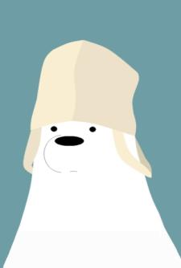
Do you think you are happy? How do you make yourself happy?

Slide 10
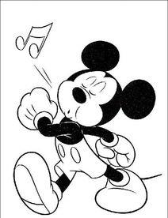
sing

Slide 11
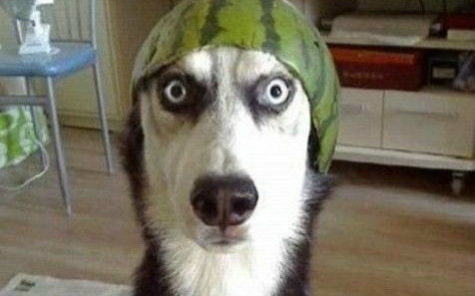
get a cute pet

Slide 12
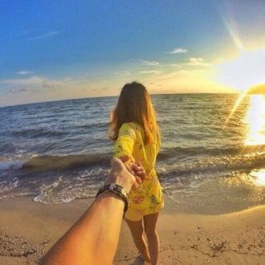
travel in a beautiful place

Slide 13
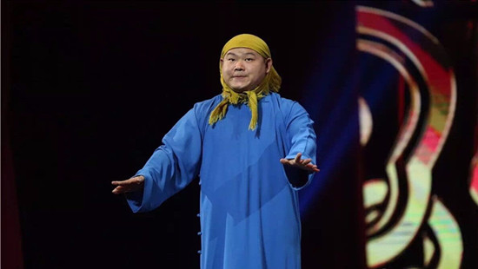
watch a funny show

Slide 14
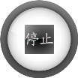
Read and check the sentences below with T or F.
F
1. In the rich and beautiful country, there lived an unhappy queen.
2. The doctor wanted to come to the palace to help with him.
3. The king needed a shirt of a happy man to wear to become happy.
4. The king’s top general was unhappy as the prime minister.
F
T
F

Slide 15
Read again, then answer the following questions.
1. How does the king behave in Paragraph 1?
He couldn’t sleep well or eat well, and often cried for no reason.

Slide 16
2. What’s the advice that the doctor gives?
To wear the shirt of a happy person.

Slide 17
3. According to the story, who are also unhappy?
The prime minister, the king’s banker and the palace singer.

Slide 18
According to the text, complete the chart.
the people who are also unhappy | their reasons of being unhappy
He is always worried about losing his power. Many people are trying to take his position.
prime minister
He is always worried about losing his money. Someone tries to steal his money every day.
king’s banker
He is always worried about being followed by others. He cannot be free.
palace singer

Slide 19
3b Find words or phrases from the story with meanings similar to these phrases.
didn’t feel like eating
was called in
examine
losing power
take my position
1. did not want to eat _________________
2. was asked to come _________________
and help
3. look carefully at _________________
4. becoming less important _________________
5. get my job _________________

Slide 20
Retelling
upon
unhappy
Once ______ a time, there lived an _______ king in a rich and beautiful _______. He slept ______ and didn’t feel like _______. The queen and his people were very _______. They sent the most famous doctor to _______ him. The doctor said _______ could help the king except a happy man’s _____. The prime minister, the banker and the ______ singer were called in to the palace at once, but _____ of them said they were happy and ____ of them had their own worries. Finally, the king’s __________ was sent to find a happy man ___________ time.
country
badly
eating
worried
examine
nothing
shirt
palace
none
each
top general
in three days’

Slide 21
Role-play
Make conversations with your partner and then choose several of your classmates to act out this story in class.

Slide 22
Writing
Imagine the king’s top general finds a happy man. Can you continue the story? Write it into a short passage about 150 words.
Finally, the king’s top general found a happy man …

Slide 23
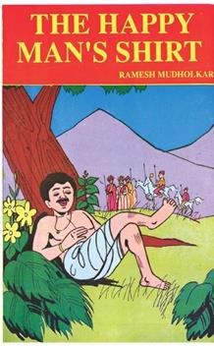
The Happy Man’s Shirt – An Italian Tale

Slide 24
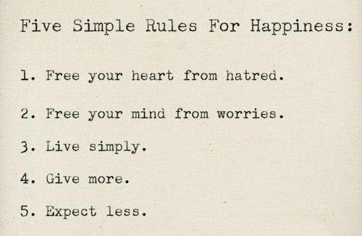

Slide 25
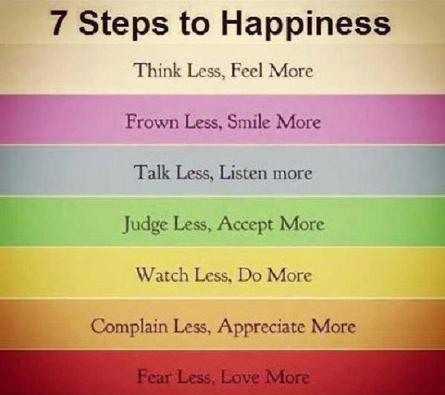

Slide 26
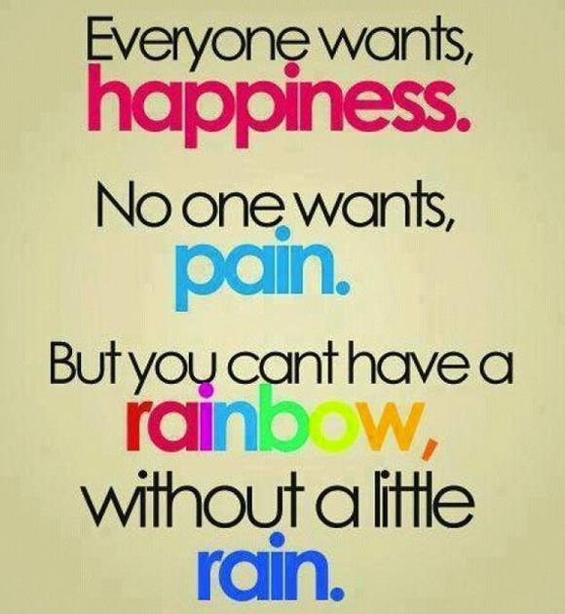

Slide 27
Proverbs about happiness
1. Man is the artificer of his own happiness.
— Henry David Thoreau
人是自己幸福的设计者。
—亨利·大卫·梭罗
2. Happiness is a form of courage.
— H. Jackson
幸福是勇气的一种形式。
—杰克逊. H.

Slide 28
3. A contented mind is the greatest blessing a man can enjoy in this world.
— Joseph Addison
知足是人生在世最大的幸事。
—约瑟夫·艾迪生
4. Happiness grows at our own firesides, and is not to be picked in strangers’ garden.
— D. W. Jerrold
幸福生长在我们自己的火炉边，而不能从别人的花园中采得。
—杰罗尔德. D. W.

Slide 29
5. To fill the hour — that is happiness.
— Ralph Waldo Emerson
让时间过得充实些，那才是幸福。
—拉尔夫·瓦尔多·爱默生
6. True happiness is of a retired nature, and an enemy to pomp and noise.
— Joseph Addison
真正的幸福不显山露水，它摒弃浮华和喧嚣。
—约瑟夫·艾迪生

Slide 30
7. Happiness lies not in the mere possession of money; it lies in the joy of achievement, in the thrill of creative effort.
— Franklin Roosevelt
幸福不在于拥有金钱，而在于获得成就时的喜悦以及产生创造力的激情。
—富兰克林·罗斯福

Slide 31
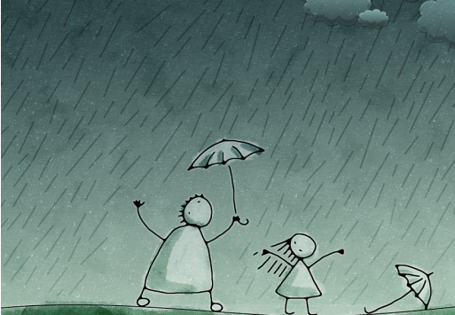
Enjoy a song Rhythm of the Rain.

Slide 32
Language points
1. …, there lived an unhappy king.
There be结构中的谓语动词有时不用be，而用其他动词，使语言表达更生动形象，如live、stand、lie等词。
Once upon a time there lived a king in China.
从前中国有一位国王。
Then there came a knock at the door.
接着听到敲门声。

Slide 33
2. He slept badly and didn’t feel like eating.
feel like 感觉起来像，觉得好像，想要
It feels like silk.
它摸起来像绸缎。
What she sings feels like a story.
她唱的歌感觉好像是一个故事。
Do you feel like going to a movie?
你想看电影吗？

Slide 34
feel like与would like 意思很相近，但feel like 后面常跟名词、动名词。
构成：feel like (doing) sth.，而would like一般接名词、动词不定式，构成：would like (to do) sth.的句式。如：
① I feel like (having) a drink.
= I would like (to have) a drink.
我想喝一杯。
② Do you feel like taking a walk.
= Would you like to take a walk?
你想散步吗？

Slide 35
— Hi, Julie. What would you like to have for supper?
— Oh, mom, I feel terrible and don’t feel like ____ anything.
A. eat B. to eat
C. eating D. ate
【解析】句中的feel like doing sth.意为 “想做……”，选C。
C

Slide 36
I feel like going for a walk this afternoon. (改为同义句)
I ______ ______ _______ go for a walk this afternoon.
我想喝杯茶。(feel like)
would like to
I feel like (drinking) a cup of tea.

Slide 37
3. His face was always pale as chalk.
(as) pale as chalk是一种明喻修辞结构，相当于汉语的“惨白；苍白”
You looked as pale as chalk when you went into hospital.
你进医院时面色苍白。
You look as pale as chalk today. What’s wrong?
今天你看上去面色苍白，哪里不舒服吗？

Slide 38
汉语描述不健康的人的面部颜色时常用“白”字，如“煞白；苍白；灰白”等，英语常用 pale 来表达。如：
He suddenly went pale.
他突然脸色苍白。
She was pale with fear.
她吓得脸色发白。

Slide 39
4. One day a doctor was called in to examine the king.
call in 找（请）来；召来
How many friends did you call in?
你邀请了多少朋友？
He is ill; you should call in the doctor right away.
他病了，你应该立即请大夫来。
Police were called in to break up the meeting.
出动了警察将集会驱散。

Slide 40
知识拓展
call off 放弃；取消；叫走
Please call off the dog; it’s barking at the children.
请把这条狗赶走，它在对着孩子们吠叫。
call on 拜访（某人）； 叫； 号召； 要求
I’m going to call on one of my former classmates.
我要去看望我的一位老同学。

Slide 41
call up 打电话；召集；召唤
Johnny, why don’t you call up your mother?
Johnny，为什么不给你妈打电话？
call for 需要，要求
call for help 需要求助
The next thing I did was to call for help.
接下来我做的事是呼救。

Slide 42
— Clean-up Day is only two weeks from now. How should we make more people know it? — We could ______ our classmates to hand out advertisements after school.
A. call up B. hand out C. put off D. think up
A

Slide 43
5. Neither medicine nor rest can help him.
neither … nor … 既不……也不……
Neither you nor he is out of money.
你不缺钱，他也不缺钱。
We are going to play neither basketball nor volleyball.
我们既不打算打篮球也不打算打排球。

Slide 44
neither
1）作代词时是对两者都进行否定，意思为“两者都不”，作主语时谓语动词用单数；
I know neither of them.
他们两个我都不认识。
Neither of the boys is from England.
这两个男孩都不是来自英国。

Slide 45
2）作形容词时也修饰单数名词，意思与作代词时相同；
3）作连词时，一般与nor搭配，表示 “既不……也不……”。作主语时，谓语动词遵循就近原则。
She neither ate nor drank yesterday.
她昨天既不吃也不喝。
Neither he nor we play football on Sundays.
他和我们星期天都不踢球。

Slide 46
知识链接
either … or …表示两者选其一，意思是“不是……就是……；要么……要么……”。作主语时，谓语动词遵循就近原则。
Either he or I am right.
不是他是对的，就是我是对的。
Either my sister or my parents are coming to see me.
不是我姐姐就是我父母要来看我。

Slide 47
— Mom, when shall we go to Weifang Museum this weekend?
— Oh, sorry. I’m going to Beijing for a meeting. ____ Saturday ____ Sunday is OK.
Neither; nor B. Both; and
C. Either; or D. Not only; but also
【解析】neither … nor …意为“既不……也不……”；both … and …意为“两者都”；either … or …意为“或者……或者……”；not only … but also …意为“不但……而且……”。 句意为“—妈妈，这个周末我们什么时候去潍坊博物馆？—哦，对不起。我将去北京开会。周六和周日都不行。”
A

Slide 48
6. Although I have a lot of power, …
power n. 权力；力量，能力
It is within my power.
那是在我的权力以内。
The police have the power of arrest.
警方有权拘捕。

Slide 49
知识拓展
come to (into) power 取得政权；（开始）掌权，执政，当权，上台
great power 大国，强国
be beyond (out of) one’s powers 力所不及，不能胜任
be in one’s power 在……的能力范围之内
do all in one’s power 全力以赴，竭力

Slide 50
7. I have a lot of wealth, but …
wealth n. 财富 为不可数名词
His own wealth grew.
他的个人财富在增长。
Health is better than wealth.
[谚]健康胜于财富。
He is a man of great wealth.
他是个大款。

Slide 51
知识拓展
wealth n. 丰富；大量
a wealth of 大量的，丰富的
There’s a wealth of books in the library.
这个图书馆藏书丰富。
She has a wealth of knowledge about China.
她对中国很了解。

