Slide 1
Unit3 This is my father
人教精通版三年级下册
WWW.PPT818.COM

Slide 2
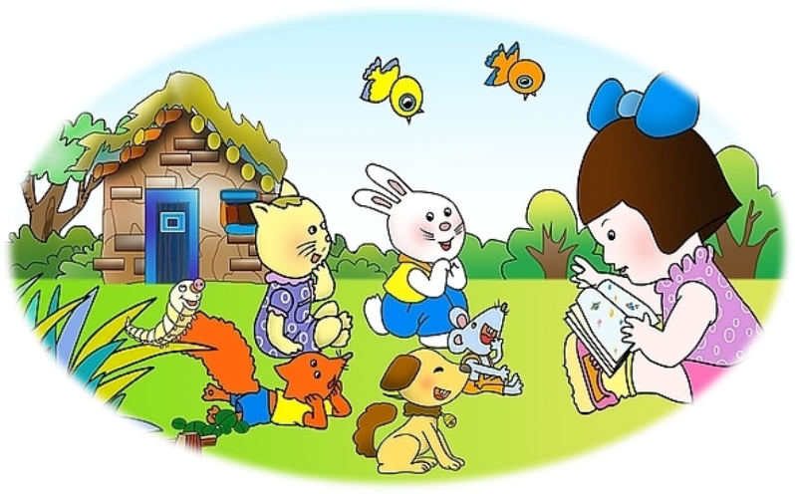
Warm-up
Show your story

Slide 3
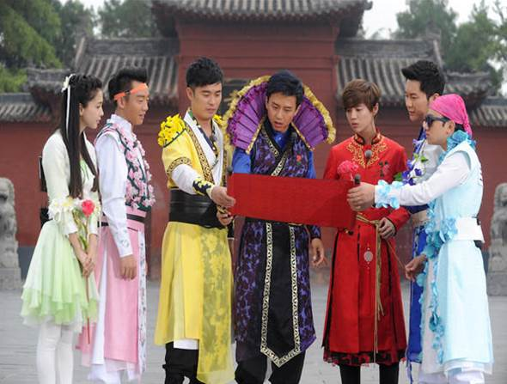
Lead-in
Running man

Slide 4
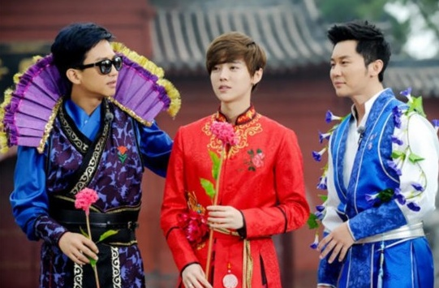
Presentation
Who is that man?
That’s Lu Han.
That’s Li Chen.
That’s Deng Chao.

Slide 5
Presentation
Who is that woman?
That’s Yang Ying.

Slide 6
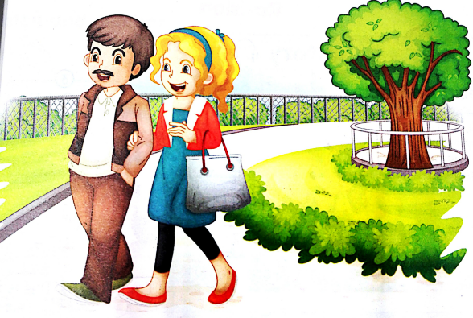
Presentation
Who is that man?
uncle
That’s my father’s brother.

Slide 7
Presentation
Who is that woman?
aunt
That’s my uncle’s wife(妻子).

Slide 8
Presentation
Who are they?
What are they talking about?

Slide 9
Presentation
Hi, Yang Ming! Who’s that man?
That’s my uncle.
Who’s that woman?
That’s my aunt.

Slide 10
Presentation
Just talk
 | Hi, Yang Ming! Who’s that man?
 | That’s my uncle.
 | Who’s that woman?
 | That’s my aunt.

Slide 11
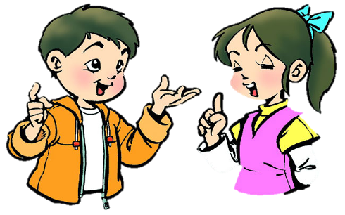
Practice
Role-play
分角色朗读出对话，注意模仿语音语调。
两人一组，试着表演出来吧。

Slide 12
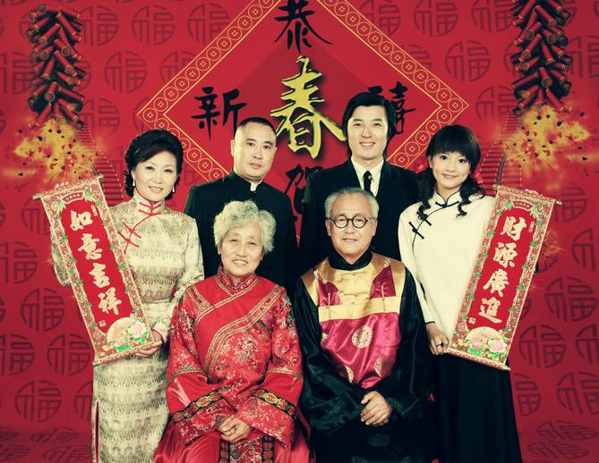
Practice
猜谜游戏
This is my mother’s brother. Who’s this?
This is my mother’s sister. Who’s this?

Slide 13
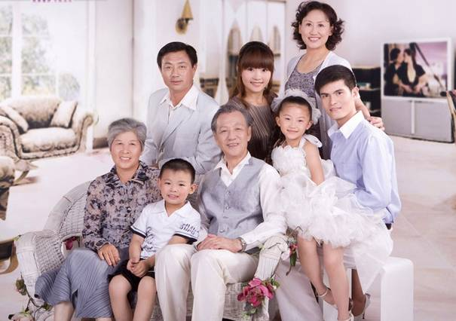
Practice
猜谜游戏
This is my father’s sister. Who’s this?
This is my uncle’s wife. Who’s this?
This is my father’s brother. Who’s this?

Slide 14
Practice
Who’s that
girl
?
That’s Sarah.

Slide 15
Practice
Who’s that
?
woman
That’s Miss White.

Slide 16
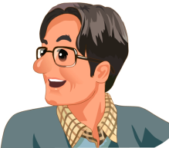
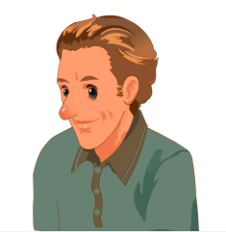
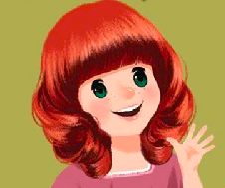
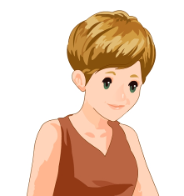
Practice
Who’s that…?
That’s…
2人1组，用所给图片，编创对话
表演对话

Slide 17
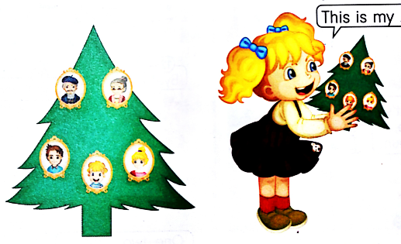
Practice
Let’s make and talk
This is my ...
Gule photos on it.
Introduce your family.

Slide 18
Summary
1.本课学到的新单词：
uncle
aunt
2.本课学到的新句型：
Who’s that man?
That’s …

Slide 19
Homework
1. Listen the dialogue three times.
听Just talk录音三遍。
2. Recite the dialogue.背诵对话。
3. With the help of the sentence parttens, make a new dialogue .在学过的主句型的帮助下，再创编一个新对话。
Close

