Slide 1
Module
2
What can you do ?
Unit 1 I can play the piano.
WWW.PPT818.COM

Slide 2
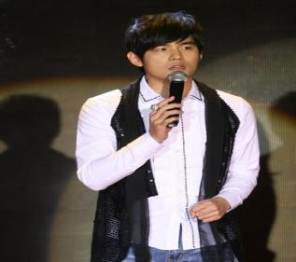
A: what can you do, ZhouJielun ?
B: I can…

Slide 3
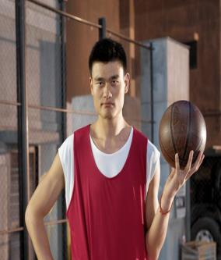
A: what can you do, YaoMing ?
B: I can…

Slide 4
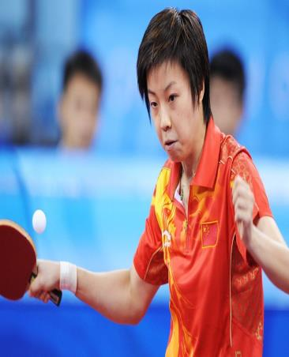
A: what can you do, ZhangYiNin?
B: I can…

Slide 5
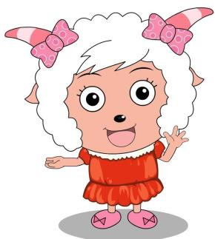
Hello, I’m Mei Yang yang.
I can read books.
I can do homework.
I am helpful.

Slide 6
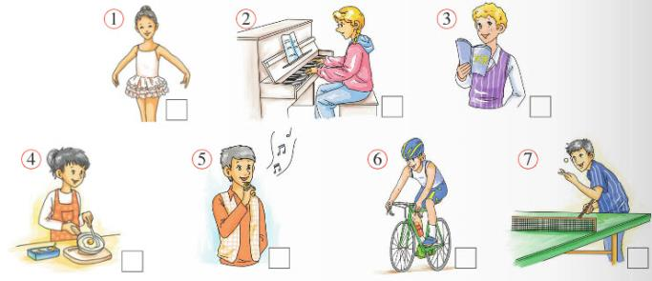
Listening and vocabulary
Match the words and expressions
from the box with pictures.
□
cook dance play table tennis play the piano
ride a bike sing speak Chinese
□
□
□
4
1
7
2
□
□
□
6
5
3

Slide 7
2. Listen and check(√) the things in Activity 1 which Tony’s dad can do.

Slide 8
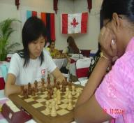
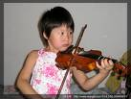
Pairwork talk about your abilities
--- Can you…?
--- Yes, I can.
--- No , I can’t .
speak English
play chess
sing
dance
play cards
play basketball
play soccer
play volleyball
play the violin
draw / paint
swim
play the guitar

Slide 9
Listen again and read.
Daming: Look! The new clubs for this term are on
the board. I’d like to join the Music Club
because I can play the piano. What about
you, Betty?
Betty: I like cooking, so I can join the Food and
Drink Club. Can you cook, Daming?
Daming: No, I can’t. Well, I can cook eggs,
but that’s all. What about Lingling?
Which club can she join?

Slide 10
Betty: I think she’d like to join the Dance Club
because she can dance really well. Tony,
how about you ?
Tony: I’d like to join the Chinese Club .I can’t
speak Chinese! So choose your favorite
club.
Tony: OK then. I play table tennis, so I choose
the Table Tennis Club. That’s my
favourite!

Slide 11
Now check(√) the clubs they want
to join.
Club Name | Music Club | Dance Club | Table Tennis Club | Food and Drink Club
Daming
Betty
Lingling
Tony
√
√
√
√

Slide 12
Language points
I’d like to join the Music Club because I can play the piano. 我想加入音乐社团意为我会弹钢琴。
a) join意为“参加; 加入”。join后面常接表示团体的名词, 表示加入某团体或成为某团体的一员; 也常接人称代词的宾格形式,表示和某人一起进行某活动。
b) play和球类,棋类搭配时,中间不用任何冠词(a, an, the)。但它和乐器类搭配时,要用冠词the。如：
play football play chess
play the guitar play the piano

Slide 13
如：
Tom plays soccer well. He wants to join
the soccer club.
汤姆足球踢得好, 他想加入足球俱乐部。
We want to go to a movie. Do you want to
join us?
我们想去看电影, 你和我们一起去吗？

Slide 14
辨析与拓展
1. join & take part in
（1） join v. 参加；加入；作……成员
join + 团体/组织，表示成为…...的一员
join the army 参军 join the Party入党
join the club 加入这个俱乐部
（2 ）take part in 参加(群众性活动、会议等)
Typical exercises：
1. What club do you want to _______?
2. To keep healthy, We should ______________
school activities.
join
take part in

Slide 15
2. What about 和 how about ……怎么样？
是英语口语中常用的两个省略句型，它们的意思和用法基本相同, 后面可以加人称代词宾格，名词或者动词-ing形式。
常用的场合有：
（1）向对方提出建议或请求。例如： How about going out for a walk? 出去散散步好吗？
（2）征询对方的看法或意见。例如： What about the TV play? 那个电视剧怎么样？
（3）询问天气或身体等情况。例如： What about the weather in your home town?
Thank you. I’m very well. What about you?

Slide 16
3. would like to do sth. 想要做某事
=would love to do sth.
“ would like ”意为“想要”，其语气婉转些。
具体用法如下： 1. 后面接名词或代词，表示“具体要”某样东西。例如： I’d like two sweaters for my daughters.
（我想给我的女儿们买两件毛衣。） Would you like one of these moon cakes？
（你想要一块这样的月饼吗？） 2. 后面接动词不定式，表示“愿望，喜爱”，常用于有礼貌地提出邀请、请求或建议。例如： Would you like to come to supper？

Slide 17
俱乐部名称的写法
join the swimming club
the dancing club
the singing club
the music club
the art club
the English club
the chess club
the sports club
the basketball/tennis/golf club
Which one do you want to join?

Slide 18
4. Complete the passage with the correct
form of the words from the box.
board choose club music term
Can you cook ? No? Join the Food and Drink
(1)________ . Can you play the piano? Join
the(2)_________ Club. What about dancing?
(3)_________The Dance Club. There are lots
of new clubs every(4)_______ . They’re all on
the(5)______and you can choose your
favourite.
club
Music
Choose
term
board

Slide 19
Pronunciation and speaking
5. Say the sentences aloud.
/ kən / I can play the piano.
/kɑ:nt / I can’t speak Chinese very well.
/kæn / Can you cook?
Now listen and repeat.

Slide 20
Learning to learn
In English, we pronounce a word in
different ways when it is stressed or
not stressed. In “Yes, I can”, we pronounce
can as / kæn /; in “ Oh, good. You can come
to help us”, we pronounce can as / kən /.

Slide 21
6. Listen and repeat.
/ i: / Chinese she we
/ e / egg tennis
/ I / English

Slide 22
7. Work in pairs. Look at the information.
Ask and answer.
 | Can | Can’t
Daming | speak Chinese play the piano | dance
Betty | speak English cook | play table tennis
Lingling | speak Chinese dance | cook
Tony | play table tennis speak English | speak Chinese well

Slide 23
Can Daming speak Chinese?
Yes, he can.
Can Betty play table tennis?
No, she can’t.

Slide 24
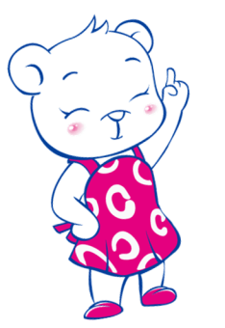
can +
动词原形
Can 无人称 数量变化
Can+主语+动原…?
Yes,…can.
No,…can’t.
主语+can’t+动原.

Slide 25
情态动词can的用法：情态动词是辅助动词
帮助说明能力、意愿等的词，它没有人称
和数的变化, 后边直接加动词原形。
肯定句：主语+can + 动词原形
否定句：直接在can后加“not”.
He can’t (cannot) swim.
一般疑问句直接把can提前
Can you dance ?
特殊疑问句：特殊疑问词+ 一般疑问句？
What can you do ?

Slide 26
More practice
Kangaroos Birds Geese Fish Rabbits Cats Dogs | can can’t | fly high. jump high. swim fast. run fast. climb trees. read and write.

Slide 27
Homework
Introduce yourself to the class.
Model: My name is …. I can sing and dance.
I can play the guitar and violin. I want to join
the music club.

Slide 28
Good bye!

