Slide 1
Unit 12
Life is full of the unexpected.
Section A Period 2 3a-4c
WWW.PPT818.COM
Notes:
1
1

Slide 2
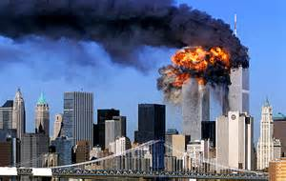
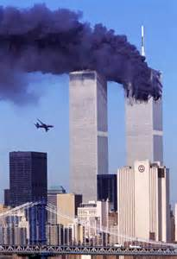
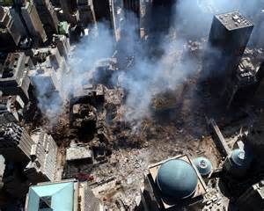
How much do you know about September 11 attacks?
Location: Manhattan, New York
Date: September 11, 2001
Target: World Trade Center
The Pentagon
Death: 2996
Non-fatal injuries: 6000+

Slide 3
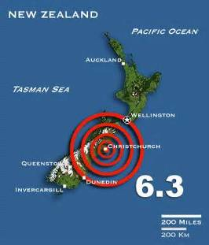
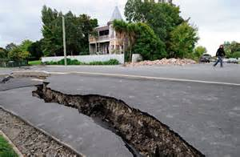
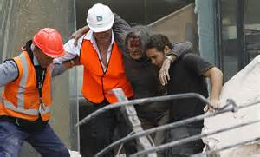
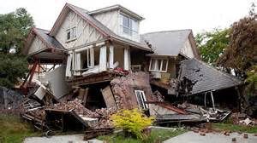
How much do you know about 2011 Christchurch Earthquake?
Date: February 2011
Magnitude: 6.3 ML
Epicenter: near Lyttelton, Canterbury, New Zealand
Casualties:
185 deaths
1500-2000 injuries, 164 serious

Slide 4
2·22新西兰克莱斯特彻奇地震
2011年2月22日中午12时51分，新西兰第二大城市克莱斯特彻奇发生里氏6.3级强烈地震，震源深度距离地表仅有4公里。新西兰警方表示，地震共造成182人遇难，成为新西兰80年来死伤最为惨重的地震。

Slide 5
3a
P91
Look through the passage and answer the questions.
Which two events does the writer mention?
2. How did the writer end up missing both events?
The writer mentions the September 11 attack in New York and the earthquake in New Zealand.
The writer went to get a coffee first and was not in the office when the plane hit the World Trade Center. He/ She had overslept and missed his/her flight, so he/she was able to avoid the earthquake.

Slide 6
Incident | Date | Place | How did writer end up missing the event?
The world Trade Center was hit by a plane
In New York
He/She decided to get a coffee first from a coffee place two blocks away.
2001.9.11
Read the passage again and fill in the blanks.
In New Zealand
He/She missed his/her plane to New Zealand.
Earthquake
2011.2.22

Slide 7
划出3a中包含过去完成时的句子

Slide 8
完成3b
Find words from the passage with opposite meanings to the words below. Then write a sentence with each word.
lost: _____ _______________________
west: _____ _____________________
3. below: ____ ______________________
4. dead: ___ _________________________
5. empty: ___ ____________________________
found I found the money on the floor.
east The sun rises in the east.
above There was a large bird flying above us.
alive His family was so happy to hear he was still alive.
full The train was so full that I couldn’t get on at all.

Slide 9
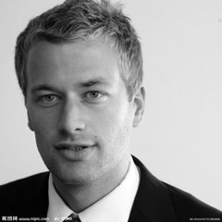
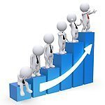
Reading and retelling
3c
stare
in disbelief
take off
unexpected
above
alive
till/until
arrive at
even though
be about to

Slide 10
Grammar Focus
根据汉语提示完成句子。
1)当我到达学校的时候，我才意识到我把书包忘在家里了。
_______ I got to school, I realized that I
______ ______ my backpack at home.
2)到我返回学校的时候，铃声已经响过了。
_____ _____ _____ I got back to school, the bell ______ _______.
When
had
left
By the time
had rung

Slide 11
3)我到达公共汽车站之前， 汽车已经离开了。
Before I _____ _____ the bus stop, the
bus ______ _______ _______.
4)我决定先买一杯咖啡，然后再去办公室。
I ______ ______ ______ go up to my office when I decided to get a coffee first.
got to
had
already left
was about to

Slide 12
5)就在我和别的工作人员一起排队等候的时候，听到了一个巨大的声响。
As I ______ _______ ______ ______ with the other office workers, I
______ _____ _____ ______.
was waiting in line
heard a loud sound

Slide 13
◆ When I got to school, I realized that I had left my backpack at home.
◆ By the time I got back to school, the bell had rung.
◆ Before I got to the bus stop, the bus had already left.
由when, by the time, before等引导时间状语从句时，若描述发生在过去的事，主句常用过去完成时(had + 过去分词)表示动作发生在过去的过去。

Slide 14
◆ I was about to go up to my office
when I decided to get a coffee first.
◆ As I was waiting in line with the
other office workers, I heard a loud
sound.
be about to do, be doing等表示即将或正在做某事时，常用when引导从句表示突然发生的动作。

Slide 15
4a
Make sentences using by the time or before.
1. Tim went into the bathroom. Mary got up.
By the time Mary got up, Tim had already
gone into the bathroom.
2. The coffee became cold. I put cream (n. 奶
油) in the coffee.
__________________________________
__________________________________
Before I put cream in the coffee, the coffee had become cold.

Slide 16
3. The teacher collected the math homework. I got to school.
__________________________________
__________________________________
4. I completed the work for my boss. The workday (n. 工作日) ended.
__________________________________
__________________________________
By the time I got to school, the teacher had collected the math homework.
I had completed the work for my boss before the workday ended.

Slide 17
5. The movie started. I arrived at the cinema.
__________________________________
__________________________________
6. My mother finished making the apple pie
(n. 果馅派). I got home from my language
course.
__________________________________
__________________________________
__________________________________
The movie had started before I arrived at the cinema.
By the time I got home from my language course, my mother had finished making the apple pie.

Slide 18
4b
Fill in the blanks with the correct forms of the words in the box.
rush out, forget, arrive at, go into,
show up (赶到；露面), find out
1. By the time I arrived at the party, everyone else _____ already __________.
2. When he put the noodles into a bowl, he realized he ____________ to add the green beans (n. 豆).
had
shown up
had forgotten

Slide 19
3. By the time my mother came back from the market (n. 市场), I ____ already __________
the door to go for my piano lesson.
4. Before she got to the airport, she _________ ___ about the earthquake.
5. When she _________ the movie theater, she remembered she had forgotten to feed her dog.
6. Before she got a chance to say goodbye, he ____________ the building.
had
rushed out
had found
out
arrived at
had gone into

Slide 20
Write two true statements and one false statement about your day yesterday. Then ask your classmates to guess the false statement.
4c
1. By the time I left for school in the morning, __________________________________
__________________________________
__________________________________
I had already had breakfast.
I had already had supper.
I had already had my hair cut.

Slide 21
2. By the end of the school day,
__________________________________
__________________________________
__________________________________
3. By dinner time, I_________________________________
I_________________________________
I_________________________________
I had finished my homework.
I had gotten a present from Tom.
I had had these articles read.
had had too many apples.
had eaten plenty of meat.
have had all the housework finished.

Slide 22
Homework
1. 复习Grammar Focus 中的内容。
Try to make sentences with before,
by the time and be doing … when,
and make use of the past perfect
tense.
2. 写作： 描述一次难忘的经历。

