Slide 1
Unit3
Welcome to our school!
WWW.PPT818.COM

Slide 2
Warm up
Questions:
How many lessons do we have today?
2. What are they?

Slide 3
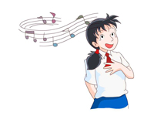
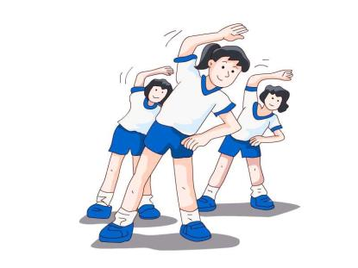
Music
PE
What subject does Kitty have?
What subject do they have?

Slide 4
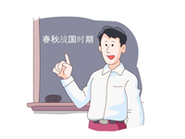
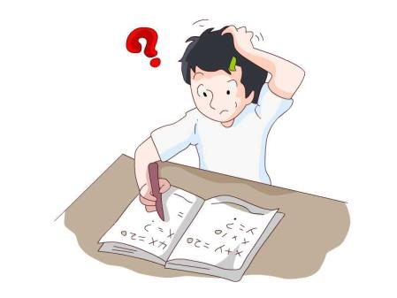
What subject does Millie have?
What subject is this?

Slide 5
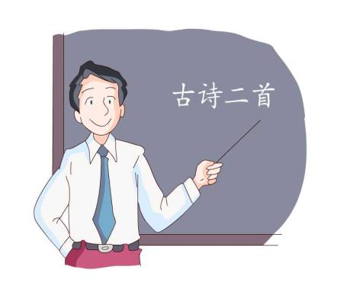
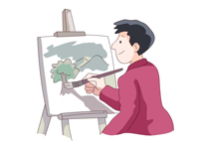
What subject is this?
What subject does this
teacher teach?

Slide 6
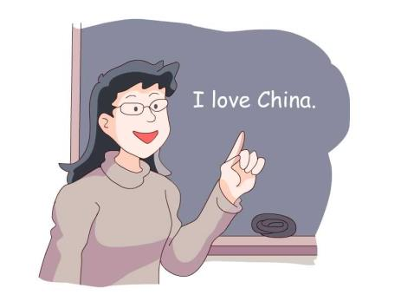
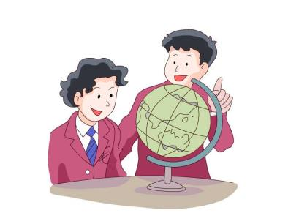
Do you know this subject? What is it?
What subject does this
teacher teach?

Slide 7
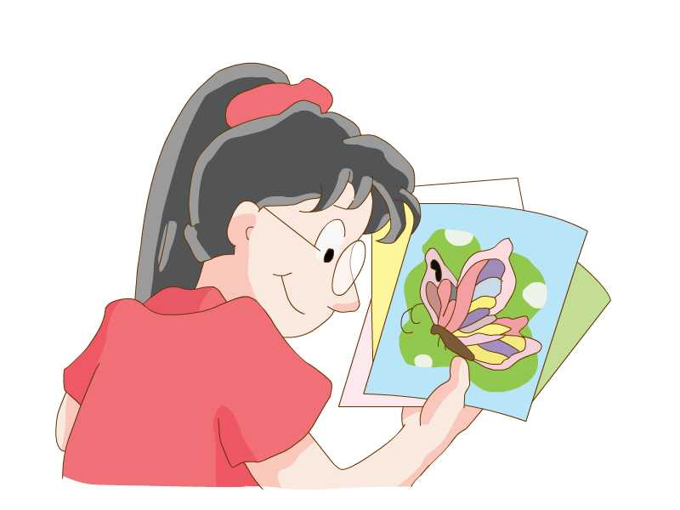
What about this subject?

Slide 8
Self-learning 1
自学一
（1）自学内容: Page31 part A
（2）自学方法:
1.自学part A，完成课本练习并小组校对答案。
2.根据课程表谈论今天的课程。

Slide 9
 | 星期一 | 科目
7∶50—8∶25 | 第一节 | 英语
8∶35—9∶20 | 第二节 | 语文
9∶40—10∶25 | 第三节 | 数学
10∶35—11∶20 | 第四节 | 思品
13∶30—14∶15 | 第五节 | 地理
14∶30—15∶15 | 第六节 | 阅读
15∶25—16∶10 | 第七节 | 班会

Slide 10
Self-learning 2
（1）自学内容: Page 31 part B
（2）自学方法:
1.听PartB 磁带，回答问题。
2.学生自编对话并表演
（3）释疑

Slide 11
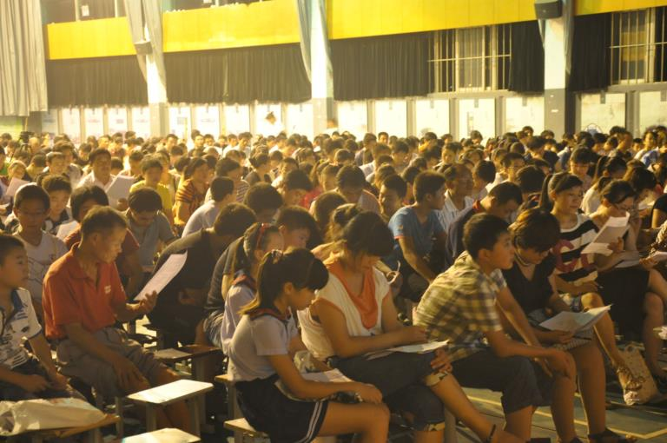
parents’ meeting

Slide 12
1 What’s the date of the Open Day in Millie’s school?
2 Can Millie’s mother go to her school?
3 What time does the parents’ meeting begin?
4 What else do parents do after the meeting?
5 Where does Millie meet her mother?

Slide 13
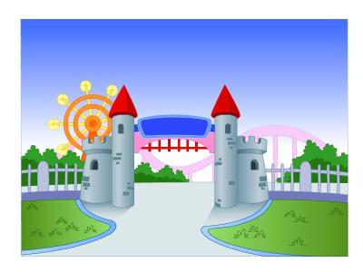
1 What’s the date of the Open Day in Millie’s school?
2 Can Millie’s mother go to her school?
3 What time does the parents’ meeting begin?
4 What else do parents do after the meeting?
5 Where does Millie meet her mother?
It’s 9 October.
Yes, she can.
At 2 o’clock in the afternoon.
They watch two of their lessons.
At the school gate.

Slide 14
Work in pairs and talk about it.
S1: What’s the date today, …?
S2: It’s …. Oh, tomorrow is ... Can you
come, ...?
S1: Yes, I can. What time is it?
S2: The ... begins at ... in ... After that,
parents ...
S1: Ok. Let’s meet at the school gate at ...

Slide 15
Warm up
S1: Which of the subject do you like best?
S2: I like… best.
S1: Why?
S2: Because it…

Slide 16
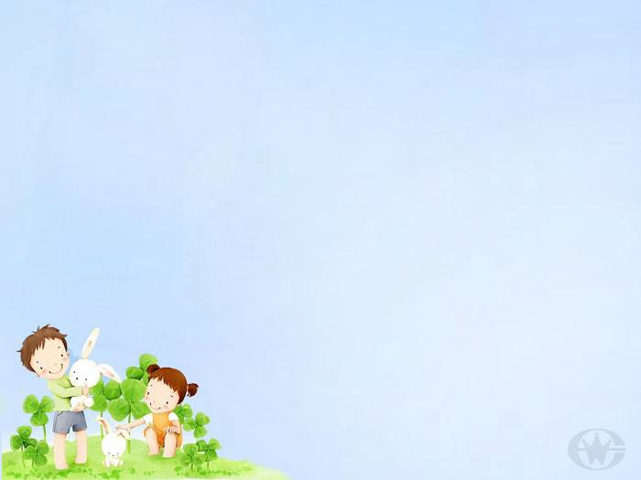
Self-learning 3
（1）自学内容: Page 30 对话
（2）自学方法:
1.听对话，回答下列问题
a. Which subject does Eddie like best?
b. How many cakes does Eddie want to
eat?
2．听对话，学生进行操练。
3.学生自编对话并进行表演。

Slide 17
1 Which subject does Eddie like best?
2 How many cakes does Eddie want to eat?
He likes Maths best.
He wants to eat three cakes.

Slide 18
Notes:
1.在开放日
2.谈论开放日
3.家长会
4.在校门口
5.哪门科目是你最喜欢的？
6.今天几号？
7.几点了？
8.让我们一点半在校门口会面。

Slide 19
Notes:
1.在开放日
2.谈论开放日
3.家长会
4.在校门口
5.哪门科目是你最喜欢的？
6.今天几号？
7.几点了？
8.让我们一点半在校门口会面。
on the Open Day
talk about the Open Day
the parents’ meeting
at the school gate
Which of the subjects do you like best?
What’s the date today?
What time is it?
Let’s meet at the school gate at 1:30.

Slide 20
Exercise:
meeting
1 There is going to be a club_________(meet) this weekend.
2 We should brush our_________(tooth) twice a day.
3 Jim feels________(real) sorry about the bad news.
4 My classroom is on the________(one) floor.
5 How many__________(parent) meetings do you have each term?
6 Jim studies English______(good). He is good at it.
7 Mr. Wu teaches______(we) English this year.
8 The_________(build) next to the library is the school hall.
9 These QQ numbers are their_________(friend).
10 The _________(member) of our class like swimming .
teeth
really
first
parents’
well
us
building
friends
members

Slide 21
Homework
1 背诵对话
2 完成课课练

