Slide 1

Module
8
My future life
Unit 1
Here’s to our friendship!
WWW.PPT818.COM

Slide 2
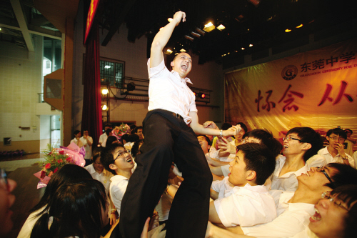
Warming up
How will you feel at the school-leavers’ party?

Slide 3
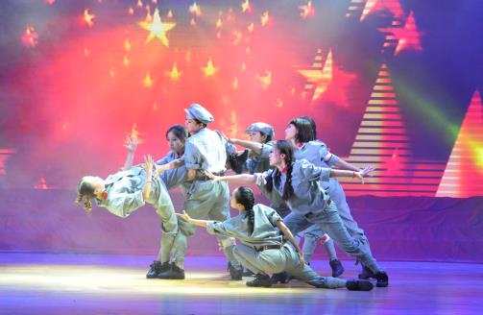
What are you going to show for your classmates?

Slide 4
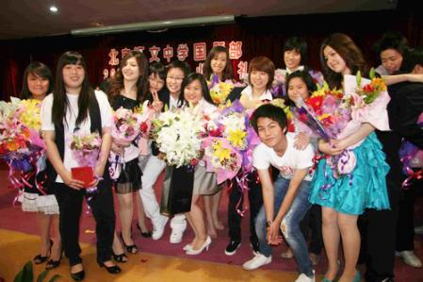
Will you wear beautiful clothes to take part in the party?

Slide 5
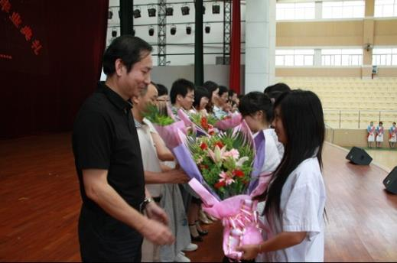
What do you want to say at the school-leavers’ party?

Slide 6

Words review
hangbag
beat
pardon
intend
fetch
pancake
n. (女用)小提包
n. 节拍；拍子
v. (口语)对不起，请原谅
v.计划；打算
v.(去) 取来；拿来
n. 薄烤饼；薄煎饼

Slide 7
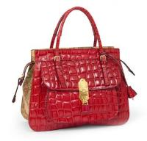
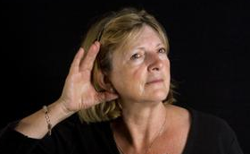

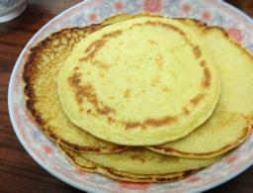

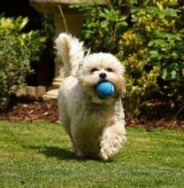
比一比，看谁能快速说出下面的单词。
beat n.
节拍，拍子
handbag
n. 女用小提包
pardon 请再说一遍
pancake
n. 薄烤饼，薄煎饼
intend
v. 计划，打算
fetch v.
取来，拿来

Slide 8
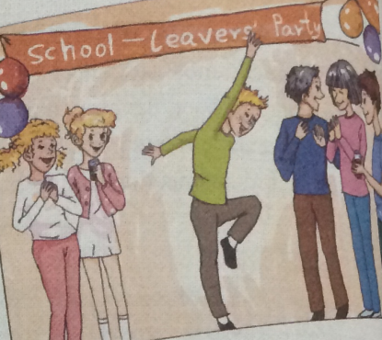
1. Look at the picture and answer the questions.
1. What is the special event?
2. What is everybody doing?

Slide 9

2. Listen and answer the questions.
Where is Betty going tonight?
What are Betty and Tony going to do?
School leavers’ party.
She’s going to help Tony put up the pictures, balloons and flags.

Slide 10
3 Why does Betty refuse to eat before she leaves?
Because she is going to eat at the party.

Slide 11
Listen to Part 3 and answer the following questions.
1. Is Lingling enjoying the party?
Yes, she is.
2. Who hang international flags on the
wall?
Tony.

Slide 12

Listen and read
Learning to learn
When you listen to the recording, try to note down the key information. Your notes will then help you retell the main information.

Slide 13

3. Listen and read
Betty:You look lovely, Ling!
Lingling: Thanks, you look great too. That's nice
handbag.
Betty: It's my mother's. Are you enjoying the
party?
Lingling: Yes, I am. But I feel a bit sad. I don't
know when we'll be back in this hall
together again. I'm going to miss you all.
Tony: Yes, we'll all miss each other.
music.
Lingling: Hey, Tony. You've hung international
flags on the walls! They make the hall
on the walls 在墙上

Slide 14
don't you 反义疑问句，遵循“前肯后否，前否后肯”原则
look wonderful!
Tony: They look OK, don't they? Listen to the
music. It's got a great beat.
Betty: Pardon? Oh, yes, but it's a bit noisy.
Lingling: Do you intend to stay in China for long,
Tony ?
Tony: I hope so. And even if I go back to the
UK, I'll come back and visit you all.
Lingling: What about you,Betty?
Betty: I'll finish my high school education here,
but I want to go back to my hometown
one day. What are your plans, Daming?
Daming: I want to become......an English teacher!
Tony: Good for you! Come on! Let's fetch
Listen to 听........
I hope so 我希望如此
go back to 回到........
want to do sth. 想要做某事
one day有一天，某一天
good for you 真行，真棒

Slide 15
something to eat. What's on the menu?
Betty: How about a hot dog? Or some pancakes?
And we've got some apple juice.
Tony: Let's raise our glasses. Here's to our
friendship, everyone.....and to the future!
All: Cheers!
Betty: And now, excuse me. I must make a
speech!
raise glasses 举杯
make a speech 作演讲

Slide 16
3. Read the dialogue of part 3 and complete the notes.
Their feelings _______________________
The hall ___________________________
___________________________________
The music _________________________
enjoyed the party; a bit sad
has international flags; looks wonderful
a great beat; a bit noisy

Slide 17
Their plans ________________________
__________________________________
__________________________________
__________________________________
__________________________________
Tony: stay in China or come back and visit;
Betty: finish high school, but go back to hometown;
Daming: become an English teacher

Slide 18
The food and drink ___________________
____________________________________
hot dogs; pancakes; apple juice

Slide 19
4. Read the passage again and anwer the questions.
1. Why is Lingling sad?
Because she is going to miss her friends.
2. What makes the hall look wonderful?
The international flags.
3. What do they think of the music?
They think the music has got a good beat.

Slide 20
4. What are Tony’s plans?
He hopes to stay in China for a long time, and even if he goes back to the UK, he’ll come back and visit his friends.
5. What is on the menu?
Hot dogs, pancakes and apple juice.
6. What do they wish for when they raise
their glasses?
For their friendship and their future.

Slide 21
5. Complete the questions with the words in the box.
future intend pancake pardon
1 If you say ________, does it mean “Please say that again” or “I’m sorry”?
2 Do you think a(n) _________ is something to eat or something to drink?
3 If you ______ to do something, do you want to do it or not?
4 Do you think the ______ will be better than the past?
pardon
pancake
intend
future

Slide 22
Now work in pairs. Ask and answer.
If you say pardon, does it mean “Please say that again” or “I’m sorry”?
Do you think a pancake is something to eat or something to drink?
If you intend to do something, do you want to do it or not?
Do you think the future will be better than the past?

Slide 23
Everyday English
Pardon? 对不起，请原谅（用于礼貌请求
别人重复自己没听清或不理解的话）
I hope so. 在简略句中，表示希望某事
发生
Good for you!（称赞某人）真行，真棒
Here’s to …（祝酒词）为……的健康（或胜利）干杯
Cheers! 用作祝酒语, 意为“干杯”

Slide 24
Language points
1. That’s a nice handbag.
handbag表示“（女用）小手提包”。
e.g. You’ll be more beautiful if you
wear the red handbag.
如果拎上这个手提包，你会更漂
亮。

Slide 25
2. Yes, I am, but I feel a bit sad.
a bit表示“有点…”。用来修饰形容词、
副词或动词，相当于a little。
e.g. It’s a bit cold today, isn’t it?
今天有点冷，不是吗？
3. It’s got a great beat! 节奏太棒了！
beat指“（音乐、诗歌等的）节奏，节
拍”。
e.g. Follow the beat, please.
请跟上节拍。

Slide 26
4. Pardon?
pardon表示“对不起，请原谅”。用于礼貌地请求别人重复没听清或没听懂的话。
e.g. -Where is the post office?
-Pardon?

Slide 27
5. Do you intend to stay in China for long,
Tony?
intend to do sth. 表示“打算做某事”。
e.g. Finney intends to go to Australia
next year if all goes well.
如果一切顺利，芬尼打算明年去澳
大利亚。

Slide 28
for long相当于 for a long period of time,
表示“很长时间”。
例如：-Have you been waiting for long?
-No, not for long. Only a few
minutes.

Slide 29
6. And even if I go back to the UK, I’ll
come back and visit you all.
even if表示“虽然，尽管”, 相当于even though。
e.g. Even if I fail this time, I would try
again.
即使我这次失败了，我还要再试
试。

Slide 30
7. Let’s fetch something to eat.
fetch表示“（去）取来，拿来”。(有一个往返的过程)
e.g. Your schoolbag is not here. Please
go downstairs and fetch it.
你的书包不在这。请到楼下把它拿
上来。
something to eat表示“吃的东西”。

Slide 31
6. Listen and mark the pauses.
I’ll finish my high school education
here, but I want to go back to my home
town one day. What are your plans,
Daming?

Slide 32
Now listen again and repeat.
I’ll finish my high school education
here, but I want to go back to my home
town one day. What are your plans,
Daming?

Slide 33
7. Read and mark the pauses.
Let’s raise our glasses. Here’s to
our friendship, everyone … and to
the future!

Slide 34
Now listen and check.
Let’s raise our glasses. Here’s to
our friendship, everyone … and to
the future!

Slide 35
8. Work in pairs. Ask and answer the questions.
1. What are your plans and hopes for the
future?
2. Are you going to have a school-leavers’
party?
3. What will you do on your holiday?
4. Will you miss your friends and
classmates? Why or why not?

Slide 36
Exercises
1. -Would you mind lending me your pen?
- ______
A. Pardon? B. Let’s go.
C. I hope so. D. Cheers.
2. I like listening to the song because it has
a great _____.
A. look B. pancake C. handbag D. beat
A
D

Slide 37
3. Betty intends _____ for America next
month.
A. leave B. leaving C. to leave D. left
4. The cake is over there, ___ it for me, please.
A. take B. fetch C. carry D. with
5.He is a college student in another city, and he always has a look at the photo of his family when he___ his parents.
A. misses B. tells C. calls D. likes
C
B
A

Slide 38
6. Please raise our glasses, and ____ our
friendship and future.
A. here's for B. here's to
C.there's D. there's for
7.The girl wants to join an English club___
her English.
A. improve B.improving
C. to improve D.to improves
8. Miss Huang ____ maths.
A. teaches our B. teaches us
C. teach our D.teaches ours
B
C
B

Slide 39

Homework
仿照课文中的对话，用英文介绍一下你毕业后的打算。60词左右。

Slide 40


