Slide 1

Unit 3
Welcome to our school!
Reading 1
WWW.PPT818.COM

Slide 2
Revision:
1.What subjects do we learn this term?
Chinese, English, Maths, Music…
2.Ask and answer
A: Which subject do you like best?
B: I like … best.
A: Are you good at …?
B: Yes/No.

Slide 3

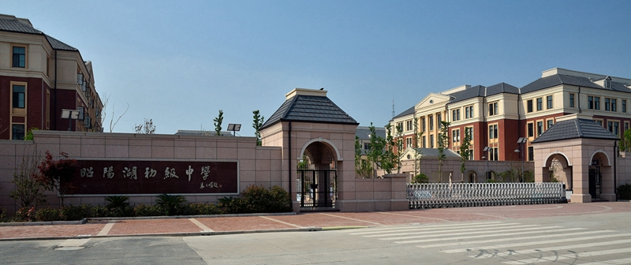
Lead-in
Can you say anything about our school?
学科网

Slide 4
How does it look?
What does it look like?
它看起来怎么样？
What is he like? 提问性状 他这个人怎么样。
be like 怎么样zx.xk

Slide 5
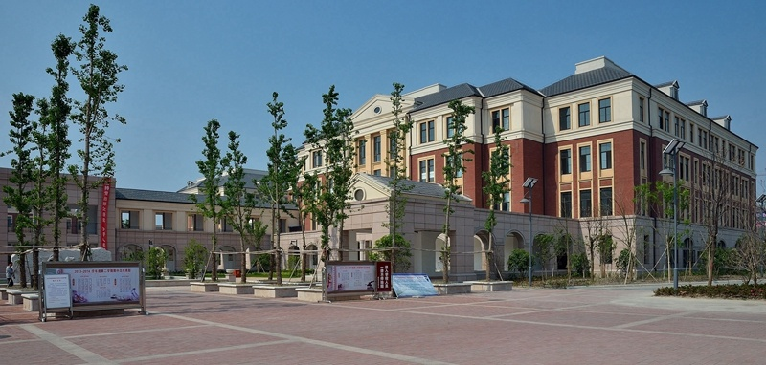
class building

Slide 6
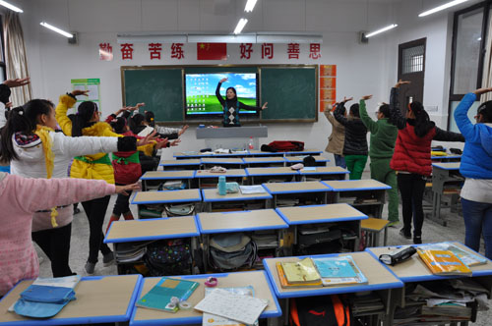
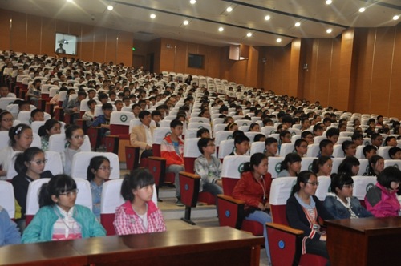
classroom
school hall

Slide 7
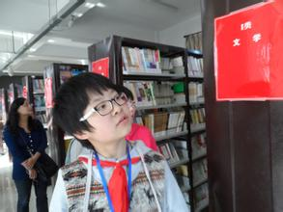
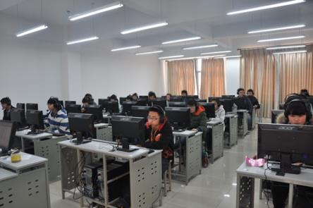
library
computer room

Slide 8
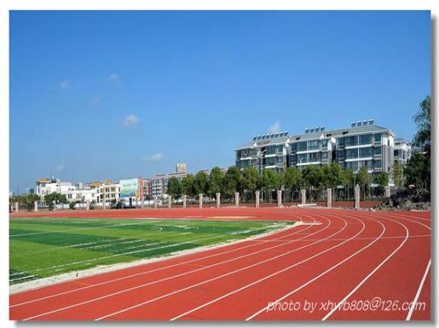
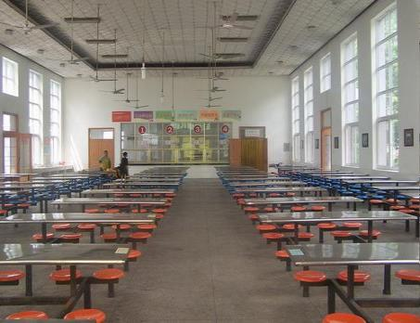
playground
学科网
dining hall

Slide 9
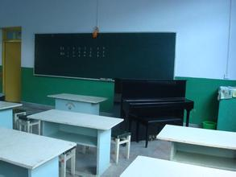
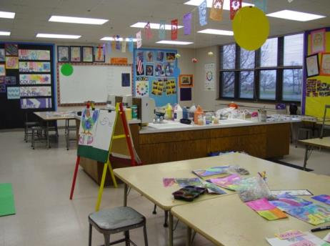
music room
art room

Slide 10
Useful sentences
Let me show you around our school.
There are some trees, flowers, classrooms, students and teachers.
There is a library, a playground and a computer room in our school.
We are now in front of the class building.
My classroom is on the ground floor.

Slide 11


Slide 12

Here are some pictures of different places at Millie’s school. Help her write the correct words under the pictures.
classroom hall library playground

Slide 13
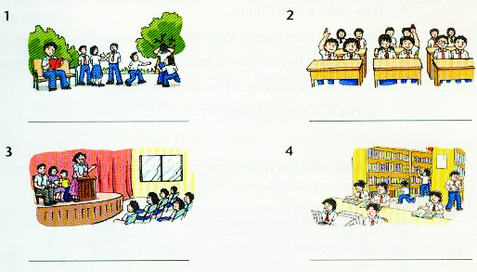
playground
classroom
hall
library

Slide 14

Read and then write a T if a sentence is true or an F if it is false.
1. Sunshine Middle School looks beautiful. ____
2. Millie and her mum are behind the classroom building. ____
3. Millie’s classroom is on the ground floor._____
4. They have a new library. _____
5. They have meetings in the library. _____
6. They do not have a school hall. _____
7. Mr Wu is in a white shirt on the Open Day.___
8. Mr Wu is a Millie’s Chinese teacher. _____
T
F
T
T
F
F
T
F

Slide 15
Translation:
1.看上去漂亮/现代化的
2.带你到处看看
3. 一间美术室
4.两间电脑室
5.在底楼
6.既干净又明亮
7.这边请
8.开会
9.穿白衬衫的那个男的
10. 在教学楼前面
look beautiful/modern
show you around
an art room
two computer rooms
on the ground floor
clean and bright
this way
have a meeting/meetings
the man in a white shirt
in front of the classroom building

Slide 16

Retell the text according to the key words.
Millie , my school , beautiful , playground , big , show you around , 18 classrooms , my classroom , on the ground , clean and bright , an art room , two music rooms , a library , looks modern , a hall , have a meeting

Slide 17
Let's visit other schools!

Slide 18
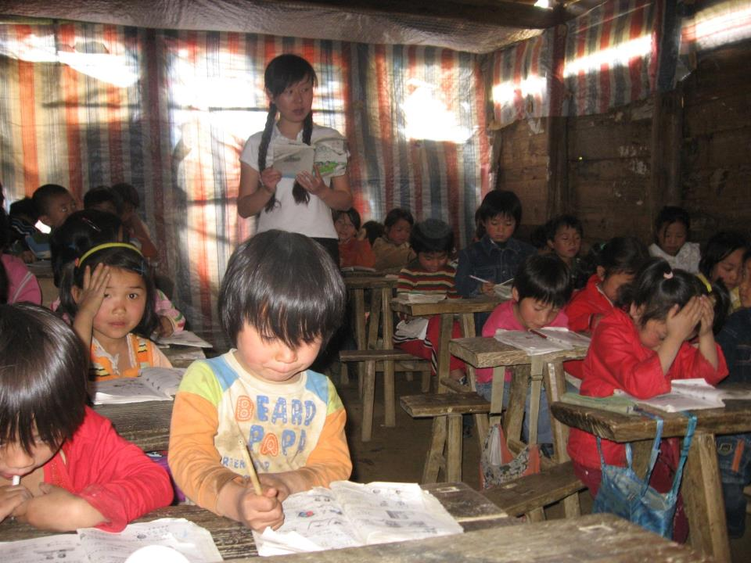

Slide 19
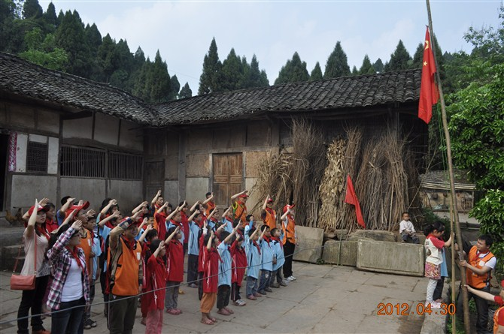

Slide 20

Try to help those poor students!
Let’s work hard together!
Let our dream fly!

Slide 21
Class exercises
一、补充单词。
1. Can you s______ me around your school?
2. You are _____ (这么) beautiful in this dress.
3. All the classrooms in our school are big and b______.
4. Our classroom is on the ______ (三) floor.
5. How many classroom b________ are there in your school?
6. We have _____ (一个) art room.
7. Our school l_______ beautiful.
8. The man _____ a white shirt is Mr. Wu.
how
so
right
third
uildings
an
ooks
in

Slide 22

Recite the dialogue.
Write a short passage about your school.

