Slide 1
陕旅版小学英语三年级上册
Unit8 What Color Is It？
第2课时
WWW.PPT818.COM

Slide 2
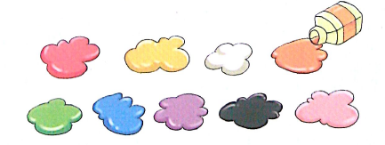
Think and tick
What color is your…?
It’s…

Slide 3
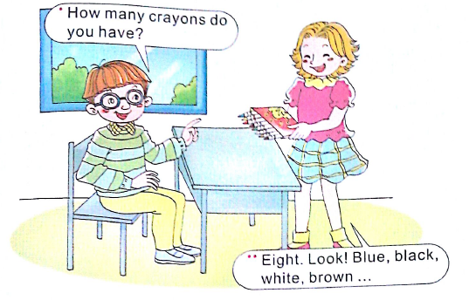
Let’s talk

Slide 4
Ask and answer
A: How many…do you have?
B: I have…

Slide 5
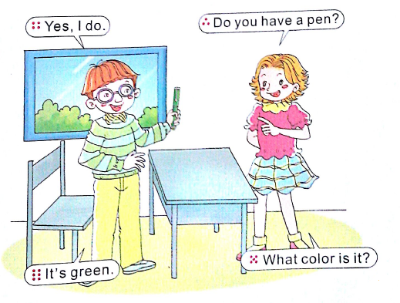

Slide 6
Ask and answer
A: Do you have a…?
B: Yes, I do.
A: What color is it?
B: It’s…

Slide 7
Role play
A: Do you have a…?
B: Yes, I do.
A: What color is it?
B: It’s…

Slide 8
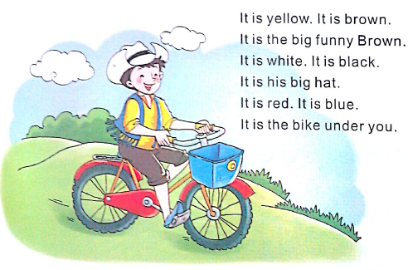
Let’s chant

