Slide 1
Module 2 Public holidays
Unit 1 My family always go somewhere interesting as soon as the holiday begins.
WWW.PPT818.COM

Slide 2
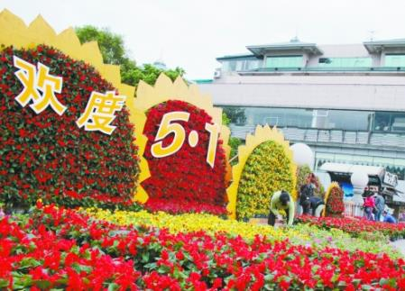
Warming-up
Guessing game
May Day
Labour Day
On 1st May
Q1: Which public holiday are people celebrating?
Q2:When is this holiday in China?

Slide 3
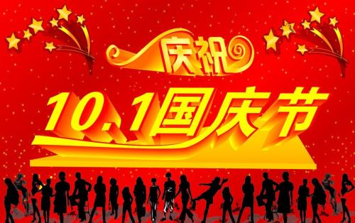
National Day
1st October

Slide 4
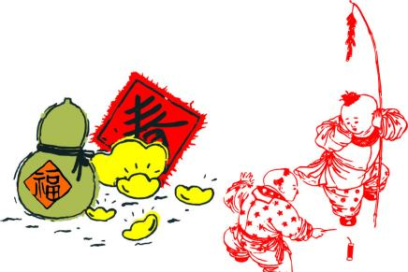
New year's day
1st January

Slide 5
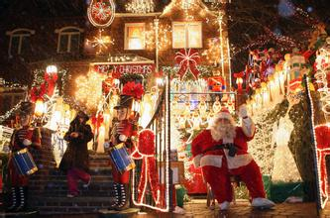
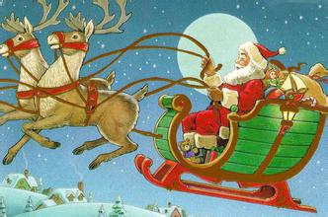
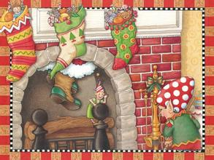
Christmas
December 25th

Slide 6
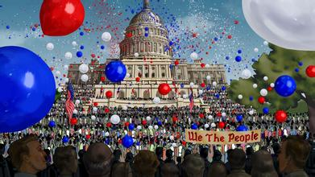
Independence Day
July 4th

Slide 7
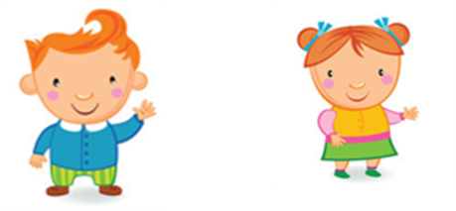
Pre-listening
Pair work

Slide 8
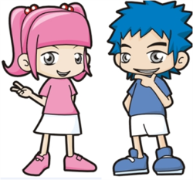
Pre-listening
What’s your favourite holiday ?
My favourite holiday is …
When is it?
It's on …

Slide 9
While-listening
Listen and answer the questions.
1. What are they talking about?
2. How many countries are they from?
They are talking about public holidays.
Three. (Tony comes from UK, Betty comes from USA, Lingling comes from China)

Slide 10
Watch and complete the table.
Country | Holiday | Date
China’s National Day
The first of October
China
Independence Day
US
4th July
(25th December)
UK
Christmas

Slide 11
Group-work
Read and then complete the table
 | China | US
Holiday
Date
Duration
Ways of celebration
Year the celebration started
National Day
1st October
three days
________and national _______everywhere
1949
Independence Day
4th July
one day
__________holiday activities,
American______eveywhere
have _________ ,
watch _______ play music
1777
all kinds of
flowers
flags
picnics
flags
bands

Slide 12
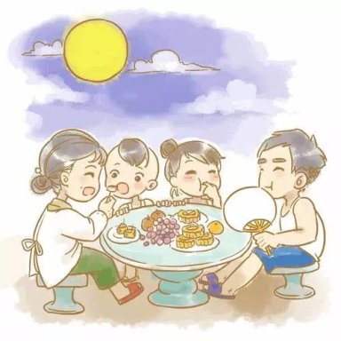
Post-listening
This week will be a public holiday.
Which public holiday it will be?
eat moon cakes
enjoy the full moon
family members get together
have a big dinner

Slide 13
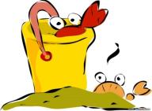
Pair-work
Let’s talk!
A: Hello,…What's the public holiday in this weekend?
B: The holiday is …
A: When is it?
B: Well, it's on …
A:How many days do you take off for this holiday?
B:We will have...days off.
A: What do your family do during the holiday?
B: …
We eat moon cakes while we are enjoying the full moon.

Slide 14
Homework:
1. Try to read the dialogue fluently.
2. Talk about your plans about this public holiday.

