Slide 1
Unit7 Know Our World
Ring Up or Call?
WWW.PPT818.COM

Slide 2
Learning aims:
1. Master words and expressions: ring, ring up, what does … mean?
2. Learn about the differences between AE and BE.
3. Know about the following culture.
Learning important points:
1.Understand the differences.
2.What does “ring up” mean in the U.S.A?

Slide 3
预习检测
1. ring up_____________ 2. go up___________
3. bathroom______ 4. translate_______
5. 用不同的方法______________
6. 在语法方面_______________
7. 英国英语_______________
给……打电话
上升；升起
浴室
翻译
in different ways
in grammar
British English

Slide 4
Think About It
What are some of the differences in spoken Chinese in different parts of China?
What are some of the differences in spoken English?

Slide 5
Listen and answer the questions.
1. What does “ Ring up ” mean in British English?
2. Why do Canadians use "eh" at the end of their sentences?
It means “Call someone on the phone”.
They describe the same thing in different ways or use different words. There are also differences in pronunciation and grammar.

Slide 6
Let’s Do It!
Listen to the dialogue and choose the correct words.
A: Hello Tina! I don’t know how to
(express/say/show) myself well. Any advice?
B: Sure. Why not talk with others in public? I think that
might help.
A: I know, but sometimes it’s hard for me to
(pronounce/spell/write) the words and sentences
correctly. Instead, I need to (pronounce/spell/write)
them, which makes me feel embarrassed.

Slide 7
Let’s Do It!
Listen to the dialogue and choose the correct words.
B: Oh! That’s the problem. Then try to improve your spoken English first.
A: Good idea! I’ll (phone/ring up/ask for) my foreign teacher to make a plan. Thanks!

Slide 8
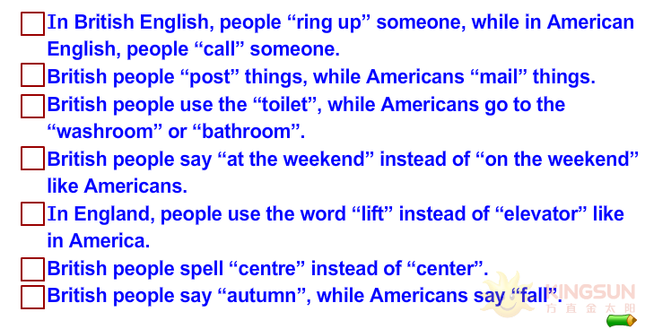
What differences between British English and American English are mentioned in the lesson? Tick the correct answers.
√
√
√

Slide 9
Talk about the differences
 | British English | American English
Vocabulary | autumn
Spelling | colour
Expression | ring up someone
Other differences | …… | …….
fall
color
call someone on the phone

Slide 10
Language points
1. I’ll ring him up. 我将给他打电话。
ring ... up 意为“给……打电话”。若ring 后所接的宾语是名词，其位置比较灵活，可放在ring后，也可放在up 后；若ring 后所接的宾语是代词，则只能放在ring 和up 之间。如：
Ring Jenny up. / Ring up Jenny. 给詹妮打电话。
Ring me up. 给我打电话。
【拓展】：表示“给某人打电话”的短语还有：call sb.; phone sb.; give sb. a ring / call; call sb. on the phone; make a telephone call to sb.等。

Slide 11
2. We have been asked to write a report on Asia.
on 意为“关于”，用于系统论述或专题讲演、论著等，具有学术性。如：
I'm reading a book on medicine.
我正在读一本关于医学的书。
for意为“为了”。如：
Do you have anything to say for yourself?
你还有什么要说的吗？

Slide 12
Exercise
I. 用所给单词的适当形式填空。
1. Americans express some things a little
__________ (different) from Englishmen.
2. “BFN” ______ (mean) “Bye for now”.
3. Would you please ______ (open) the window for me?
4. The question is very difficult. I would like ______ (ask) my teacher.
5. Don’t worry! Mr. Black ___________________ (come) soon.
differently
means
open
to ask
will come / is coming

Slide 13
II. 单项选择。
1. —What can I do for you, sir?
—I’d like to buy a book ______ food.
A. in B. on C. at D. with
2. Children’s Day is coming. I want to buy _____ gifts for my little son.
A. few B. little C. a few D. a little
3. —Hello, this is Jenny speaking. Is Jack in?
—Yes. ______, please.
A. Come on B. Hold on
C. Keep on D. Hold out
B
C
B

Slide 14
Homework
Listen and read the dialogue again.
Recite the dialogue.

