Slide 1
Unit 5 Lesson 3
What’s this ?
WWW.PPT818.COM

Slide 2
New Words

Slide 3
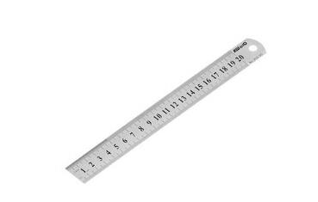
ruler
尺子

Slide 4
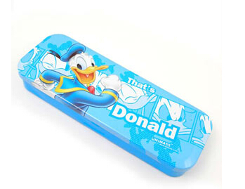
pencil-case
铅笔盒

Slide 5
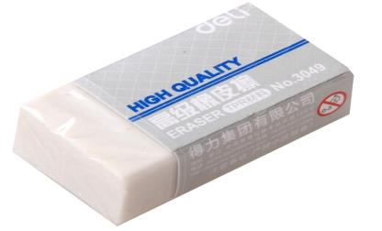
eraser
橡皮

Slide 6
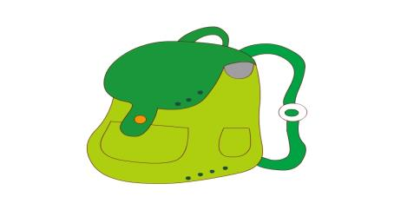
schoolbag
What’s this?
It’s a schoolbag.

Slide 7
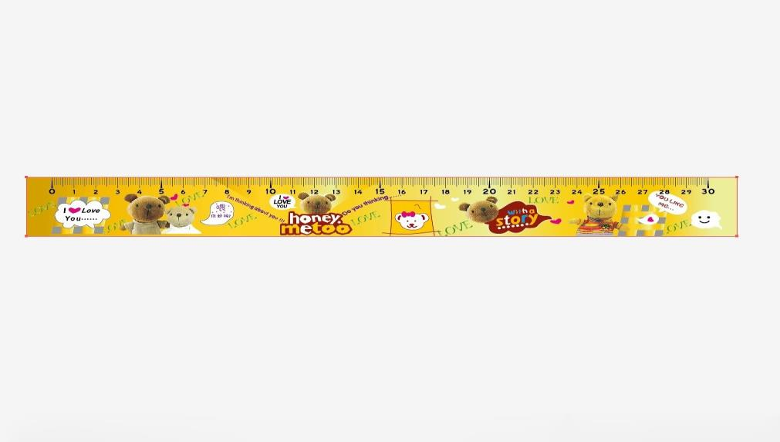
ruler
What’s this?
It’s a ruler.

Slide 8
pencil
What’s this?
It’s a pencil.

Slide 9
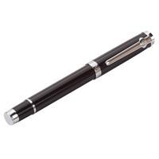
pen
What’s this?
It’s a pen.

Slide 10
book
What’s this?
It’s a book.

Slide 11
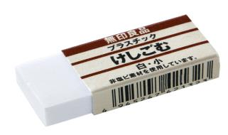
eraser
What’s this?
It’s an eraser.

Slide 12
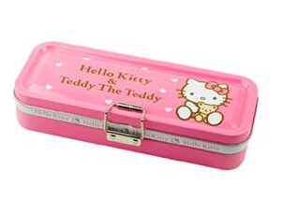
pencil-case
What’s this?
It’s a pencil-case.

Slide 13
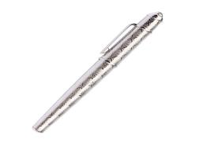
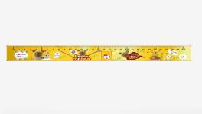
What’s this?
It’s a
schoolbag.
It’s a
book.
It’s a
pen.
It’s a
ruler.
It’s a
pencil.

Slide 14
Think and talk!

Slide 15
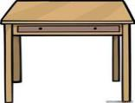
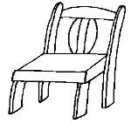
A: What’s this?
B: It’s a …

Slide 16
L
l
M
m
N
n

Slide 17
Homework
Copy the words.
eraser pencil-case ruler
What’s this?
It’s…
2. Make a mini dialogue.

