Slide 1
Module
Photos
11
Unit 2 The photo which we liked best was taken by Zhao Min.
WWW.PPT818.COM

Slide 2
Warm up
Traditional Culture
City and people
Categories of
photos
Music
Nature
Most Unusual
Historic China
Sports

Slide 3
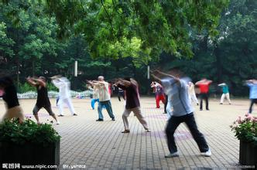
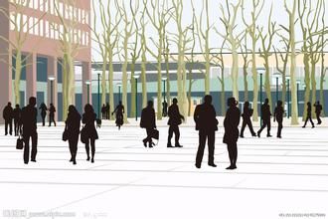
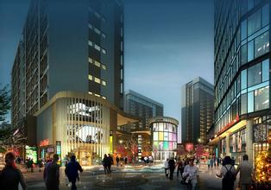
City and People

Slide 4
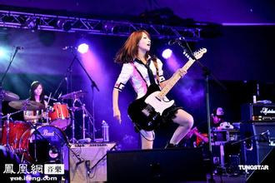
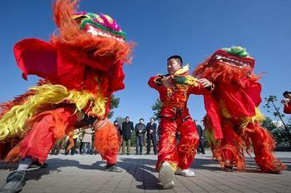
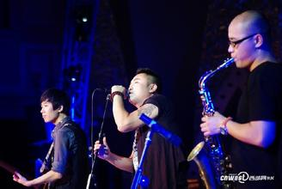
Traditional Culture
Music

Slide 5
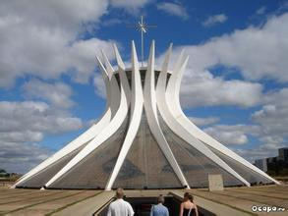
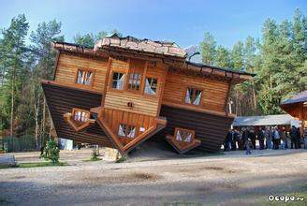
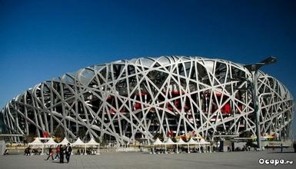
Most Unusual

Slide 6
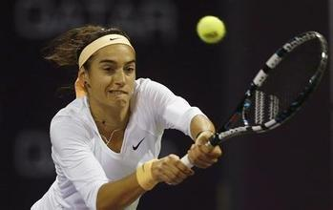
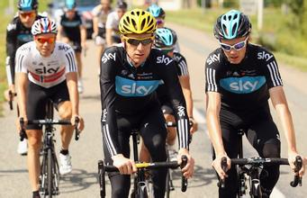
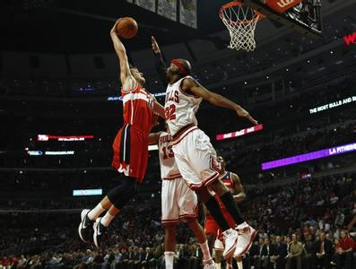
Sports

Slide 7
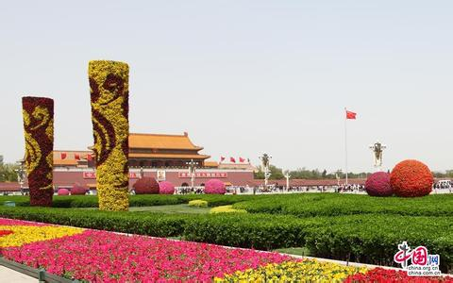
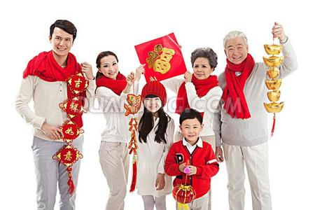
Historic China

Slide 8
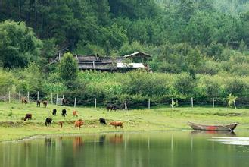
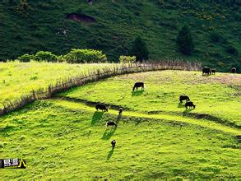
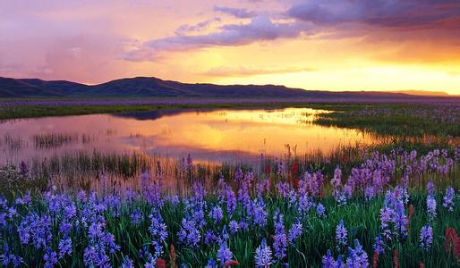
Nature

Slide 9
New words and expressions
/tə'naɪt/
(在)今晚；(在)今夜 adv.
tonight
朗读；宣读
read out
/'wɪnə/
winner
获胜者 n.
(与…)相比
compare…with
即使；尽管
even through
/rʌʃ/
冲；奔 v.
rush
/blaʊz/
女衬衫 n.
blouse

Slide 10
/skə:t/
裙子 n.
skirt
保护…;使…不受
protect sth. against sth.
/'sɪŋə/
歌手；歌唱家 n.
singer
/kəngrætʃu'leiʃnz/
(复数)祝贺 n.
congratulations
/hed'ma:stə/
男校长 n.
headmaster
/'prizənt/
授予；递呈.
present

Slide 11
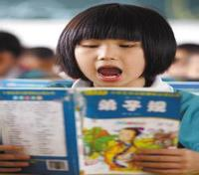
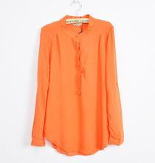
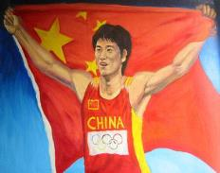
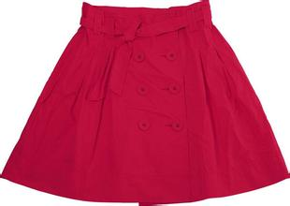
blouse
女衬衫
read out
朗读；宣读
skirt
裙子
winner
获胜者

Slide 12
rush冲；奔
I’ve got to rush. Got a meeting in a few minutes.
我得走了，几分钟后要开个会。
拓展：
(1).作动词(空气或液体)迅速流动，奔涌
Water rushes out of huge tunnels.
水从巨大的隧道中奔涌出来。
(2). 作名词, (强烈的感情)迸发，涌进
He felt a sudden rush of panic at the thought.
想到这点，他突然一阵恐慌。

Slide 13
(3). 常用短语 be rushed off one’s feet.
忙得不可开交。
We used to be rushed off our feet at lunchtimes.
以前我们在午饭时间会忙得不可开交。
present授予；递呈
He presented quite a new view of the affair.
他对那件事提出了相当新的想法。
拓展：
(1). 做名词时，礼物 a beautiful present
(2). 作形容词， 出席的；现在的
A number of singers were present at the meeting.

Slide 14
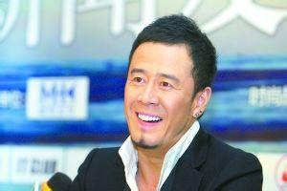
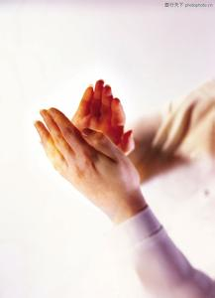
singer歌手；歌唱家
congratulations祝贺

Slide 15
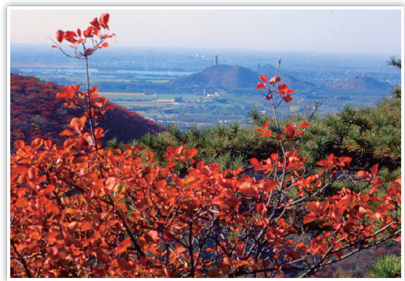
Reading and vocabulary
Look at the subjects of the photo competition.
which subject does this photo belong to?
● City and People
● Music
● Home and Away
● Nature

Slide 16
Watch and read

Slide 17
2. Read the passage and check your answer
to Activity 1. Find out who took the photo.
Results of the photo competition
Tonight I am more than happy to read out the winners of the photo competition. We were very pleased with our competition this year. Compared with other years, we received many more photos. Even though all of the photos are excellent, we are sorry to say that we cannot give prizes to everyone.

Slide 18
The person who won the prize for the subject Nature is fifteen-year-old Li Wei. Li Wei took a photo of the trees in Xiangshan Park. His photo shows the different colours on the hill.
The photo which we liked best in the City and People group was taken by Zhao Min. Zhao Min is only twelve years old. Her photo shows a person rushing across a street on a windy evening. It is a beautiful girl who is wearing a blouse and skirt, and who is protecting her books against the showers.

Slide 19
The best photo in the Music group was taken by He Zhong. His photo of the group Crazy Feet shows the singer, Becky Wang, and the band playing at a concert. He Zhong manages to show how this great new band moves and sounds, and the good time which their fans are having.
A group of photos which show Beijing and Cambridge in England have won the prize for the subject Home and Away. They show some of the experiences of a young visitor to our country, and some memories of his home. The winner is Tony Smith!

Slide 20
Congratulations to our winners and thanks to everyone who entered the competition. Now let’s welcome our headmaster to present the prizes to the winners!
3. Complete the table.
Winner | Subject | What the photo shows
Li Wei | Nature | ●the trees in Xiangshan Park ● the different colours on the hill

Slide 21
Zhao Min
He Zhong
●Shows a person rushing across a street on a windy evening.
City and People
●Crazy Feet the singer, Becky Wang, and the band playing at a concert
●Shows how this great new band moves and sounds, and the good times which their fans are having.
Music

Slide 22
Tony Smith
●Beijing and Cambridge in England
●Shows some of the experiences of a young visitor to our country, and some memories of his home.
Home and Away

Slide 23
Language points
1.Tonight I am more than happy to read out the
winners of the photo competition.
今晚我非常高兴宣读本次摄影比赛的获胜者。
more than很，非常
She was dressed more than simple.
她穿着十分朴素。
拓展：
(1). 多于(通常后接数词，也可接其他词)
I’ve known him for more than twenty years.
我认识他20多年了.

Slide 24
(2). 不只是, 不仅仅是(通常接名词，动词，从句)
He is more than a father to her.
他待她胜过父亲。
(3). 极其，非常(通常接形容词，副词或分词)
She was more than kind to me.她对我们很友好。
(4).难以，完全不能(通常接情态动词can)
That is more than I can tell=I can’t tell this.
那事我实在不明白。
(5).与动词like, love 等连用，还可以表示
“更，更加”
I like tennis more than I like football.
与足球相比， 我更喜欢网球。

Slide 25
2. Compare with other years, we received many more photos.
和往年相比，我们收到的相片多了很多。
compare with 在句中作状语，意为
“和……相比”。如：
Compared with last year, we have had more success this year.
和去年相比，我们今年取得了更大的成功。

Slide 26
3. Even though all of the photos are
excellent, we can’t give prizes to
everyone.
尽管所有的照片都很棒，但我们也不能
给每一个人都颁奖。
★ even though 意为“即使；尽管”，
引导让步状语从句。如：
Even though it was raining, she went to
school on foot.
尽管天在下雨，她还是步行上学去了。

Slide 27
4. Congratulations to our winner and
thanks to everyone who entered the
competition.
祝贺获奖者，并感谢所有参赛者。
congratulations to sb (on sth) 表示“(因
某事)向某人表示祝贺”。如：
Congratulations on winning the first prize.
祝贺你得到一等奖。

Slide 28
Useful expressions
be pleased with
compared with
even enough
take photos
manage to do
some memory of
Congratulations to sb.
welcome sb. to
对……满意
与……相比
即使
拍照
设法作某事
对…的记忆/回忆
祝贺某人
欢迎某人去…

Slide 29
4. Complete the passage with the correct form of
the words in the box.
blouse, present, tonight, windy, winner
The headmaster (1)___________ the prizes to the (2) ________ of the photo competition
(3)___________. Li Wei won the prize for the subject Nature. In the City and People group,
presented
winner
tonight

Slide 30
Zhao Min won a prize with a photo of a girl who wears a (4)_________and skirt rushing
across the road, on a (5)________ evening in the rain. He Zhong won the prize in the Music group, and Tony Smith won the prize for the subject Home and Away.
blouse
windy

Slide 31
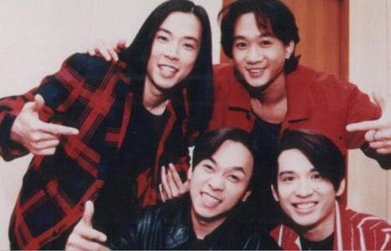
Writing
5. Bring a photo and make a photo display.

Slide 32
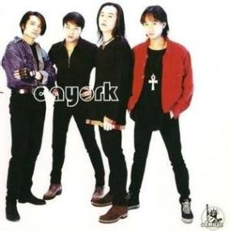
6. Choose a photo from the display.
Answer the questions.
What does it show?
The photograph which I like best
shows a band called Beyond.
2. Where was it taken?
It was taken during a concert.

Slide 33
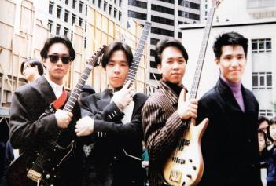
3. Where are the things and/or people in the
photo?
From left to right:
Huang Jiaju(黄家驹), Huang Guanqiang
(黄家强), Huang Guanzhong(黄贯中),
Ye Shirong(叶世荣)
4. Why do you like it?
It shows the fun everyone is having.

Slide 34
7. Write a passage about the photo.
Use the answers in Activity 6 to help you.
Beyond was a famous rock band in Hong Kong that was founded in 1983. They have always identified with the people of Hong Kong, as reflected in their songs about social issues, pursuit of dreams, politics, and peace. Wong Ka Kui's " 海阔天空 (Boundless Oceans Vast Skies) & 光辉岁月(Glorious Years) are two of their best known works. Beyond stands out in the Chinese music

Slide 35
industry due to the fact that they are one of the very few groups who compose and write their own music. With the exception of a single song, a tribute to their hero Sam Hui, Beyond has never recorded a cover in the studio. 译文是：beyond是1983年成立的香港著名摇滚乐团。一提起他们，香港的人们就都想到有关于社会现象，梦想的追求，政治，与和平的歌。黄家驹的海阔天空和光辉岁月是知名度最高的两首歌。 beyond是少数的创作型乐团之一，所以在中国音乐圈里显得相当醒目。除了一首单曲（送给他们的英雄sam hui的）之外，他们从来没有在工作室里面录过一张唱片。

Slide 36
Exercises
一. 用方框中单词的适当形式完成下列句子。
winner, windy, rush, tonight, blouse
blouse
The girl wears a __________.
It’s been_______ all morning.
Bobby is going about his home work very
seriously________.
4. They ________ up the stairs an hour ago.
5. Who’s the ________ of the tennis match?
windy
tonight
rushed
winner

Slide 37
二. 根据汉语意思完成英语句子。
在考试中即使我们失败了，我们也不应该放
弃学它。
______ ____________ we failed in the test, we shouldn’t give up learning it.
2. 祝贺你们， 你们在这次的比赛中表现很出色。
_________________ _____ ______， You did
well in the match.
Even
though/if
Congratulations
to
you

Slide 38
3. 和他们的照片相比， 您就会知道我们的更漂亮。
____________ _______their photos, you will know ours are more beautiful.
4. 一共有四个奖品， 因此接着往下看， 找出
获胜者是谁。
There are four prizes, so ______ ____ to find out who the winner are.
Compared
with
read
on

Slide 39
5. 刘小姐正在写一本书。
Miss Liu is ________ ____ a new book.
working
on

Slide 40
Homework
1). Review the text;
2). Write a short passage about your
favourite photograph. (More than 80 words.)
3). Remember to bring your photo to school
tomorrow.

