Slide 1
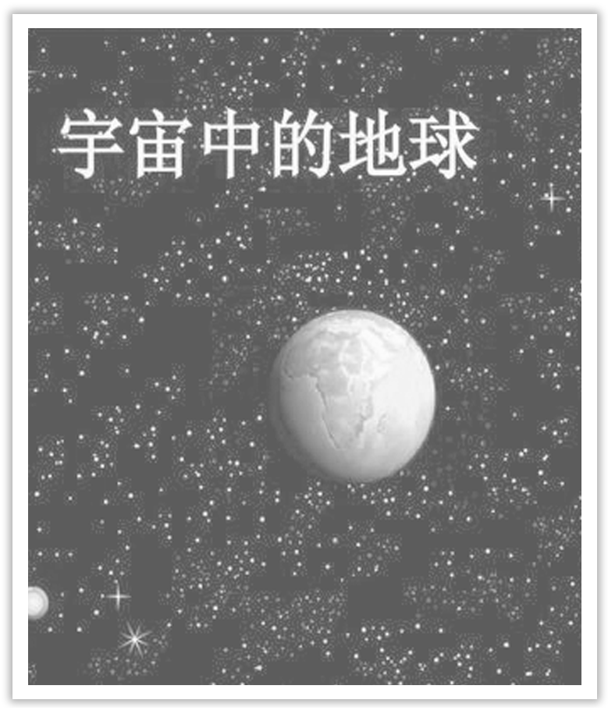
Unit 4 Space Exploration
Section Ⅰ Listening and Speaking
WWW.PPT818.COM

Slide 2
主题语境——人与自然之地球与宇宙
【语境概说】 本单元的主题语境为人与自然之地球与宇宙，该主题语境主要包括自然科学研究成果、太空探索、地球与宇宙奥秘等。该主题与学生学习和生活密切相关，在此主题意义引领下，有助于培养学生科学探索方面的学习内容，增强学生不畏艰难的毅力，促进学生语言能力、文化意识、思维品质和学习能力的融合发展。

Slide 3
Taken as a whole，the universe is absurd.整个说来，宇宙无法理解。
A grain of sand includes the universe.一粒沙包含着宇宙。
Let your soul stand cool and composed before a million universe.
在千百万宇宙之前让你的灵魂保持冷静和安详。
The universe is full of magical things，patiently waiting for our wits to grow sharper.宇宙充满着不可思议的事物，期待着我们的智慧变得更加敏锐。

Slide 4
1.Translate the following words and phrases.
①astronauts n. ____________
②procedure n. ____________
③curious adj. ____________
④mental adj. ________________
宇航员
程序
感到好奇的
心理的，精神的

Slide 5
⑤physical adj. ____________
⑥training n. ____________
⑦programme n. ____________
⑧requirement n. ____________
⑨intelligent adj. ____________
⑩degree n. ____________
身体的
训练
项目
要求
聪明的
学位

Slide 6
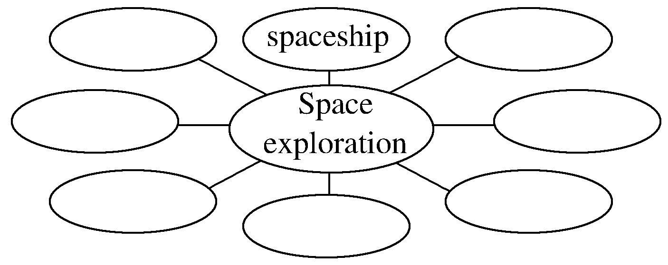
2.Brainstorming：What can you think of space exploration?
________________________________________________________________________
astronaut，space shuttle，solar system，space suit，alien，planet，launch
3.Look at the pictures on Page 38 and tell your classmates what you can see.
______________________________________________________________________
4.Finish Ex.1 on Page 38.
I can see the solar system and Chinese astronaut Yang Liwei waving to us.

Slide 7
1.Finish Ex.2 on Page 38.
2.Finish Ex.3 on Page 38.
3.Finish Ex.4 on Page 39.

Slide 8
1.Speaking—Finish Ex.5 on Page 39 by following the example
A：You know，I think being an astronaut would be cool.
B：Do you want to work in space in the future?
A：I’m not sure，but I think it might be too difficult for me.There are so many requirements.First of all，you must be intelligent enough to get a related college degree.Then you have to...
B：So what might be the most difficult part for you?
A：I guess it might be the...

Slide 9
2.Pronunciation
①The streets are wide and clean.
(这句话中的streets、wide和clean、都要重读；the、are、and不重读。)
②I am so glad to see you again.
(这句话中的so、glad、see、again要重读，而I、am、to、you不重读。)
③We saw him playing by the river.
(这句话中强调we和him时，也可重读，表示“我们”而不是别人看见。)

Slide 10
④On my way to school，my bike was broken.
(这句话中的on在句首应重读。)
⑤I’m sorry I can’t do that.(这句话中的can’t要重读。)
⑥Didn’t I tell you yesterday? (这句话中的didn’t要重读。)
⑦—Are you a student?
—Yes，I am.(这里句子末尾的am要重读。)

Slide 11
语言知识积累
selection procedure 挑选程序
attend pilot training 参加飞行员训练
flying experience 飞行经验
space equipment 太空设备
mental and physical training 心理和体能训练
graduate from 从……毕业
space programme 太空项目
fighter pilot 战斗机飞行员
space flight 太空飞行

Slide 12
文化知识习得
astronaut，cosmonaut，taikonaut都是宇航员吗？
astronaut，cosmonaut，taikonaut词中都含有词根 naut(意为“舵手”)。astronaut的astro－是英语前缀，cosmonaut源于俄语 kosmonaut，前缀是 kosmo－，两个前缀都表示“天体/宇宙”。因此前者多指 “美国宇航员”，后者多指 “苏联/俄罗斯宇航员”。taikonaut是汉语拼音taikong和词根naut的组合，极具中国文化特色。

Slide 13
学习策略形成
1.听懂听力材料中的数字。
2.学会用不同句式表达必要性。
句子重读和非重读
在句子中比较重要的单词都要重读，这些词大多是实词，比如名词、形容词、数词、代词(除人称代词)、副词、动词(除在句子中部的be，have，情态动词和助动词；但若位于句尾，总重读；若在句首，可重读；与not缩写时总重读)，而单音节虚词(如冠词、连接词、前置词和感叹词)一般都不重读。

Slide 14
1.be curious about 对……感到好奇
The audience is curious about how Yang Liwei became the first Chinese astronaut.(教材P₃₈)观众很好奇杨利伟是如何成为第一位中国宇航员的。
People gathered round，curious to know what is happening.
人们聚拢过来，很想知道发生了什么事情。
[自主发现]
be curious to do 很想做某事

Slide 15
[巩固内化] 单句语法填空
①They were very curious ____________ the people who lived upstairs.
②Many men have been attracted by the unknown world and curious ____________ (know) more about the outer space.
about
to know

Slide 16
2.be related to与……有联系
Number questions are typically related to：time，telephone number，addresses，prices，weights，distances，etc.(教材P₃₈)
数字问题通常与时间、电话号码、地址、价格、重量、距离等有关。
Light industry is closely related to agriculture.
轻工业和农业密切相关。
[思考] 想一想表示“与……有关”的其他短语：
①_________________________ ② _________________________
③ _________________________ ④ _________________________
have something to do with
be involved in
be connected with
in connection with

Slide 17
[巩固内化]
单句语法填空/补全句子
①The discussion to be held tomorrow is related _________ the incident.
②If you are asked ____________ (relate) questions，you must not tell them.
③I am writing to you ________________________ your recent job application.
我写此信与你最近求职一事有关。
to
related
in connection with

